Slide 1
Argumentation &
Critical Thinking part 3: The structure of argument
Maciej Pichlak
Department of Legal Theory and Philosophy of Law
University of Wroclaw
maciej.pichlak@uwr.edu.pl
https://prawo.uni.wroc.pl/user/12147

Slide 2
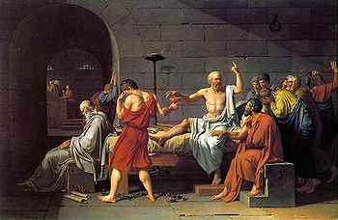
The structure of argument
Since every man is mortal, and Socrates – believe me or not – is a man, therefore Socrates is mortal.
[P1] Every man is mortal.
[P2] Socrates is a man.
[C] Socrates is mortal.
P1 + P2
C

Slide 3
In logic, we have an argument whenever we have reasons suggested as premises for a conclusion. Explanations can contain reasoning in this sense and can, therefore, be classified as arguments.

Slide 4

Linked or convergent premises?
[P1] Although the living room window is open, there are no footprints outside, despite the softness of the ground after yesterday's rain.
[P2] The clasp on the box was not broken but opened with a key that had been hidden behind the clock.
[P3] No one heard the dog barking, so the dog did not bark.
[C] The crime was committed by someone in the house.
P3a
P3b
P1
P2
P3
P1a + P1b +P1c
C

Slide 5
It’s a good idea to study BBA in Wrocław, for there is an excellent teaching staff. Moreover, Wrocław is a great city to live.

Slide 6
You have a problem, so you should ask for an advice someone who you trust. You trust your mother, and you should, therefore, ask her for an advice.

Slide 7
Enthymemes
It’s Tuesday today. So tomorrow will be Wednesday.
There is Wednesday a day after Tuesday. Therefore, tomorrow will be Wednesday.
The bigger the burger the better the burger.
Burgers are bigger at Burger King.

Slide 8
P: Jimmy was really in hurry.
C: He probably was very thirsty.
P: The salary is really good.
C: You should take this job.
P. No one could have left the room.
C. The murderer was never in the room.

Slide 9
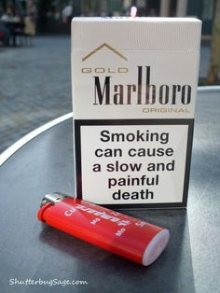

Slide 10

