Slide 1
Argumentation
& Critical Thinking
Conspiracy theories and pseudoscience
Maciej Pichlak
Department of Legal Theory and Philosophy of Law
University of Wroclaw
maciej.pichlak@uwr.edu.pl
https://prawo.uni.wroc.pl/user/12147

Slide 2
Conspiracy theories and pseudoscience:
How to recognize them and fight against them
Special credits to: Marcin Napiórkowski and mitologiawspolczesna.pl

Slide 3
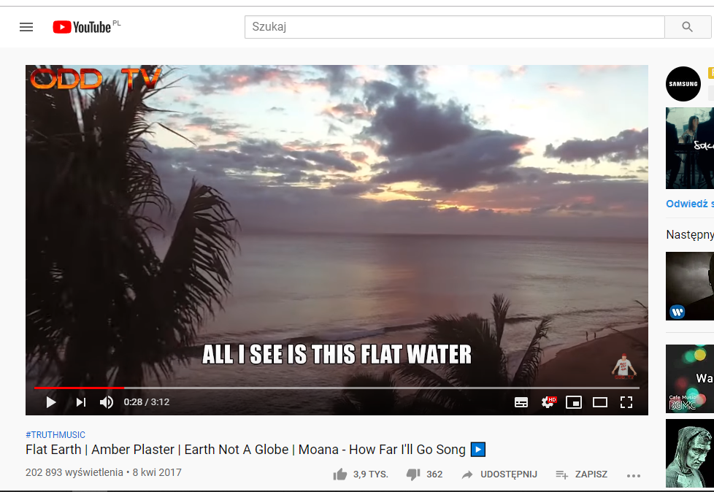

Slide 4
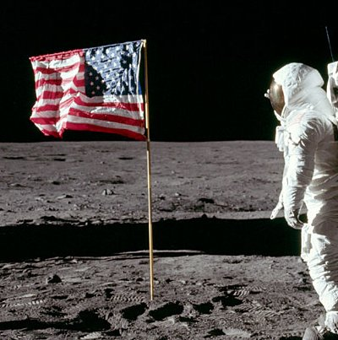
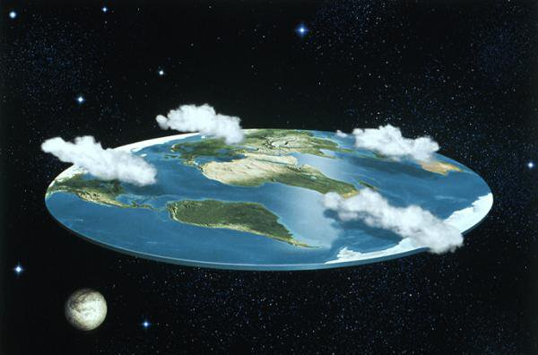
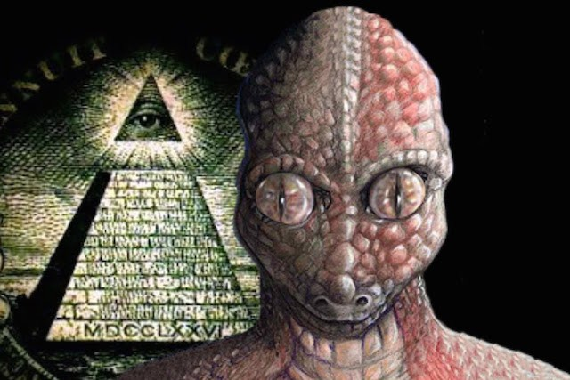

Some most popular conspiracy and pseudo-scientific theories
Flat Earth
Landing on the Moon never happened
Reptilians are ruling the world
Anti-vaccination movement

Slide 5
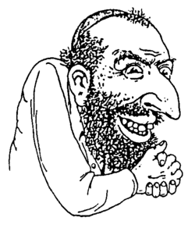
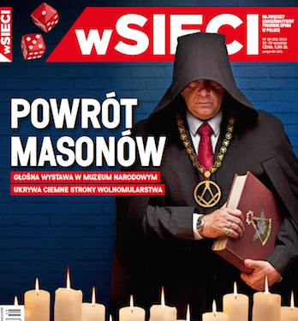
Yet at the end of the day…
…this is always Jews / Freemasonry / Big Pharma / Reptilians once again

Slide 6
Some structural features of CT and PS
A promise o certainty (against probability); non-falsifiable
Democratization of cognition (against specialization)
„You can make just one simple experiment…”
Special form: „Just look into your soul”
Reliance on ‚direct’ experience and common sense (against artificial scientific methods)
„The evidence for a flat earth is derived from many different facets of science and philosophy. The simplest is by relying on ones own senses to discern the true nature of the world around us. The world looks flat, the bottoms of clouds are flat, the movement of the sun; these are all examples of your senses telling you that we do not live on a spherical heliocentric world. This is using what's called an empirical approach…”
https://wiki.tfes.org/Frequently_Asked_Questions

Slide 7
Some structural features of CT and PS
Do not consider consequences
- Why people don’t know that the Earth is flat?
- Because of the global conspiracy of governments and space agencies (NASA and others).
- Why should they want to keep this conspiracy?
- In order to rule the world / keep us away from the God / exterminate human species / ...

Slide 8
Some structural features of CT and PS
Developed out of (and usually against) the recognized system of science, still disguised in a costume of scientific methods.
An author, where it was published, who supports it, relations to the up-to-date knowledge
‚Evil scentists’ as a part of the global conspiracy.
They try to sell you some products / services
It has been proved that water has a memory, and here you can buy a special bottle which helps change the memory structure of your water, and a special handbook how to change your life by changing the water you use.

Slide 9
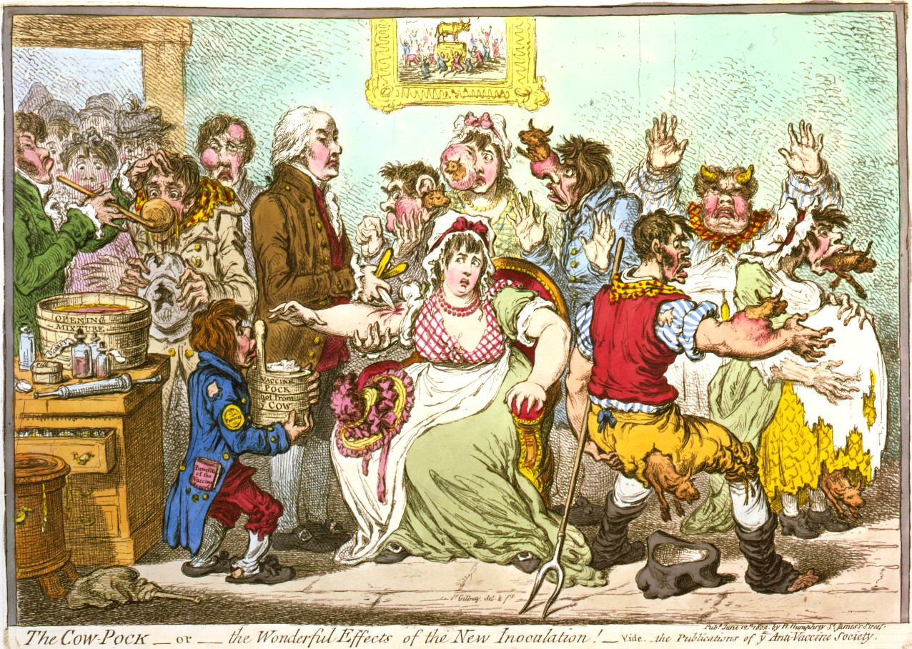
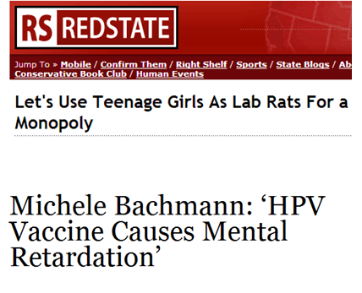


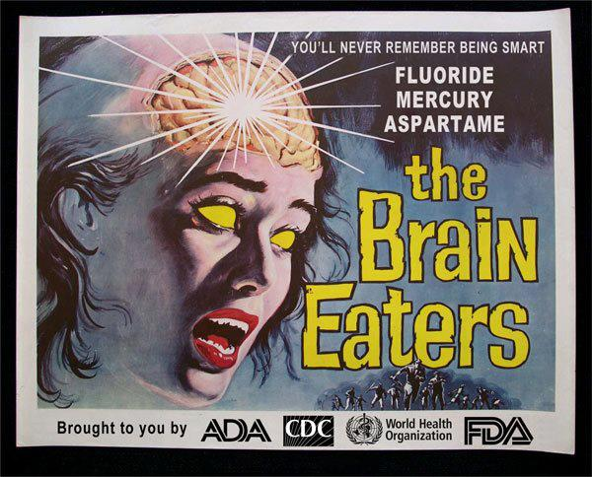
Transformations in time / an explanatory dispersion

Slide 10
Here we come again…

Slide 11
How to react?
Use facts and logic
Ridicule the group believing in the theory
Use the strenghts of CS and PS: be emotional, be spectacular, be attractive
SENSUAL – CLEAR FOR COMMON SENSE – ATTRACTIVE
https://www.youtube.com/watch?v=MtWMz51eL0Y

Slide 12
Some resourses I used
http://Mitologiawspolczesna.pl
https://www.spidersweb.pl/2014/07/pseudonauka-vs-nauka.html
http://mitynauki.pl/2011/04/07/jak-rozpoznac-pseudonauke/
https://wiki.tfes.org/The_Flat_Earth_Wiki

