Slide 1

BANKING
LECTURE (1)

Slide 2
e-mail: magdalena.paleczna@uwr.edu.pl
Office hours:
Tuesday: 13.10-15.10
Room 107B

Slide 3
2019-03-05 11:30 : 13:00 ROOM 06B
2019-03-19 11:30 : 13:00 ROOM 06B
2019-04-02 11:30 : 13:00 ROOM 06B
2019-04-16 08:00 : 09:30 ROOM 06B
2019-04-16 11:30 : 13:00 ROOM 06B
2019-04-30 09:45 : 11:15 ROOM 01B
WRITTEN GRADING

Slide 4
REQUIREMENTS FOR PASSING A COURSE
Written grading, four questions , two general questions and two detail questions.
Students choose two questions-
one general and one detail.
To pass a student needs 50%, for B(4) - 80%, for A (5) - 90%

Slide 5
BANKING LECTURES
1. Specificity of banking and the bank characteristic feature of the banking mediation. Concept and essence of bank.
Bank at the financial market. Bank as a special entrepreneur (characteristic feature). The role of the bank in modern
economy.
2. Banking system function, structure, basic institutional law of the banking system. Types of banks according to polish
law, universal and specialized banks. Network security systems of banks.
3. Function, organization of central bank. European Banking Central System. Independent central banking. Objectives
and instruments of monetary policy.
4. Banking supervision- concept, essence, function, organization in Poland. Idea of supervisory regulation, supervisory
measures. Banking supervision in framework of the European financial market supervision and Banking Union.
5. Guarantee schemes bank deposit- concept, objectives, principle functions. The Bank Guarantee Funds.
6. Risk banking- concept, essence. Types of banking risk and links between them, form of reducing banking risk,
especially credit risk.
7. Finance banking- bank found. Basic indicators, evaluation of the bank assessment, prudential standards. The position
and financial activity of banks, founds of bank, assessment of the financial and economic bank situation.Basic
assessment indicators the financial and economic bank situation, application of prudential rules.

Slide 6
SOURCES
The Regulation of the Single Financial Market in the European Union. A New Dimension. Jurkowska- Zeidler Anna Maria, Białostockie Studia Prawnicze, z. 5, 2009, pages: 115-124
2. Creation and enforcement of financial market law in the light of the economisation of law, // Nieborak Tomasz, Wydawnictwo Naukowe UAM, Poznań 2016, pages from: 258.
3. The banking act, the foreign exchange act, the act on mortgage bonds, and mortgage banks : bilingual edition Polish-English / red. Tomasz Rodzik. - Stan prawny: styczeń 2005. - Warszawa : C.H.Beck, 2005.
4. Banking and financial markets after global crisis of the years 2008-2010 / ed. by Adam P. Balcerzak ; Nicolaus Copernicus University. Faculty of Economic Sciences and Management. - Toruń : Polish Economic Society. Branch, 2012.
5. Banking and financial stability in Central Europe : integrating transition economies into the European Union / ed.by David Green, Karl Petrick. - Cheltenham ; Northampton, MA Edward Elgar Publishing, 2002.
6. Transforming payment systems in Europe / ed. by Jakub Henryk Górka, Basingstoke; New York : Palgrave Macmillan, 2016.

Slide 7

Specificity of banking and the bank characteristic feature of the banking mediation.
Concept and essence of
bank.
Bank at the financial market.
Bank as a special
entrepreneur
(characteristic feature).
The role of the bank in
modern economy.

Slide 8
Specificity of banking and the bank characteristic feature of the banking mediation.

Slide 9
A bank is a financial intermediary that offers
loans and deposits, and payment services. Nowadays banks also offer a wide range of
additional services, but it is these functions that constitute banks’ distinguishing features.
Banks play such an important role in channelling funds from savers to
borrowers.

Slide 10
To understand how banks work, it is necessary to understand the role of financial intermediaries in an economy. This will help us to answer the question about why we need banks.

Slide 11
Financial intermediaries and financial markets’ main role is to provide a mechanism by which funds are transferred and allocated to their most productive opportunities.

Slide 12
A bank is a financial intermediary whose core activity is to provide loans to borrowers and to collect deposits from savers.

Slide 13
By carrying out the intermediation function banks collect surplus funds from
savers and allocate them to those (both people and companies) with a deficit of
funds (borrowers). In doing so, they channel funds from savers to borrowers thereby
increasing economic efficiency by promoting a better allocation of resources.

Slide 14
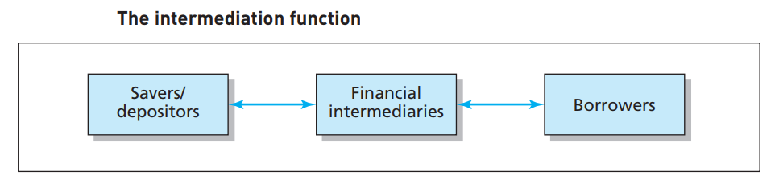

Slide 15
The role of banks

Slide 16
To understand fully the advantages of the intermediation process, it is necessary to analyse what banks do and how they do it.

Slide 17
We have seen that the main function of banks is to collect funds (deposits) from units in surplus and lend funds (loans) to units in deficit. Deposits typically have the characteristics of being small-size, low-risk and high-liquidity.

Slide 18
Loans are of larger-size, higher-risk and illiquid. Banks bridge the gap between the needs of lenders and borrowers by performing a transformation function:

Slide 19
size transformation;
b) maturity transformation;
c) risk transformation.

Slide 20
Savers/depositors are willing to lend smaller amounts of money than the amounts required by borrowers.

Slide 21

Think about the difference between your savings account and the money you would need to buy a house!

Slide 22
Banks collect funds from savers in the form of small-size deposits and repackage them into
larger size loans.

Slide 23
Banks perform this size transformation function exploiting economies of scale associated with the lending/borrowing function, because they
have access to a larger number of depositors than any individual borrower

Slide 24
b) Maturity transformation
Banks transform funds lent for a short period of time into medium- and long-term
loans. For example, they convert demand deposits (i.e. funds deposited that can be
withdrawn on demand) into 25-year residential mortgages.

Slide 25
b) Maturity transformation
Banks’ liabilities (i.e., the funds collected from savers) are mainly repayable on demand or at relatively short notice.
On the other hand, banks’ assets (funds lent to borrowers) are normally repayable in the medium to long term.

Slide 26
c) Risk transformation
Individual borrowers carry a risk of default (known as credit risk) that is the risk that they might not be able to repay the amount of money they borrowed.
Savers, on the other hand, wish to minimise risk and prefer their money to be safe.

Slide 27
c) Risk transformation
Banks are able to minimise the risk of individual loans by diversifying their investments, pooling risks, screening and monitoring borrowers and holding capital and reserves as a buffer for unexpected losses.

Slide 28
For banks, the main source of funding is customer deposits; this funding is then invested in loans, other investments and fixed assets (such as buildings for the branch network).

Slide 29
Banks make profits by charging an
interest rate on their loans that is higher than the one they pay to depositors.

Slide 30
Bank as a special
entrepreneur
(characteristic feature)

Slide 31
Banks may be established as state banks, cooperative banks or banks incorporated as joint-stock companies.

Slide 32
A bank shall have a management system implemented
The management system consists of a set of rules and mechanisms related to decision making processes which take place in the bank and to evaluation of its banking activity.
The bank management system encompasses at least:
1) a risk management system,
2) an internal control system.

Slide 33
The objective of the risk management system shall be to identify, measure, estimate and monitor the risk present in the banking activity, in order to ensure the correctness of the process of setting up and achieving detailed goals of the business activity carried out by the bank.

Slide 34
The internal control system includes as follows:
1) risk control mechanisms,
2) review of the compliance of bank’s activity with the provisions of law and internal regulations,
3) internal audit.

Slide 35
The initial capital provided by the bank's founders shall be no less than the zloty equivalent of EUR 5,000,000, converted at the mid-rate published by Narodowy Bank Polski and ruling on the day the authorisation to establish the bank is granted

Slide 36
A bank may commence its business following receipt of an appropriate authorisation from the Financial Supervision Authority.

Slide 37
The activity of banks, branches and representative offices of foreign banks, as well as of branches and representative offices of credit institutions, shall be subject to supervision exercised by the Financial Supervision Authority

Slide 38
Supervision of the activity of a branch or representative office of a foreign bank in Poland, and of a branch or representative office of a domestic bank abroad, may be performed on terms laid down in an agreement between the Polish Financial Supervision Authority and the competent supervisory authorities, these terms including the scope of examinations and procedure for their performance.

Slide 39
What banking business is?

Slide 40
All countries have regulations that define what banking business is.

Slide 41
For example, in all EU countries banks have been permitted to perform a broad array of
financial services activity since the early 1990s.

Slide 42
A good example of the breadth of financial activities that banks can undertake is given by the UK’s Financial Services and Markets Act 2000 which defines the range of activities that banks can engage in, including:
Accepting deposits
● Issuing e-money (or digital money) i.e., electronic money used on the internet
● Implementing or carrying out contracts of insurance as principal
● Dealing in investments (as principal or agent)
● Managing investments
● Advising on investments
● Safeguarding and administering investments
● Arranging deals in investments and arranging regulated mortgage activities
● Advising on regulated mortgage contracts
● Entering into and administering a regulated mortgage contract
● Establishing and managing collective investment schemes (for example investment funds and mutual funds)
● Establishing and managing pension schemes

Slide 43
Polish law provides for a list of activities that can be performed exclusively by banks, which comprise:
a) taking deposits payable on demand or at a specified maturity, and maintaining those deposit accounts;
b) maintaining other bank accounts;
c) extending credit;
d) extending and confirming bank guarantees;
e) issuing and confirming letters of credit;
f) issuing bank securities; and
g) bank monetary settlements

Slide 44
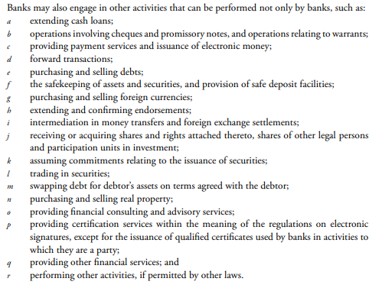

Slide 45
In recent years, conglomeration* has become a major trend in financial markets, emerging as a leading strategy of banks.
This process has been driven by technological progress, international consolidation of markets and deregulation of geographical or product restrictions
Financial conglomerates are defined as a group of enterprises, formed by different types of financial institutions, operating in different sectors of the financial industry. Group organisational structure is believed to bring about, on the one hand the possibility of exploiting greater cost economies and, on the other hand the capacity of the group to isolate risk from its different activities. On the revenue side, the ability of financial conglomerates to distribute a full range of banking, securities and insurance services may increase their earning potential and lead to a more stable profit stream. Customers may value a bundled supply of financial services more than separate offers for reasons of transactions and information costs.

Slide 46
In the EU, financial conglomeration was encouraged by the Second Banking Directive (1989), which allowed banks to operate as universal banks: enabling them to engage, directly or through subsidiaries, in other financial activities, such as financial instruments, factoring, leasing and investment banking.

Slide 47
Does the banking sector
development cause
economic growth or does
growth cause or encourage
banking sector development?

Slide 48
There is a long-debated issue whether there is a connection between financial development and economic growth. The question is whether there is causality and if so in what direction: is it the financial development that induces economic growth or maybe financial development merely follows economic growth.

Slide 49
Financial development means the factors, policies, and institutions that lead to effective financial intermediation and markets, and deep and broad access to capital and financial services (IMF).

Slide 50
Banks have always played an important position in the country’s economy.
They play a decisive role in the
development of the industry and trade.
They are acting not only as the custodian of the wealth of the country but also as resources of the country, which are necessary for the economic development of a nation.

Slide 51
The banking sector is a subset of the financial sector and its
role in the growth process of an economy cannot be overemphasized.

Slide 52
It plays a dominant role in the financial intermediation process of most developing and developed countries,
thus connoting that the financial sector of most countries is
bank-based.

Slide 53
The banking sector is a pivotal segment in many
countries, hence the need for continuous implementation of
adequate policy measures and reforms in order to ensure that
the banking sector performs its function efficiently.

Slide 54
A bank can be associated with a financial service
conglomerate able to provide basic financial services and properly function within the economic, political, legal and international environment that determines its
profit and expansion opportunities, interest rates,
exchange rates and the particular resources a bank need.

Slide 55
The efficiency of the banking system is a key
determinant of sustainable growth. Thus, banks are
essential for any modern economy, not only in terms of
turnover, but also as the primary financier of the
national economy.

Slide 56
In order to perform their functions, banks provide a large array of financial services to attract customers and to meet their demands.
The Economist has often described banks as intermediaries
between savers and users of capital.
Banks are special intermediaries because of their unique capacity to finance production by lending their own debt to agents willing to accept it and to use it as money.

Slide 57
The general role of commercial
banks is to provide financial services to general
public and business, ensuring economic and
social stability and sustainable growth of the economy.

Slide 58
The banking system is an important channel through which financial development exerts an effect on economic growth.
The role of a banking sector is particularly important for small economies and developing countries where bond and equity markets are underdeveloped.
Many firms highly depend on bank loans as a primary (or only) source of external finance.
Given the important role of banks in mobilizing savings to productive investment
opportunities and in exerting sound corporate governance, banking
sector development is crucial for economic growth.

Slide 59
Being at the same time borrowing and lending institutions, banks also offer other types of services, such as:
payments,
settlements and funds transfer,
foreign exchange transactions,
savings and investment
services,
payroll services,
financial advice,
Investments
and bill finance, safe-deposit boxes.

Slide 60
So as to provide these financial services, commercial banks perform
certain functions within the national economy:
The function of deposit’ acceptance,
attracting temporarily
available resources from business and individual
customers;
the investment function,
granting loans for those in need of financial support;
the commercial function that enables fund transfer between account
holders determined by various activities.

Slide 61
Altogether, banks channel savings into productive capital, facilitate
productive use of surpluses to generate employment and
promote economic welfare and provide risk-free income
to depositors.

Slide 62
The banking sector performs five functions
which can facilitate economic growth. These functions are
(i) providing ex ante information about possible investments and
allocate capital,
(ii) monitoring investments and exert corporate governance after providing credit,
(iii) facilitating trading, risk diversification, and risk management
(iv) mobilising and pooling deposits, and
(v) facilitating the exchange of goods and services.

Slide 63
Therefore, banking sector development refers to the
increase in the ability of the banking sector to perform these
functions efficiently.

Slide 64
According to information from the Polish
Financial Supervision Authority (PFSA),
in January 2018, there were 35 commercial banks operating in Poland,
28 branches of EU credit institutions and 553 cooperative banks.

Slide 65
The total assets of the banking sector in Poland amount to approximately
1.78 trillion zlotys,
And the sector employs approximately 165,000 people.

Slide 66
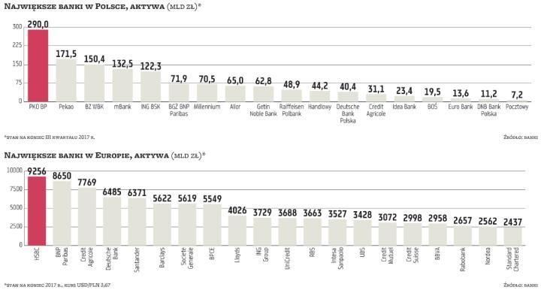

Slide 67
The development of a banking sector will have a positive effect on economic growth if it lessens financial constraints of firms and increases the efficiency of fund allocation to firms with valuable investment opportunities.

Slide 68
This suggests that banking sector
development can boost economic productivity and increase
efficiency among firms.

