Slide 1

BANKING
LECTURE (1)

Slide 2

Banking system function,
structure, basic institutional
law of the banking system.
Types of banks according to polish law, universal and
specialized banks.
Central bank

Slide 3
BANKING SYSTEM
The banking system - the overall banking institutions and standards that define their mutual relations and relations with the environment.
In the market economy, the classic model of the banking system is the so-called two-tier banking system.
It consists of a central bank and various types of banks operating on individual financial markets.
The banking system is part of the financial system.

Slide 4
BANKING SYSTEM
In order for a banking system to exist, it is necessary to develop banks and financial markets. It is possible to operate with clear principles of the structure of this system.

Slide 5
BANKING SYSTEM
Banking systems are usually grouped according to two models - the Anglo-Saxon model and
the German-Japanese model.

Slide 6
BANKING SYSTEM
The Anglo-Saxon model of the banking system is based on financial markets which are the main source of raising funds for further development of business entities.
The main role is played by investment banks, that is financial institutions that deal with the direct transfer of savings to the money and capital market.
Investment banks deal with all financial services that go beyond the traditional [[[Deposit]] deposit activity]. The role of commercial banks boils down to ongoing operational service for business entities.

Slide 7
BANKING SYSTEM
The German-Japanese model assumes that the banking system plays the main role in the financial sector.
Banks satisfy both short and long-term demand for money, hence the universal role is played by universal banks, that is financial institutions that carry out all types of banking operations.

Slide 8
BANKING SYSTEM
Referring to Poland, one can encounter the classification of the banking system consisting of three groups of institutions:
stabilizing
creating the market
and subsidiary bodies

Slide 9
BANKING SYSTEM
Stabilizing institutions - these are the institutions responsible for supervising the proper functioning of the entire system.
CENTRAL BANK (NATIONAL BANK OF POLAND) - responsible for regulating banks' liquidity and supporting financial stability (including the banking sector),
SUPERVISORY BODY (POLISH FINANCIAL SUPERVISION AUTHORITY) - ensuring control over the conduct of banking activities and undertaking actions for the proper functioning of the financial market,
ENTITY GUARANTEEING THE PAYMENT OF DEPOSITS (BANK GUARANTEE FUND)

Slide 10
BANKING SYSTEM
Stabilizing institutions - these are the institutions responsible for supervising the proper functioning of the entire system.
CENTRAL BANK (NATIONAL BANK OF POLAND) - responsible for regulating banks' liquidity and supporting financial stability (including the banking sector),
SUPERVISORY BODY (POLISH FINANCIAL SUPERVISION AUTHORITY) - ensuring control over the conduct of banking activities and undertaking actions for the proper functioning of the financial market,
ENTITY GUARANTEEING THE PAYMENT OF DEPOSITS (BANK GUARANTEE FUND)

Slide 11
BANKING SYSTEM
Institutions creating the market (banking sector) –
means banks that operate within the banking system
(in Poland they are commercial banks, cooperative banks and branches of credit institutions)

Slide 12
BANKING SYSTEM
Subsidiary bodies
these include institutions that do not conduct deposit and lending activities:
non-bank issuers of payment cards,
insurance institutions,
the National Depository for Securities,
the National Clearing House,
the Credit Information Office
and institutions associating banks (eg. The Polish Bank Association)

Slide 13
Banking regulation

Slide 14
EU

Slide 15
DEFINITION OF BANK
A bank is a financial institution licensed to receive deposits and make loans. Banks may also provide financial services, such as wealth management, currency exchange, and safe deposit boxes.
A bank is an institution where people or businesses can keep their money.
An organization where people and businesses can invest or borrow money, change it to foreign money, etc., or a building where these services are offered.

Slide 16
DEFINITION OF BANK DUE U.S. LAW
“BANK” MEANS A BANK OR TRUST COMPANY INCORPORATED AND DOING BUSINESS UNDER THE LAWS OF THE UNITED STATES (INCLUDING LAWS RELATING TO THE DISTRICT OF COLUMBIA) OR OF ANY STATE, A SUBSTANTIAL PART OF THE BUSINESS OF WHICH CONSISTS OF RECEIVING DEPOSITS AND MAKING LOANS AND DISCOUNTS, OR OF EXERCISING FIDUCIARY POWERS SIMILAR TO THOSE PERMITTED TO NATIONAL BANKS UNDER AUTHORITY OF THE COMPTROLLER OF THE CURRENCY, AND WHICH IS SUBJECT BY LAW TO SUPERVISION AND EXAMINATION BY STATE OR FEDERAL AUTHORITY HAVING SUPERVISION OVER BANKING INSTITUTIONS. SUCH TERM ALSO MEANS A DOMESTIC BUILDING AND LOAN ASSOCIATION.

Slide 17
DEFINITION OF BANK DUE POLISH LAW
A BANK SHALL CONSTITUTE A LEGAL PERSON, ESTABLISHED PURSUANT TO THE PROVISIONS OF STATUTE, OPERATING ON THE BASIS OF AUTHORISATIONS TO PERFORM BANKING
OPERATIONS THAT EXPOSE TO RISK
FUNDS WHICH HAVE BEEN ENTRUSTED TO THE BANK AND WHICH ARE IN ANY WAY REPAYABLE.

Slide 18
DEFINITION OF BANK DUE POLISH LAW
UNDER POLISH LAW, BANKS CAN BE ESTABLISHED EITHER AS STATE BANKS (BY THE GOVERNMENT) OR AS PRIVATE BANKS IN THE FORM OF A JOINT-STOCK COMPANY OR A COOPERATIVE.

Slide 19
Types of banks

Slide 20

RETAIL OR PERSONAL BANKING
Relates to financial services provided to consumers and is
usually small-scale in nature.
Typically, all large banks offer a broad range of personal
banking services including payments services (current account with cheque facilities, credit transfers, standing orders, direct debits and plastic cards), savings, loans, mortgages, insurance, pensions and other services.

Slide 21
RETAIL OR PERSONAL BANKING
A variety of different types of banks offer personal banking services. These include:
Commercial banks
Savings banks
Co-operative banks
Credit unions

Slide 22
COMMERCIAL BANKS
Commercial banks are the major financial intermediary in any economy.
Why?

Slide 23
COMMERCIAL BANKS
THEY ARE THE MAIN PROVIDERS OF CREDIT TO THE HOUSEHOLD AND CORPORATE SECTOR AND OPERATE THE PAYMENTS MECHANISM
COMMERCIAL BANKS ARE TYPICALLY JOINT STOCK COMPANIES AND
MAY BE EITHER PUBLICLY LISTED ON THE STOCK EXCHANGE OR PRIVATELY OWNED

Slide 24
COMMERCIAL BANKS
Commercial banks deal with both retail and corporate customers, have well-diversified deposit and lending,
generally offer a full range of financial services.
The largest banks in most countries are commercial banks and they include household names.

Slide 25
COMMERCIAL BANKS
While commercial banking refers to institutions whose main business is deposit taking and lending it should always be remembered that the largest commercial banks also engage in investment banking, insurance and other financial services areas.
They are also the key operators in most countries’ retail banking markets.

Slide 26
COMMERCIAL BANKS
According to information from the Polish Financial Supervision Authority (PFSA), in January 2018, there were 35 commercial banks operating in Poland.

Slide 27
COMMERCIAL BANKS
https://www.knf.gov.pl/en/ENTITIES
https://prnews.pl/raport-prnews-pl-liczba-placowek-bankowych-iii-kw-2018-439007

Slide 28
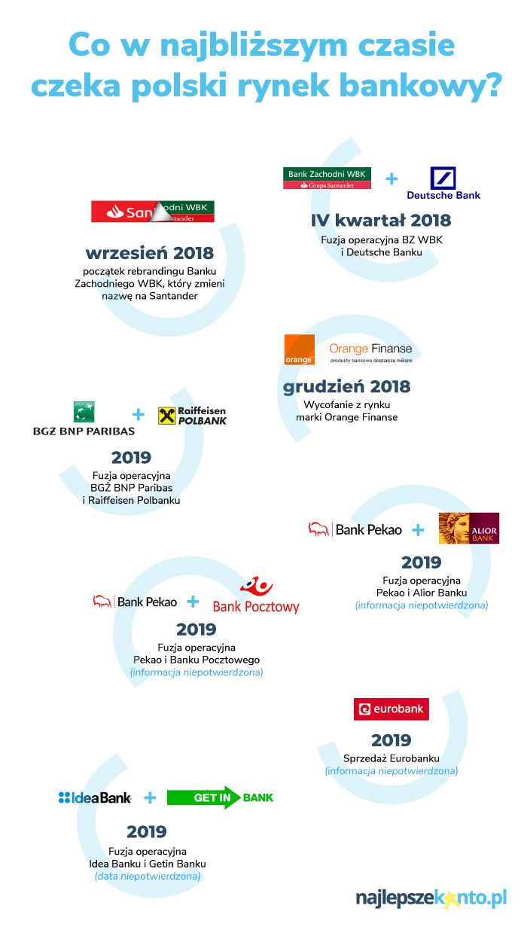
COMMERCIAL BANKS
operational merger
rebranding
Withdrawal from market
operational merger
operational merger
operational merger
sale of eurobank to Bank Millennium
operational merger

Slide 29
https://www.relbanks.com/top-european-banks/assets

Slide 30
SAVINGS BANKS
Savings banks are similar in many respects to commercial banks although their main difference (typically) relates to their ownership features –
savings banks have traditionally had mutual ownership, being owned by
their ‘members’ or ‘shareholders’ who
are the depositors or borrowers.

Slide 31
CO-OPERATIVE BANKS
Another type of institution similar in many respect to savings banks are the
co-operative banks.

Slide 32
CO-OPERATIVE BANKS
These originally had mutual ownership and typically offered retail and small business banking services.
A recent trend has been for large numbers of
small co-operative banks to group (or consolidate) to form a much larger institution.

Slide 33
COOPERATIVE BANKS
A cooperative bank is a bank which is a cooperative, to which the provisions of the Cooperative Act shall apply with regard to the matters which are not regulated under the Act of 7 December 2000 on the Operations of Cooperative Banks, their Affiliation, and Affiliating Banks.

Slide 34
COOPERATIVE BANKS- POLAND
Cooperative banks, after obtaining in accordance with the Banking Law Licenses of the Polish Financial Supervision Authority, may perform the following banking activities:
1) accepting cash deposits payable on demand or upon arrival
the designated date and keeping accounts of these contributions;
2) keeping other bank accounts;
3) granting loans;
4) granting and confirming bank guarantees;
5) conducting bank monetary settlements;
6) granting cash loans;
7) granting consumer loans and credits within the meaning of the regulations
separate act;
8) check and bill of exchange transactions;
9) providing payment services and issuing electronic money
within the meaning of the Act of 19 August 2011 on Payment Services
10) purchase and sale of monetary receivables;
11) storage of items and securities and sharing
safe deposit boxes;
12) granting and confirming sureties;
13) performing other banking activities on behalf of and for the benefit of the bank
uniting.

Slide 35

COOPERATIVE BANKS
According to information from the Polish Financial Supervision Authority (PFSA), in January 2018, there were 553 cooperative banks.

Slide 36
SPECIALIZED BANK

Slide 37
SPECIALIZED BANK
A bank that carries out specific activities due to the scope and form of operations or to the type of clients.

Slide 38
MORTGAGE BANK
A bank whose core business is: granting loans secured by a mortgage and issuing mortgage bonds based on them (in Poland mortgage banks have the exclusive right to issue these debt securities), granting loans to entities with high creditworthiness (eg Treasury States, the National Bank of Poland, territorial self-government units) or guaranteed by these entities and issuing public mortgage bonds on their basis.

Slide 39
INVESTMENT BANK
An investment bank (IB) is a financial intermediary that performs a variety of services.
Most Investment banks specialize in large and complex financial transactions, such as underwriting, acting as an intermediary between a securities issuer and the investing public, facilitating mergers and other corporate reorganizations, and acting as a broker or financial advisor for institutional clients.

Slide 40
INVESTMENT BANK
Investment banks are a bridge between large enterprises and the investor. Their main roles are to advise businesses and governments on how to meet their financial challenges and to help them procure financing, whether it be from stock offerings, bond issues or derivative products.

Slide 41
INVESTMENT BANK
An investment bank is a special financial institution that operates mainly on the capital market.
The bank does not accept deposits or grant loans or credits.
The basis of its activity is the organization of the flow of capital resources, between entities reporting to it for investment purposes and entities with a financial surplus.
In connection with the above, IB acts as an intermediary between the issuer and the investor in money and capital market operations.

Slide 42
INVESTMENT BANK
The scope of services provided by investment banks includes:
operations on the securities market (including brokerage activities, dealerships, securities brokerage, underwriting)
operations on the money market (inter alia transactions on the interbank market, transactions on the market of enterprise debt securities)
fund management (eg creation and management of venture capital funds, management of liquid assets and customer shares)
financial consulting (investment consulting, development of acquisition and merger strategies, securitization design)

Slide 43
STATE OWNED BANK
A state bank is a special type of bank that can be set up by ordinance of the Council of Ministers, eg for the needs of specific objectives.
The creation of a state bank does not require the permission of the Polish Financial Supervision Authority, but only the consultation of its opinion.
The regulation of the Council of Ministers on the creation of a state bank defines the name, seat, subject and scope of the bank's activities, its statutory funds, including funds separated from the State Treasury assets, which become the bank's assets.

Slide 44
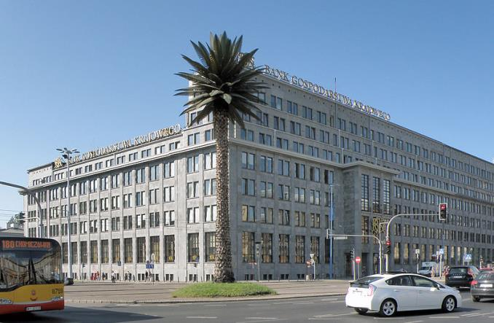

STATE OWNED BANK
It is not a state-owned enterprise, a state-owned organizational unit or a unit of the public finance sector.
In Poland is only one state owned bank- BANK GOSPODARSTWA KRAJOWEGO.

Slide 45
BANK GOSPODARSTWA KRAJOWEGO
Bank Gospodarstwa Krajowego is a state development bank whose mission is to support the social and economic development of Poland and the public sector in the fulfilment of its tasks.
The Bank is a financial partner actively supporting the entrepreneurship and making effective use of development programmes. It is the initiator of and the participant in cooperation between business, public sector, and financial institutions.
Together with other development institutions, the Bank plays a significant role in implementation of the Strategy for Responsible Development.

Slide 46
Establishment and
organisation of banks,
branches
and representative
offices of banks
Due Polish Banking Act

Slide 47
Banks may be established as state banks, cooperative banks or banks incorporated as joint-stock companies.

Slide 48
Either natural or legal persons may be founders of a bank incorporated as a joint-stock company, with the proviso that there shall be no fewer than three such founders.

Slide 49
The initial capital provided by the bank's founders shall be no less than the zloty equivalent of EUR 5,000,000, converted at the mid-rate published by Narodowy Bank Polski and ruling on the day the authorisation to establish the bank is granted

Slide 50
In the case of cooperative banks, the founders of which have expressed their intention to conclude an affiliation agreement pursuant to the Act on the Operations of Cooperative Banks, their Affiliation and Affiliating Banks, the initial capital shall be no less than the zloty equivalent of EUR 1,000,000, converted at the mid-rate published by Narodowy Bank Polski and ruling on the day authorisation to establish the bank is granted.

Slide 51
A bank may commence its business following receipt of an appropriate authorisation from the Polish Financial Supervision Authority.

Slide 52
An authorisation to commence the business may be issued where it is determined that the bank:
1) is properly prepared in organisational terms to commence the business,
2) has assembled the full amount of initial capital,
3) is in possession of facilities suitable for the safekeeping of monetary funds and other valuables, taking into consideration the scope and kinds of banking activity to be conducted,
4) fulfils other conditions stipulated in the decision on granting the authorisation to establish the bank.

Slide 53
The Polish Financial Supervision Authority shall notify the European Banking Authority of granting the authorisation referred .
The bank shall notify the Banking Guarantee Fund of being entered in the National Court Register.

Slide 54
A BRANCH OF A FOREIGN BANK
A branch of a foreign bank shall be founded in the country on the basis of a permit of the Financial Supervision Commission, issued upon application of the bank concerned.
A branch of a foreign bank shall operate under regulations issued by a foreign bank.

Slide 55
A BRANCH OF A FOREIGN BANK
A branch of a foreign bank shall be obliged to:
1) use the business name of the foreign bank in the language of the state of its seat accompanied by the designation of the bank’s legal status translated into Polish and the words “branch in Poland”;
2) manage separate accounting in Polish, in accordance with the provisions binding upon the domestic banks;
3) operate in conformity with approved regulations;
4) keep all documents relating to its activity in the seat of the branch.

Slide 56
Central bank

Slide 57

A central bank is an independent national authority that conducts monetary policy, regulates banks, and provides financial services including economic research.
Its goals are to stabilize the nation's currency,
create and emits money and prevent inflation.

Slide 58
The most important areas of activity of CB are:
monetary policy,
issue of currency,
development of payment system,
management of official reserves,
education and information,
services to the State Treasury.

Slide 59
Central bank is responsible for the stability of the national currency.
CB develops and implements the monetary policy strategy and the annual monetary policy guidelines.
Through the management of the official reserves CB ensures the requisite level of the State's financial security.

Slide 60
As an issuer of currency, CB maintains the liquidity of cash payments.
An important objective of CB is guarding the stability of the financial system.
As part of its supervisory and regulatory functions, CB oversees the liquidity, efficiency and security of the payment system.
It also contributes to the development of a secure infrastructure of the financial market.

