Slide 1
Critical Thinking
& Argumentation
Maciej Pichlak
Department of Legal Theory and Philosophy of Law
University of Wroclaw
maciej.pichlak@uwr.edu.pl
https://prawo.uni.wroc.pl/user/12147

Slide 2
The objectives
To acquaint students with the general principles of correct reasoning and basic types of arguments.
To acquire skills in critical thinking, constructing and assesing arguments.
To develop analytical and communicational competences.

Slide 3
The content
Lectures:
The concept of argument
The structure of argument
Recognizing and constructing arguments
Conspiracy theories and pseudosciene
THE EXAM
Seminar classes:
Selected types of arguments
Constructing and reconstructing of arguments
Evaluation (assessment) of arguments
Fallacies
THE FINAL TEST

Slide 4
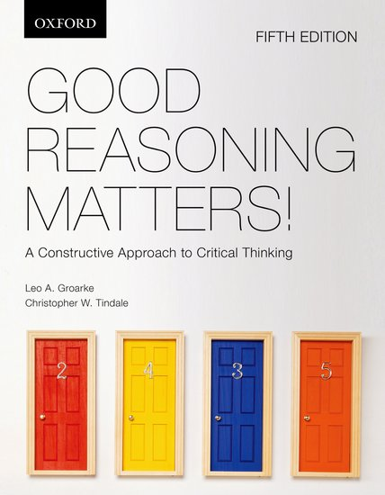
Essential reading

Slide 5
How much?
I have 100 Euro more than you.
How much Euro do you have, if together we have 110 Euro?

Slide 6
Who has the keys?
There are: Mum, Dad, Grandma, Grandpa, Aunt, Uncle, and the Cousin sitting around the table. They are looking for the keys.
Mum: This is Uncle who’s got the keys.
Dad: No, this is Grandpa or Cousin.
Grandma: Ok, I’ve got it.
Grandpa: Don’t look at me, I don’t have it.
Aunt: Grandma cannot have it, I’ve got it.
Uncle: No, this is Mum or Dad who has it.
Cousin: I know that only one of you said the truth.
Who has the keys?

Slide 7
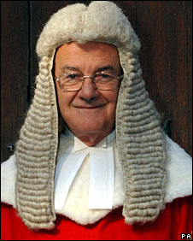
Critical thinking may be critical…
„The court finds as unreliable the declaration of the accused that he has bought a car radio found in his flat. The professional experience of the court allows for a conclusion that a theft does not buy such a thing as a car radio, and even for a lower price, for he can steal it for free.”

