Slide 1
Critical Thinking
& Argumentation part 2: The concept of argument
Maciej Pichlak
Department of Legal Theory and Philosophy of Law
University of Wroclaw
maciej.pichlak@uwr.edu.pl
https://prawo.uni.wroc.pl/user/12147

Slide 2
The practice of argumentation
To argue:
To quarrel
to offer reasons (arguments)
A pragmatic goal of argumentation and its rationality.
„Things that are true and things that are better are, by their nature, practically always easier to prove and easier to believe in”.
Aristotle, Rhetoric

Slide 3
The concept of argumentation
“Argumentation is a communicative and interactional act complex aimed at resolving a difference of opinion with the addressee by putting forward a constellation of propositions the arguer can be held accountable for to make the standpoint at issue acceptable to a rational judge who judges reasonably.”
(van Eemeren et al., 2014, p. 7)

Slide 4
The concept of argument
Argument: a basic component of argumentation
A sense of argument by Monty Python:
http://www.youtube.com/watch?v=YUIA40uLlKw
„An argument is a connected series of statements to establish a definite proposition”.

Slide 5
The concept of argument
1. Proposition: what is it?
How can I help you?
For the next class, please read the first chapter of the textbook.
University of Wrocław has the biggest number of the Nobel Prize winners in Europe.
The European Union should take responsibility for the situation in Syria.
2. Premises and conclusion
It’s raining → [so] streets are wet.

Slide 6
How to recognize an argument when you see it
Jimmy went into a shop, pushing Janice away. Then he went directly to a shelf with beer.
Since Jimmy was really in hurry, he probably was very thirsty.
Eventually, for Jimmy beer was more important than Janice. Apparently, you can hardly meet a real gentleman these days.
If Jimmy doesn’t change his attitude, his relationship with Janice is in serious danger.
Notes:
Unless:
Jimmy’s relationship with Janice is in serious danger, unless he changes his attitude.

Slide 7
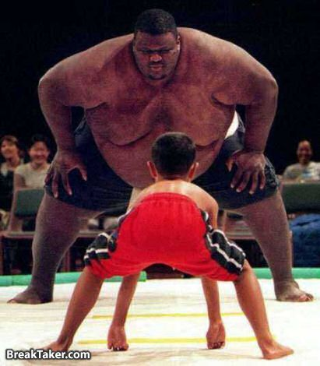
Strong vs. weak arguments
Strong argument is the one with:
acceptable and relevant premises;
conclusion following from premises on the ground of accepted principle of inference.
P.I.
P
C

Slide 8
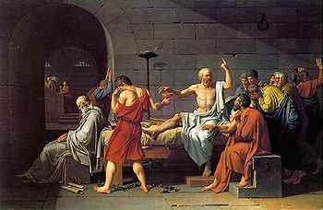
The structure of argument
Since every man is mortal, and Socrates – believe me or not – is a man, therefore Socrates is mortal.
[P1] Every man is mortal.
[P2] Socrates is a man.
[C] Socrates is mortal.
P1 + P2
C

Slide 9
In logic, we have an argument whenever we have reasons suggested as premises for a conclusion. Explanations can contain reasoning in this sense and can, therefore, be classified as arguments.

Slide 10

Linked or convergent premises?
[P1] Although the living room window is open, there are no footprints outside, despite the softness of the ground after yesterday's rain.
[P2] The clasp on the box was not broken but opened with a key that had been hidden behind the clock.
[P3] No one heard the dog barking, so the dog did not bark.
[C] The crime was committed by someone in the house.
P3a
P3b
P1
P2
P3
P1a + P1b +P1c
C

Slide 11
It’s a good idea to study CJ in Wrocław, for there is an excellent teaching staff. Moreover, Wrocław is a great city to live in.

Slide 12
You have a problem, so you should ask for an advice someone who you trust. You trust your mother, and you should, therefore, ask her for an advice.

Slide 13
Enthymemes
It’s Tuesday today. So tomorrow will be Wednesday.
There is Wednesday a day after Tuesday. Therefore, tomorrow will be Wednesday.
The bigger the burger the better the burger.
Burgers are bigger at Burger King.

Slide 14
P. The room was sealed from the inside.
C. No one could have left it.
P. No one could have left the room.
C. The murderer was never in the room.

Slide 15
P: Jimmy was really in hurry.
C: He probably was very thirsty.
P: The salary is really good.
C: You should take this job.
P: No one heard the dog barking.
C: The dog did not bark.

Slide 16
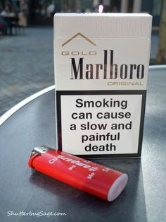

Slide 17

