Slide 1
Fundamentals of Law & Government
Introductory Lecture

Slide 2
The content
Lectures:
POLITICAL PART
Marcin Jędrysiak
LEGAL PART
Maciej Pichlak
THE EXAM
Seminar classes:
CONSTITUTIONAL PART
Anna Śledzińska-Simon
THE TEST / THE PROJECT

Slide 3
Lecturers
Maciej Pichlak
Department of Legal Theory and Philosophy of Law
room 302 A
maciej.pichlak@uwr.edu.pl
https://prawo.uni.wroc.pl/user/12147
Marcin Jędrysiak
Department of Legal and Political Thought
room 304 B
marcin.jedrysiak@uwr.edu.pl
https://prawo.uni.wroc.pl/user/12898

Slide 4
Lectures’ content
FUNDAMENTALS OF GOVERNMENT
Introduction to the course. Objectives and content of the course. Law and government in contemporary societies.
Basic concepts of political science
Government and its ideology: Ideology, political doctrine, politics, political culture and socialization
Various doctrines of government
The political process: political parties, interest groups and social movements. The organization of interests, communications media, elections and electoral system
Structure and forms of government: Liberal democracy and welfare state, autocratic systems, totalitarianism

Slide 5
Lectures’ content, part 2
FUNDAMENTALS OF LAW
Law as a complex concept. Functions of law.
Basic families of legal order
Legal system. Various types of legal systems (municipal law, local law, international law, transnational law). Public and private law.
Sources of law and law creating in various legal systems.
Legal rules and principles
Interpreting statutes: the notion and methods of statutory interpretation.
Interpreting precedents: the doctrine of precedent, ratio finding, distinguishing, and overruling.

Slide 6
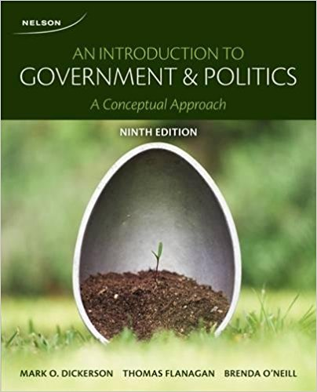
Recommended reading, 1

Slide 7
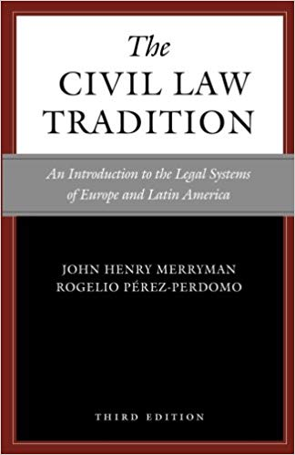
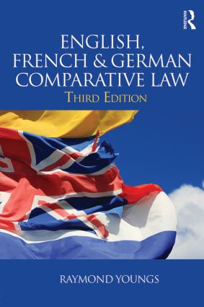
Essential
Recommended reading, 2
J.H. Merryman,
The Civil Law Tradition
Supplementary
R. Youngs, English, French
& German Comparative Law

Slide 8
https://www.youtube.com/watch?time_continue=4&v=rCxJhj7tMkc
This Court has already concluded that the Prime Minister’s advice to Her Majesty was unlawful, void and of no effect. This means that the Order in Council to which it led was also unlawful, void and of no effect and should be quashed. This means that when the Royal Commissioners walked into the House of Lords it was as if they walked in with a blank sheet of paper. The prorogation was also void and of no effect. Parliament has not been prorogued. This is the unanimous judgment of all 11 Justices.

Slide 9
The Law’s Empire
  'We live in and by the law. It makes us what we are: citizens and employees and doctors and spouses and people who owe things. It is sword, shield and menace: we insist on our wage, or refuse to pay our rent, or are forced to forfeit penalties, or are closed up in jail, all in the name of what our abstract and ethereal sovereign, the law, has decreed. (...) We are subjects of law's empire, liegemen to its methods and ideals, bound in spirit while we debate what we must therefore do.'
  Ronald Dworkin, Law's Empire

