Slide 1
The Concept of Law
Legal Families of the World
Fundamentals of Law & Government
Maciej Pichlak
Department of Legal Theory and Philosophy of Law
University of Wroclaw
Room 302A | maciej.pichlak@uwr.edu.pl
https://prawo.uni.wroc.pl/user/12147

Slide 2
The purpose of law
To guide a human conduct
To provide publicly ascertainable standards of behaviour
To secure order and peace
To justify acts of coercion
To legitimize a domination of the ruling class over other classes
Justice, security, purposiveness

Slide 3
Social functions of law
preventing undesirable behaviour and securing desirable behaviour (criminal law, tort law)
providing facilities for private arrangements between individuals (civil law)
provisions of services and the redistribution of goods (administrative law, tax law)
settling unregulated disputes (courts and tribunals)
------------------------------------------------------------------
Stabilization and innovation
Organization
Protection
Repression and prevention (education)

Slide 4

Law as a multi-layered system
„Shrek Principle”
'Typical' rules, that is legal provisions which are formulated in legal texts
(or other traditional sources of law), creates only a 'surface-level' of law.
Next to this level, law includes also other components.
Concepts of legal system and legal order

Slide 5

Lex et ius
Lex: formally
enacted law
Ius:
  Law in general
  ‚lawyers-made law’
  ‚natural’ law
  final legal decision
  Ius est ars boni et aequi.
  Celsus

Slide 6
„Sources” of legal order
LAW
(as ius)
Legislation
(law as lex)
Legal
doctrine
Legal
practice

Slide 7
Legal culture
A set of beliefs, attitudes and customs related to the valid law.
Legal culture sensu largo and sensu stricto (culture of legal professionals).
Legal culture sensu stricto is created by legal practices, legal science, and legislation

Slide 8
Components of legal culture (Tuori)
methodical element (methods of legal reasoning)‏
conceptual element (basic concepts of law)‏
normative element (general legal principles)‏
general doctrines‏

Slide 9
Law as a multi-layered system
The role of legal culture (ius):
Positive (binding legal standards)
Negative (the limits of law)
Mediating (canons of interpretations)
Critical (a yardstick for criticism of law)
Discursive and practical knowledge
Components of legal culture and their discursive expressions.

Slide 10
Main legal families
Civil law (Romano-Germanic)
Common law (Anglo-American)
Far East
Islamic
Hindu
Scandinavian
[Post-soviet]

Slide 11
The concept of legal family
Criteria for distinguishing legal family (Koetz and Zweigert):
Historical background;
Methods of reasoning;
Institutions;
Sources of law;
Dominant ideology.
Other possibilities: language; territory; political system

Slide 12
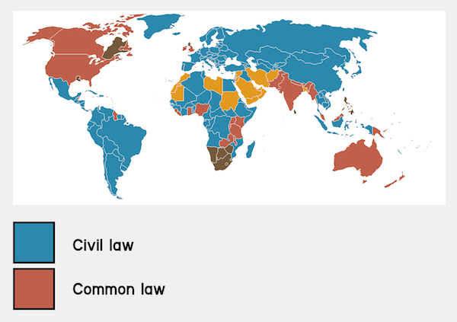
Civil law vs. common law
Source: www.frenchentree.com

Slide 13
Civil law
Originates from the continental Europe
Based on the reception of the Roman law
Legislation is the primary source of law
Codifications (Code of Napoleon, BGB)
Similar methods of legal reasoning and interpretation
Abstract, systematic; the role of legal doctrine

Slide 14
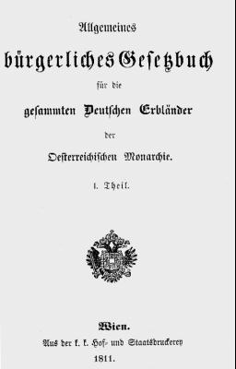
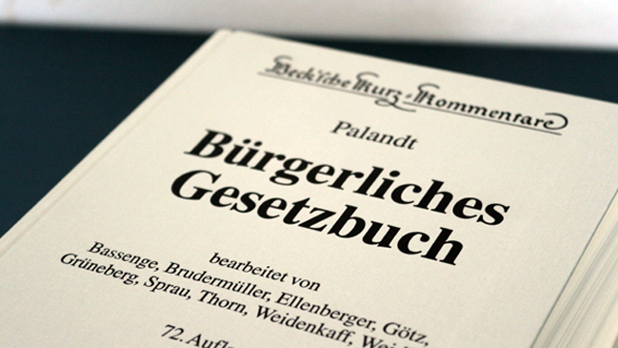
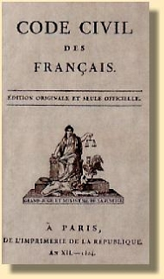
1900
1811
1804

Slide 15
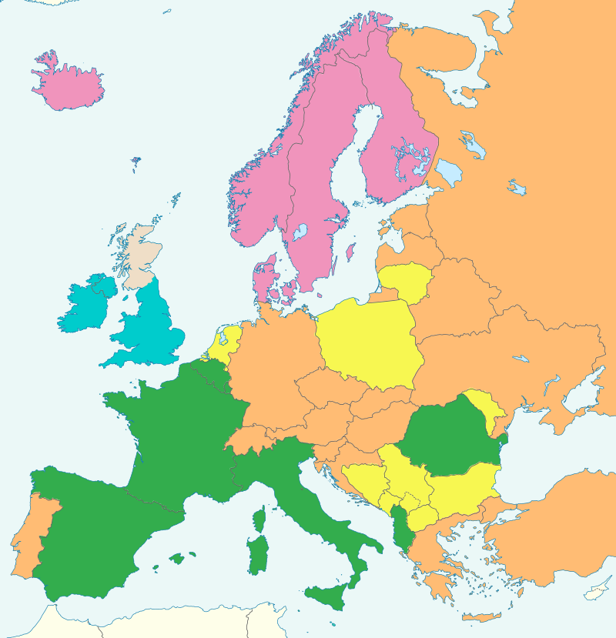
Civil law:
Germanic vs.
Romanistic
Tradition
Germanic
Romanistic
Nordic
Mixed
Common law
Source: By Ain92 - Own work, CC BY-SA 3.0, http://commons.wikimedia.org/w/index.php?curid=26756779

Slide 16
Common law
Originates from England, adopted in its (former) colonies
Embraces legislation, regulations and judge-made law (precedents: common law in a strict sense)
Precedents might be based on common law or equity
Developed independently, with unique reception of the Roman law
Less codified and systematized
More casuistic and practically-oriented

Slide 17
Common law and civil law: further differences
The role of judges
The Rule of Law vs. Rechtsstaat
Separation of powers vs. check and balance
Models of judicial constitutional control

