Slide 1
Legal Families of the World
Legal System
Fundamentals of Law & Government
Maciej Pichlak
Department of Legal Theory and Philosophy of Law
University of Wroclaw
Room 302A | maciej.pichlak@uwr.edu.pl
https://prawo.uni.wroc.pl/user/12147

Slide 2
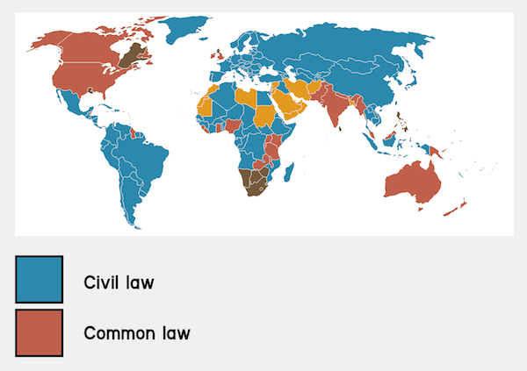
Civil law vs common law
Source: www.frenchentree.com

Slide 3
Civil law
Originates from the continental Europe
Based on the reception of the Roman law
Legislation is the primary source of law
Codifications (Code of Napoleon, BGB)
Similar methods of legal reasoning and interpretation
Abstract, systematic; the role of legal doctrine

Slide 4
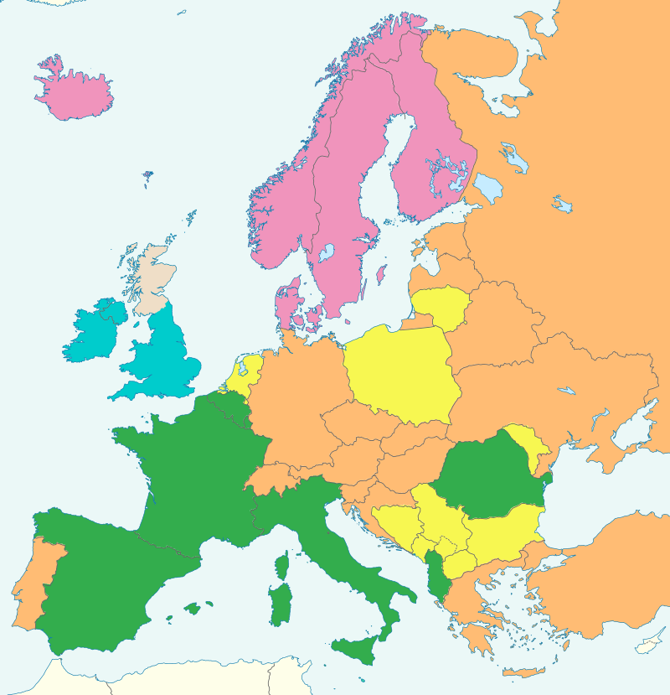
Civil law:
Germanic vs
Romanistic
Tradition
Germanic
Romanistic
Nordic
Mixed
Common law
Source: By Ain92 - Own work, CC BY-SA 3.0, http://commons.wikimedia.org/w/index.php?curid=26756779

Slide 5

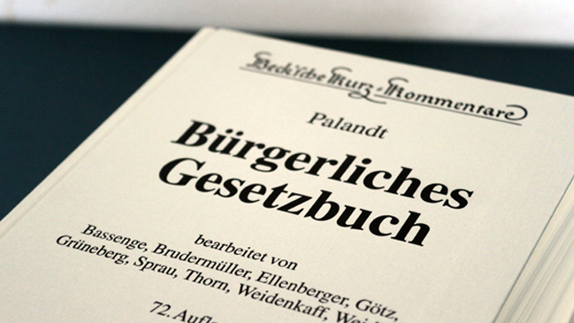

1900
1811
1804

Slide 6
Common law
Originates from England, adopted in its (former) colonies
Embraces legislation, regulations and judge-made law (precedents: common law in a strict sense)
Precedents might be based on common law or equity
Developed independently, without reception of the Roman law
Less codified and systematized
More casuistic and practically-oriented

Slide 7
Common law and civil law: further differences
The role of judges
The Rule of Law vs. Rechtsstaat
Separation of powers vs check and balance
Models of judicial constitutional control

Slide 8
Religious and traditional laws
Islamic law (Sharia and Fiqh), Hindu law (India), Halakha (Israel)
Distinct from the western idea of law
No clear separation of legal, religious, or moral standards
In contemporary legal systems their status varies

Slide 9
Islamic law
Sharia (rules) and Fiqh (jurisprudence)
Sources of sharia: Quran and Sunnah
Spheres of regulation:
  Religious obligations
  Family law
  Economic laws
  Criminal laws
  Dietary, hygiene, dress code etc.

Slide 10
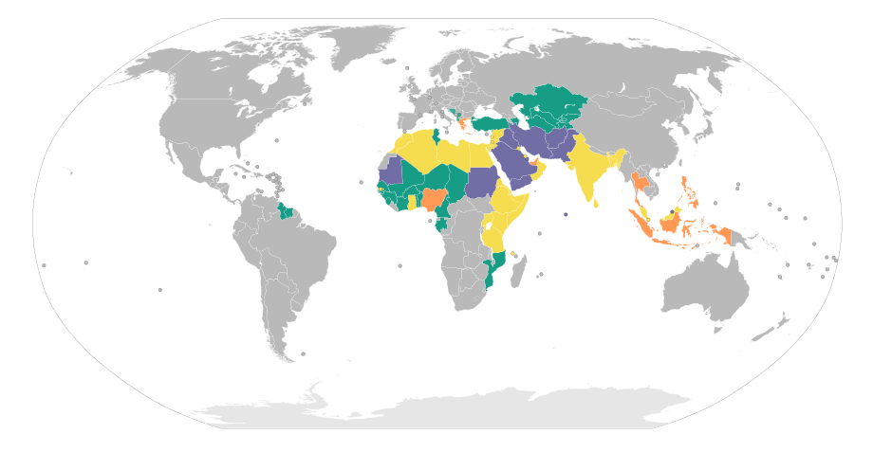
Application of sharia
Source: https://commons.wikimedia.org/w/index.php?curid=24745568
- none; - Muslim’s personal law - full; - others

Slide 11
Legal system of India vs. „Hindu law”
India is a federal state and laws may vary from one state to another
The legal system of India is called a hybrid system and includes:
  Common law
  Civil law (mainly on Goa)
  Various personal laws, according to ethnicity and religion (Hindu law, Muslim’s law, „Christian” law)

Slide 12
„Hindu law”
A post-colonial term; the more proper one is Dharma
Group of customs and traditional standards
Regarded to be the oldest jurisprudential system in the world
Based on a caste system
To some extent recognized by formal legal system and Indian courts
Relates mainly to personal laws, family (marrital) laws, some private contracts

Slide 13
Legal systems of Far East
Most relevant: Chinese law, Japanese law
Contemporarily usually a mixture:
  of western law and traditional customary law (Japan);
  of western law and socialist law (China).
Perceived as more focused on harmony than justice, reconciliation than adjudication.
Less litigatory than in the so called Western world.

Slide 14
The conept of legal system
SYSTEM:
collection of elements;
internally organized.
Legal system is a system of binding legal norms, which are organized according to formal and material relations between them.

Slide 15

Municipal law
(domestic law, national law)

Slide 16
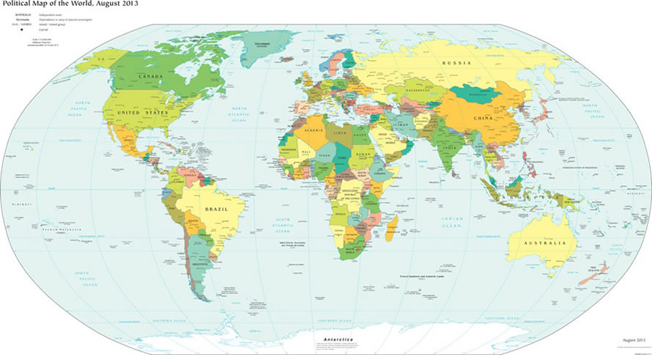
International law

Slide 17
International law
- Public international law
relations between sovereign states
- Supranational law
states and private individuals;
limitation of state’s sovereignity by supranational jurisdiction (CJEU; ICC)
- Private international law (conflict of laws)

Slide 18
Public vs. private law
Public law governs the relationships between individuals and the state. It governs the exercise of powers of the government and public authorities.
Private law governs relationships between private entities: citizens, families, or corporate bodies. It governs their rights and duties in mutual relations.

Slide 19



Public vs. private law:
Mr. Mustafi and the Town Hall
Public
Private
CONTRACT
RESIDENCE
PERMIT

Slide 20


Public vs. private law:
Mr. Mustafi and the Town Hall
Public
Private

Slide 21
Branches of law
Public law
Constitutional
Administrative
Criminal
Law of criminal proceeding
Law of civil proceeding
Law of administrative proceeding
Private law
General civil law
Property law
Law of contracts
Law of torts
Family law
Labour law
Law of commerce
Others

Slide 22
The organization of legal system
Vertical and horizontal organization as based on formal and material relations
Formal + material
H
I
E
R
A
R
C
H
Y
material
BRANCHES

Slide 23
Hierarchy
Formal relation of competence
Material relation of content
in a strong sense
in a weak sense
Consequences: lex superior derogat legi inferiori

