Slide 1
Legal System
Fundamentals of Law & Government
Maciej Pichlak
Department of Legal Theory and Philosophy of Law
University of Wroclaw
Room 302A | maciej.pichlak@uwr.edu.pl
https://prawo.uni.wroc.pl/user/12147

Slide 2
The conept of legal system
SYSTEM:
collection of elements;
internally organized.
Legal system is a system of binding legal norms, which are organized according to formal and material relations between them.

Slide 3

Municipal law
(domestic law, national law)

Slide 4
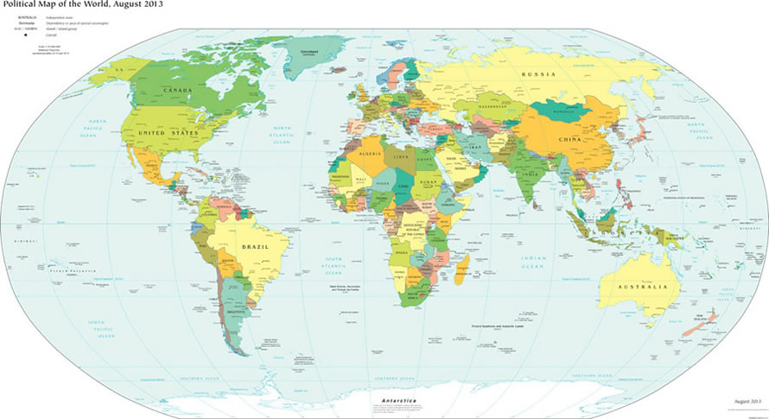
International law

Slide 5
International law
- Public international law
relations between sovereign states
- Supranational law
states and private individuals;
limitation of state’s sovereignity by supranational jurisdiction (CJEU; ICC)
- Private international law (conflict of laws)

Slide 6
Public vs. private law
Public law governs the relationships between individuals and the state. It governs the exercise of powers of the government and public authorities.
Private law governs relationships between private entities: citizens, families, or corporate bodies. It governs their rights and duties in mutual relations.

Slide 7



Public vs. private law:
Mr. Mustafi and the Town Hall
Public
Private
CONTRACT
RESIDENCE
PERMIT

Slide 8


Public vs. private law:
Mr. Mustafi and the Town Hall
Public
Private

Slide 9
Branches of law
Public law
Constitutional
Administrative
Criminal
Law of criminal proceeding
Law of civil proceeding
Law of administrative proceeding
Private law
General civil law
Property law
Law of contracts
Law of torts
Family law
Labour law
Law of commerce
Others

Slide 10
The organization of legal system
Vertical and horizontal organization as based on formal and material relations
Formal + material
H
I
E
R
A
R
C
H
Y
material
BRANCHES

Slide 11
Hierarchy
Formal relation of competence
Material relation of content
in a strong sense
in a weak sense
Consequences: lex superior derogat legi inferiori

Slide 12
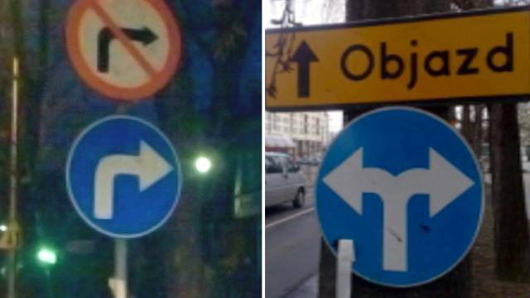
Collisions (conflicts) of rules

Slide 13
Rules of collision
Lex superior derogat legi inferiori
Lex posterior derogat legi priori
Lex specialis derogat legi generali
The problem of meta-rule
The problem of applying the hierarchical rule:
different situations of administrative agency and various types of courts.
Lex inferior non derogat legi superiori?

Slide 14
Article 148. § 1. Whoever kills a human being
shall be subject to the penalty of the deprivation of liberty for a minimum term of 8 years, the penalty of deprivation of liberty for 25 years or the penalty of deprivation of liberty for life .
§ 2. Whoever kills a human being:
1) with particular cruelty,
2) in connection with hostage taking, rape or robbery,
3) for motives deserving particular reprobation,
4) with the use of firearms or explosives
shall be subject to the penalty of the deprivation of liberty for a minimum term of 12 years, the penalty of deprivation of liberty for 25 years or the penalty of deprivation of liberty for life .
§ 3. Whoever kills more than one person in one act or has earlier been validly and finally convicted for homicide
shall be also subject to the penalty specified in § 2.
§ 4. Whoever kills a person due to the influence of an intense emotion justified by the circumstances
shall be subject to the penalty of the deprivation of liberty for a term of between 1 and 10 years.

Slide 15
Part Two
Subjects of Law

Slide 16
Legal entities
Every unit recognized by law
On the edge? Animals, artificial intelligence, natural areas, gods…
PERSONS |  | OTHER UNITS
PHYSICAL PERSONS (natural persons, private individuals) | LEGAL PERSONS - PERSONA FICTA (juridical, juristic, artificial, fictitious persons) Companies Corporations Partnerships States etc. | Units that lack legal personality Agencies Some kinds of partnerships etc.

Slide 17
The stucture of legal person
Addressee: a unit to whom the legal rule is addressed
Legal personhood: capability to posses legal rights and obligations
Legal capacity: capability to amends one’s own rights and obligations
Capacity to sue and to be sued

Slide 18
Capacity to sue and being sued
Legal
capacity
Legal
personhood
Being
an addressee

Slide 19
Liability
Liability (legal liability): responsibility in law
‚Liable’ as ‚legally obligated’
Liability and duty of care or duty to act
Ground for liability:
Criminal deed
Contract
Delict / tort
Obligations of public law (e.g. tax)

Slide 20

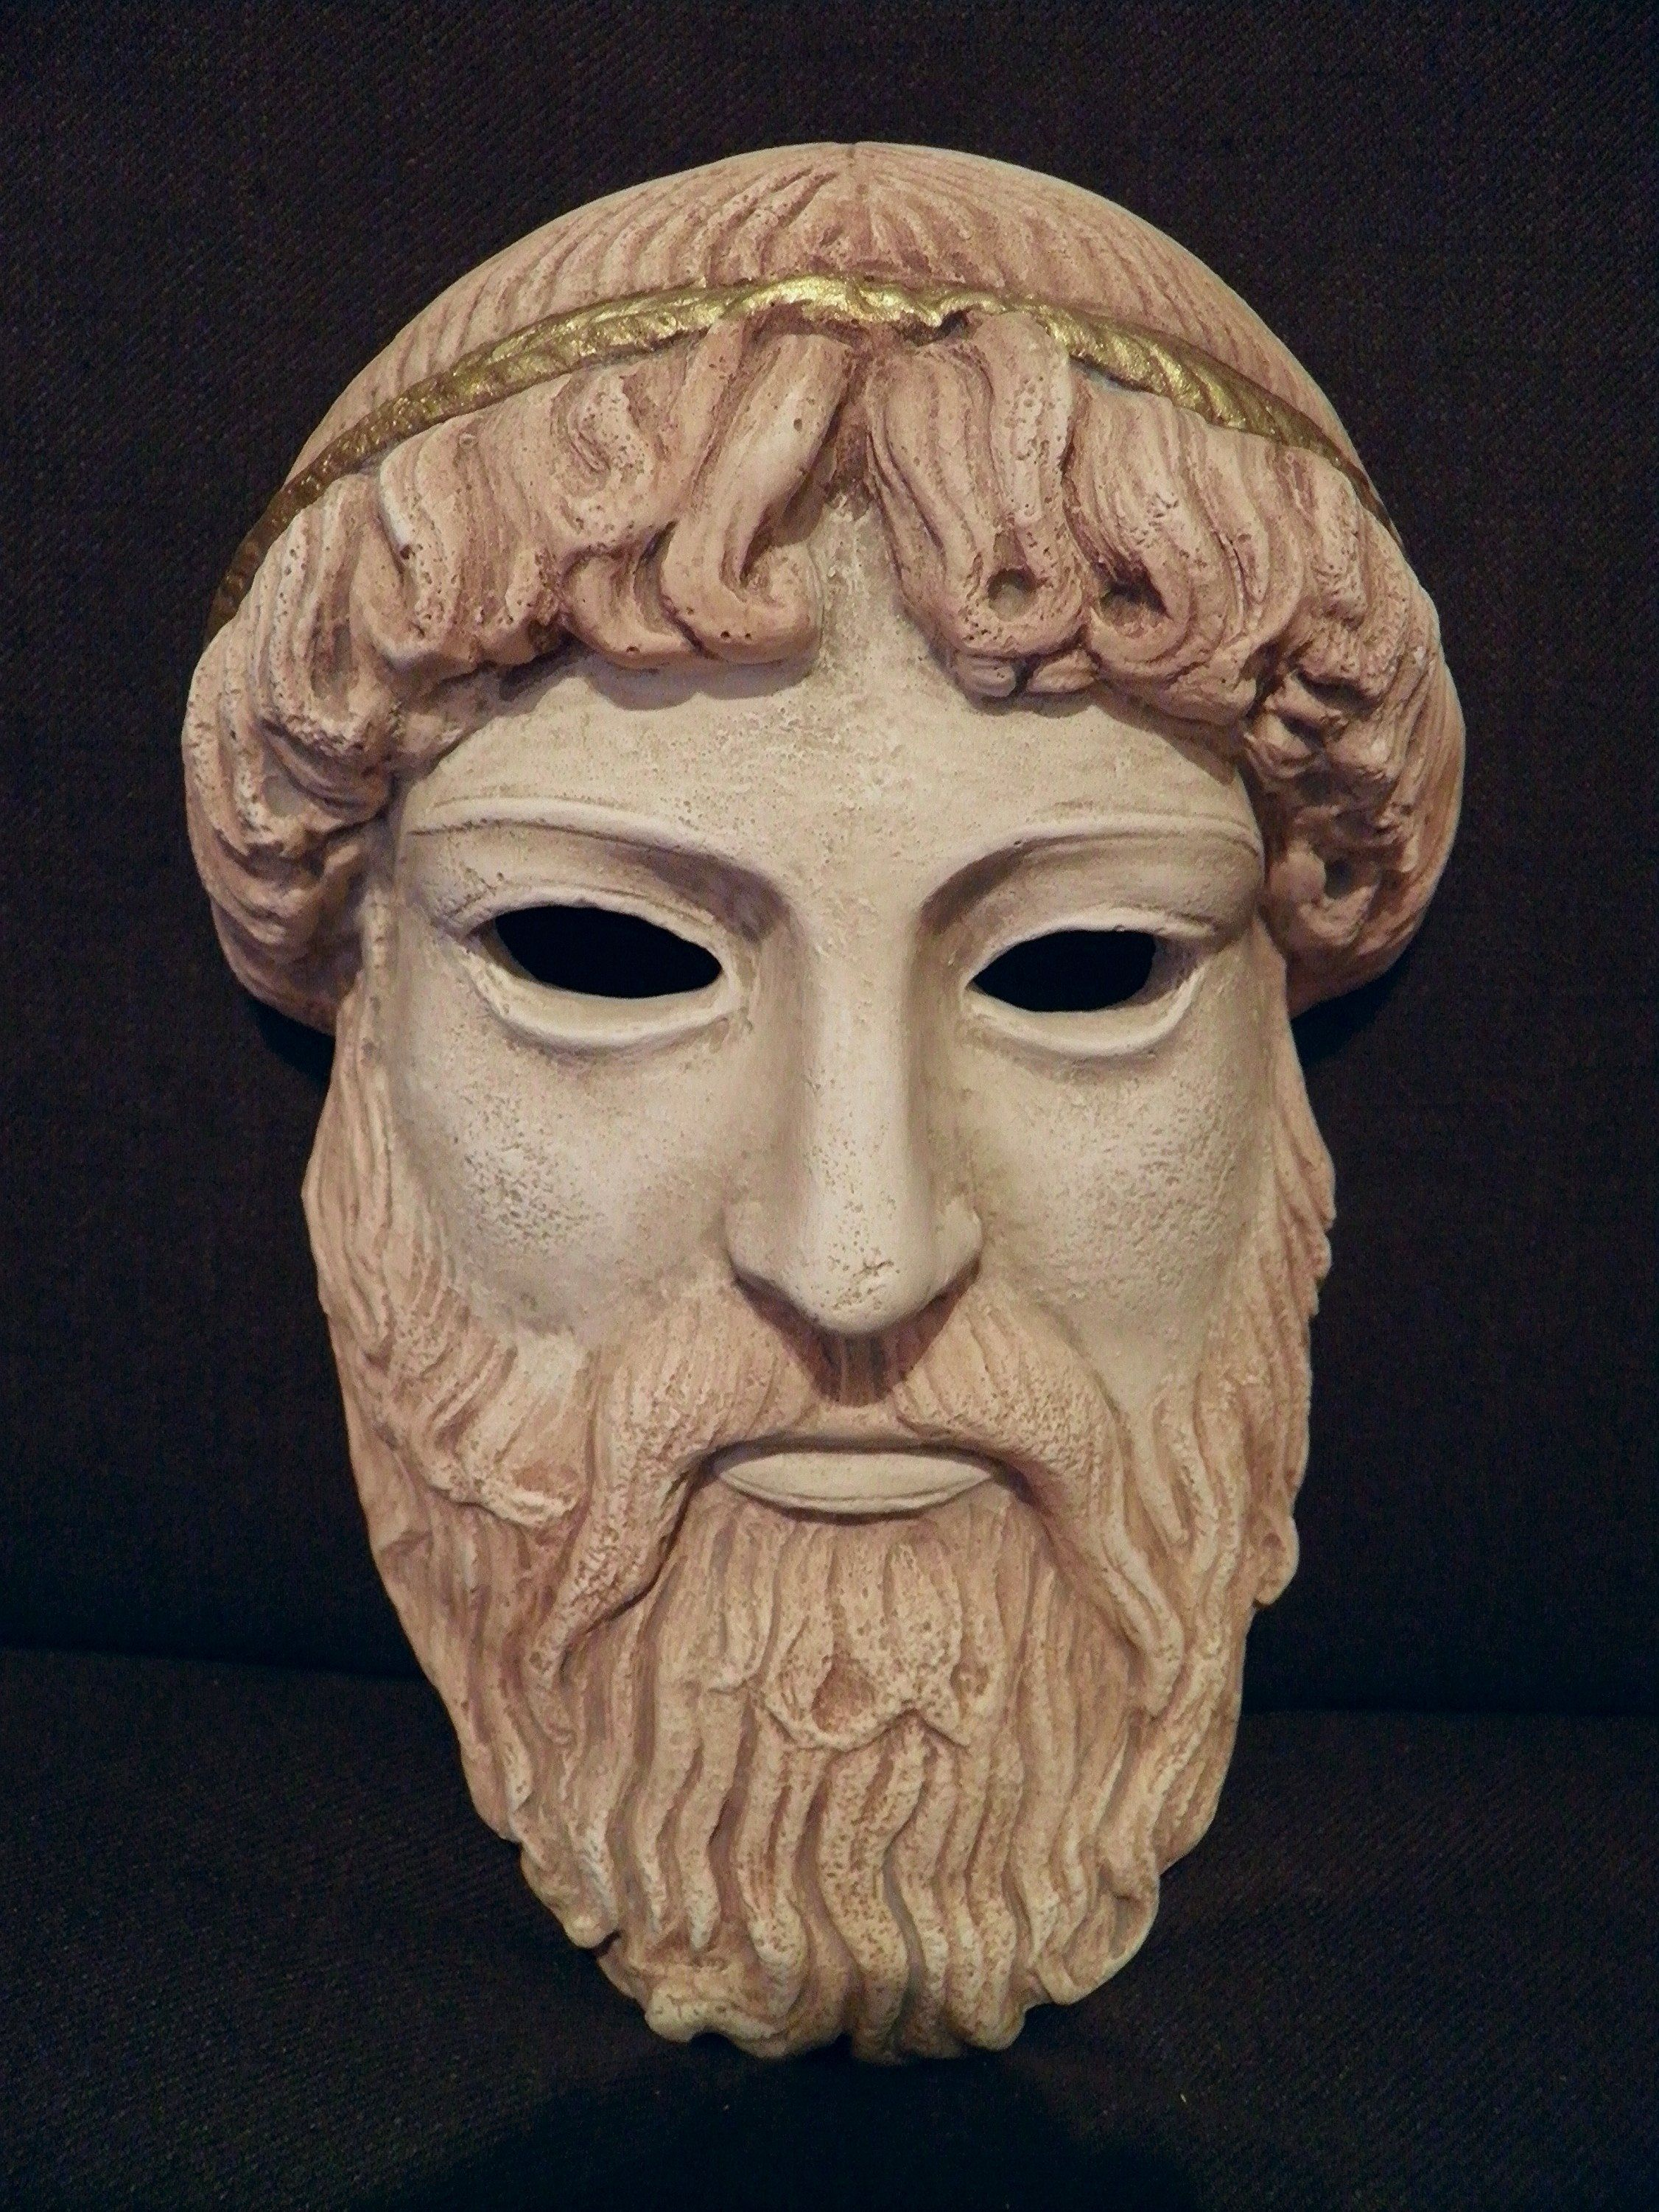
History of persona ficta
Roman law: collegia
The concept of person
Persona (prosopon) in the Greek theatre
Christian theology of person:
The God and a human being
Free will – Reason - Consciousness

Slide 21
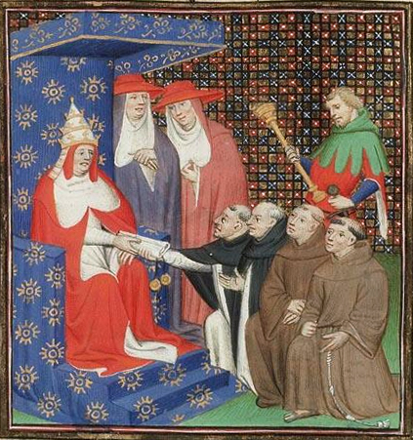
XIII century: monastery as persona ficta
Pope Innocent IV
The lack of soul –
no criminal nor delict liability

