Slide 1
Statutory interpretation
Fundamentals of Law & Government
Maciej Pichlak
Department of Legal Theory and Philosophy of Law
University of Wroclaw
Room 302A | maciej.pichlak@uwr.edu.pl
https://prawo.uni.wroc.pl/user/12147

Slide 2

Legal interpretation
The process of determining the meaning of legal rules.
Lex et ius
Ius:
  the totality of law
  ‚lawyers-made law’
  final legal decision
  Ius est ars boni et aequi.
  Celsus

Slide 3
Legal reason – a controversy
'God had endowed His Majesty with excellent science, and great endowments of nature ...' still 'his Majesty was not learned in the laws of his realm of England, and causes which concern the life, or inheritance, or goods, or fortunes of his subjects, are not to be decided by natural reason but by the artificial reason and judgment of law, which law is an art which requires long study and experience, before that a man can attain to the cognisance of it.'
Sir Edward Coke to King James I, in 1607
The first thing we do, let's kill all the lawyers.
W. Shakespeare, Henry The Sixth, Part 2, about 1590

Slide 4

Methods of interpretation in practice
No vehicles in the park.
An ambulance may go
into the park.
An ambulance crew
on a picnic?

Slide 5
Methods of interpretation (civil law)
literal
the linguistic meaning
-common rules
-typically legal rules
non-lingustic
systemic
rule as a part of a system
-features of system
-principles of system
- position of the rule in system
teleological
-axiological context
-pragmatic context
historical
-intention of
the legislator

Slide 6
Literal interpretation
(linguistic, grammatical)
„Literal interpretation (or textualism) may be defined as the action of explaining what a normative text conveys by looking at the usual meaning of the words contained therein. The literal interpretation of a clear and precise provision is the method of interpretation that best reflects the principle of legal certainty…”
Lenaerts and Gutierrez-Fons 2013
The doctrine of sens clair / acte clair and Clara non sunt interpretanda

Slide 7

When language is not enough…
Whosoever steps on grass, or destroys
plants, shall be subject to penalty of…
Standards of inconsistency or absurdity
→ Systemic or purposive interpretation

Slide 8

Systemic interpretation (systematic)
Need for the consistency and the completeness of system
The role of legal principles
„…each provision (…) must be interpreted in such a way as to guarantee that there is no conflict between it and the general scheme of which it is part”.
Lenaerts, Gutierrez-Fons
Argumentum a rubrica
During interpretation, the location of the rule in legal system should be respected.
→ Is industrial alcohol an alcoholic beverage?

Slide 9
Teleological interpretation
(purposive, functional)
Argumentum ad absurdum
One may not choose the interpretation that guides to absurd, ridiculous or unacceptable consequences.
Purpose or ratio legis
The rule should be interpreted in accordance with and with respect to its ratio legis/ purpose.
ratio legis: reasons for enacting the rule (its goal or value it serves)‏

Slide 10
Historical interpretation
The intention of historical legislator
The role of travaux préparatoires

Slide 11
Outcomes of interpretation
literal – narrowing – extensive
The principle of the priority of literal/ linguistic interpretation
The subsidiarity of non-linguistic methods of interpretation

Slide 12
Outcomes of interpretation
Extensive interpretation is usually restricted:
on exceptions (exceptiones non sunt extendendae)‏
on lex specialis rule
on rules limitating fundamental rights
in criminal law to disadvantage of the accused

Slide 13
The park revisited
No vehicles in the park.
An ambulance may go
into the park.
An ambulance crew
on a picnic?
Relations of methods: exceeding the literal interpretation

Slide 14


Relations of methods: the vagueness of language
Can a flatboat be a residential building?
Tax law

Slide 15
Relations of methods: a mutual support
When interpreting a provision, according to which ‘When a witness is staying abroad, a protocol of his previous confessions may be read in front of a court [without his or her direct presence]’, a court decided that this provision is applicable to witnesses who are staying abroad both permanently or temporarily. The court argued that:
according to the clear meaning of the interpreted rule there are no reasons to differentiate the situation of both groups of witnesses (these staying abroad either permanently or contemporarily);
the intention of issuing this rule was to ensure the swift and unimpeded course of criminal procedure, what reflects the general principles of the swiftness and the effectiveness of criminal trial, with which the proposed interpretation is consistent;
one should take into account the fact that the interpreted rule belongs to the law of criminal procedure. The interpretation proposed by the court is in line with the basic tenets of criminal proceeding, according to which a witness may be interviewed by proper authorities of foreign country (within the procedure of international legal aid), but such a solution is limited to exceptional situations, when confessions cannot be obtained in another way.

Slide 16
Methods of interpretation in common law and civil law
Civil law | Common law
Linguistic interpretation | Plain meaning rule
Systemic interpretation Purposive interpretation Historical interpretation | Golden rule Mischief rule

Slide 17
The plain meaning rule
„If the words of the statute are in themselves precise and unambiguous, then no more can be necessary than to expound those words in their natural and ordinary sense. The words themselves alone do, in such case, best declare the intention of the lawgiver”.
Sussex Peerage Case, 1844
The golden rule:
„In construing … statutes … the grammatical and ordinary sense of the words is to be adhered to, unless that would lead to some absurdity, or some repugnance or inconsistency with the rest of the instrument, in which case the grammatical and ordinary sense of the words may be modified, so as to avoid the absurdity and inconsistency, but no farther”.
Grey v. Pearson, 1857

Slide 18
The mischief rule
Four matters were required by the court to be ‘discerned and considered’, in order to carry out the ‘sure and true interpretation of statutes’:
(a) what was the common law before the making of the Act?;
(b) what was the mischief and defect for which the common law did not provide?;
(c) what remedy has Parliament resolved and appointed to cure the disease?;
(d) the true reason of the remedy.
(De Cruz 1999)

Slide 19
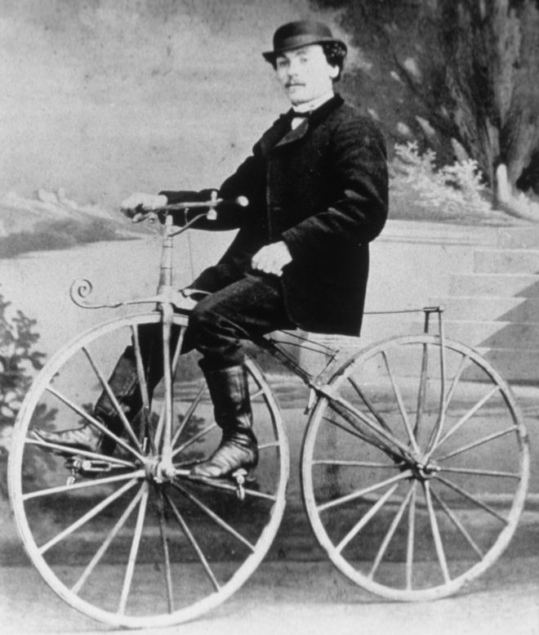

The mischief rule in pratice:
‘Is bicycle a carriage?’
Corkery v Carpenter [1951]
The Licensing Act 1872
It won’t be a stylish marriage,
I can’t afford a carriage
But you’ll look sweet upon the seat
Of a bicycle built for two.
„Daisy Bell” song

