Slide 1
Fundamentals of Law and Government
Basic Concepts
Part 2

Slide 2
Sovereignty
What is sovereignty?
Is there definition of sovereignty?
Is sovereignty limited?

Slide 3
Do we need a territory in order to be sovereign?
What is a difference between sovereignity and independence?
Are theories of sovereignity changing?

Slide 4
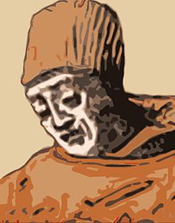
Marsilius Of Padua (Italian: Marsilio Or Marsiglio Da Padova; Born Marsilio Dei Mainardini or Marsilio Mainardini, c. 1275 – C. 1342)

Slide 5
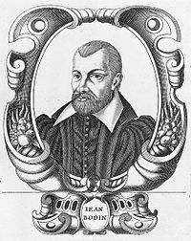
Jean Bodin (1530–1596)

Slide 6
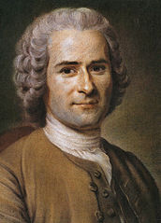
Jean-Jacques Rousseau (28.06.1712 – 2.07.1778)

Slide 7
Citizenship
What is citizenship?
How to acquire citizenship?
Are there different ways to acquire citizenship?

Slide 8
What is ius sanguinis?
What is ius soli?
What is iure matrimonii?
Are there some people that are excluded from citizenship?

Slide 9
Nation
What is nation?
Is there only one definition of nation?
What is the difference between a nation and an ethnic group?
What is political nation (civic nation)?
What is an ethnic (cultural) nation?

Slide 10
What is the origin of nations?
What is the difference between nationality and citizenship?
What is patriotism?
What is multiculturalism?

