Slide 1
Fundamentals of Law and Government
Government and its Ideology

Slide 2
Ideology
What is ideology?
What is the origin of the concept of ideology?
Do we, as individuals, have an ideology?
Is it possible to be free from ideology?

Slide 3
Doctrine
What is doctrine?
What is political program?

Slide 4
Right wing and left wing
What is the difference between right wing and left wing political parties?
Where and when had the division between right and left originated?

Slide 5
Norberto Bobbio’s view on the political spectrum
Totalitarian left
Moderate left
Moderate right
Equality
Hierarchy
Liberty
Totalitarian right
LIBERTY
CENTER

Slide 6
Krzysztof pomian’s view on the political spectrum
Socialdemocracy
Authoritarian right
Democratic
left
Democratic
right
Communist
Fascist
Equality
Liberty
Hierarchy

Slide 7
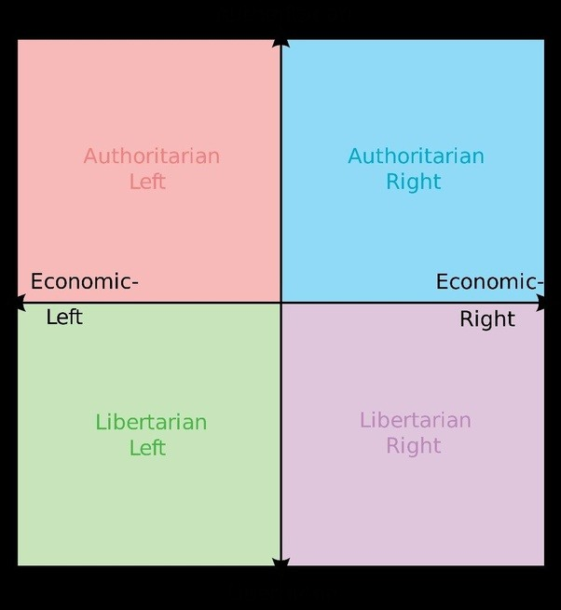
Political spectrum according to libertarians

Slide 8
Political culture
What is political culture?
What are pure types of political culture according to Verba and Powell?

Slide 9
Socialisation
What is political socialisation?
What are the factors of political socialisation?

