Slide 1

HUMAN RESOURCE MANAGEMENT
Lecture No 1

Slide 2
Office hours
Justyna Mielczarek-MikołajówPhD
https://prawo.uni.wroc.pl
Please check out our pages on University website for more details
marcin.stasz@uwr.edu.pl
Friday 11:30 - 13:30, room 502A,
Marcin Stasz
justynamielczarek5@wp.pl
Wednesday 15.20-17.20, room 404A,

Slide 3
Course schedule
8 lectures (4 th of March – 10 th of June)
1.Organisation issues, basic information about the subject
4. Team management
5. Motivation
6.New technology of human resorce management
3. The process of managing people; conflict in the organisation
2.The concept of organisation, culture of organisation
6.Selected modern concepts of human resources management
7. Test – 30 questions, muliple-choice test, 16 points to pass the test

Slide 4

Organisations issues
Presentations from lecturers
Literature:
1) J. Beardwell, T. Claydon
Human Resource Management. A contemporary Approach, 2007.
2) R.W.Griffin, Management, 2012.

Slide 5
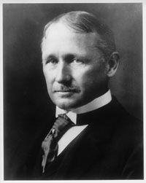
History of Human
Resource Management
The classical school – direction: scientific
management(1885-1920)
was represented by F.W.
Taylor, L.F. Gilbert and
H .L. Gant. who focused
people’s attention on the labor productivity model.
They saw the need for proper selection of employees

Slide 6

Taylor/tailor?

Slide 7

History of Human
Resource Management
F.W. Taylor introduced numerous innovations in the way of designing work stations and in the way of empleyee training.
He pointed the need for training and cooperation between employees and managers.
F.W. Taylor introduced a piecework pay system
PRODUCTON PAY
The basis of the scientific method of this school was observation, experiment and expierience.

Slide 8

How to do something faster?

Slide 9

History of Human
Resource Management
Gibert’s developed several
methods that would allow the
bricklayer to work more efficiently.
They changed the details of bricklayer’s work. The result of these changes was the reduction in of the number of movements from 18 to 5 and an increase in work
QUIZ: How much the efincience of workers will increase?
a) 50% b) 100% c) 200%
But generally school of science management focused people’s
attention on the labor productivity model. They saw the need of
proper selection of employees
.

Slide 10
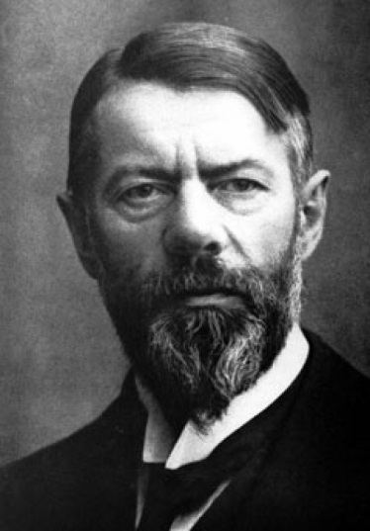
History of Human
Resource Management
Classical school of management – administrative direction (1920-1950 e.g. M. Weber, H. Fayol, they dealt only indirectly with human resouces).
M. Weber costructed a model of bureaucrracy which was the ideal type for him .
  Along with Émile Durkheim and Karl Marx
  he is regarded as founder of sociology
M.Weber

Slide 11
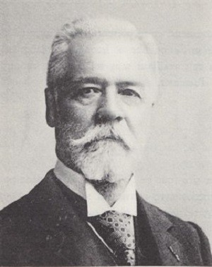
History of Human
Resource Management
Classical school of management ( 1920-1950) e.g. H. Fayol, M. Weber they dealt with human resources only indirectly.
This shows Fayol's 14 principles which indicated the authority, division of labor,
responsibility, discipline, salary etc.
H. Fayol

Slide 12
Manager's competences
 | small enterprise | medium enterprise | large enterprise
Administrative skills/talents | 25% | 30% | 40%
Technical skills/talents | 30% | 25% | 15%
Trade skills/talents | 15% | 15% | 15%
Others: financial and accounting skills/talents | 30% | 30% | 30%

Slide 13
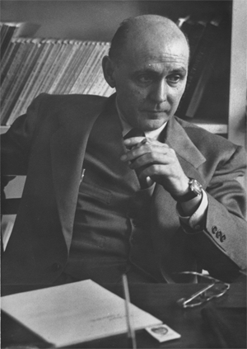
History of Human
Resource Management
School of interpersonal relations 1930-1950 (E. Mayo, F.J. Roethlisberger) conducted research on the impact of work organization and an adequate pay on the increase in pay productivity. Some factors, for example, relation between employees may have more E. Mayo impact on the employee than financial factors

Slide 14
History of Human
Resource Management
The Behavioral School (the 1950s) continued and changed the achievements of the school of interpersonal relations (Ch. Argiris, R. Likert, and Mc Gregor). They investigated tensions between traditional organizational structures and the individual needs of employees

Slide 15
History of Human
Resource Management
Human resource development after second war: There are important issues related to the protection of work, humanization of work or employee participation and their work organization
The image of the employee changes - attention is paid to the employee's potential, its development.
.

Slide 16
History of Human
Resource Management
Models of human resource management
Michigan model Harvard model

Slide 17
Michigan model
This model would be described as ‘hard’ HRM because it emphasises treating employees as a means to achieving the organisation’s strategy, as a resource that is used in a calculative and purely rational manner.
In this concept, the company's strategy is of paramount importance.

Slide 18
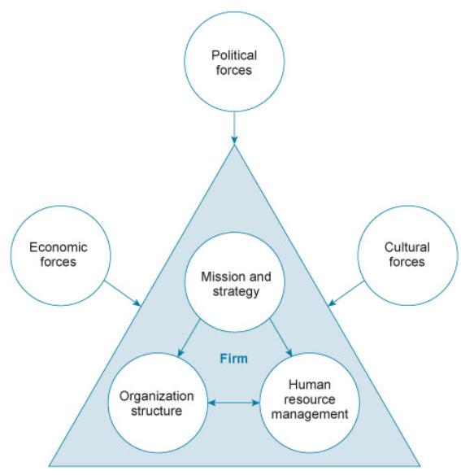
Michigan model

Slide 19
Michigan model
In this model, we distinguish four forms:
_e_e_ _ _ _ n,
a _ _ r _ _ _ a _
r _ _ _ _d.
_ _ v_ _ o _m _ _ t

Slide 20
Michigan model
In this model, we distinguish four forms:
s e_e_ t i _ n,
a p _ r _ _ s a l
r _ w a _d.
d _ v e _ o p m _ _ t

Slide 21
Michigan model
In this model, we distinguish four forms:
SELECTION – finding the most suitable employees in order to meet business needs
APPRISAL – monitoring perfomance and providing feedback to the organisation and its employment
REWARD – ?
DEVELOPMENT – evolving the skills and knowledge required to meet buisness objectives.

Slide 22
Michigan model
 | SINGLE-PRODUCT COMPANY | MULTI-DIVISIONAL STRUCTURE
SELECTION | its people on the basis of their EXPERTISE | systematic and according both functional EXPIERIENCE and GENERAL MANAGMENT ABILITY
APPRAISAL | INFORMAL, administered via contact | FORMAL, impersonal based on quantitative criteria such as productivity and return on investment and on qualitative, subjective, judgments about individual performance
REWARDS | UNSYSTEMATIC across the function and employee development | SYSTEMATIC reward contribution to be diversification trategy, and it’s likely that bonuses would be granted according to achievment of profitabilility targets
DEVELOPMENT | will be limited primarily to the FUNCTIONAL across the employee works | MORE COMPLEX AND SYSTEMATIC– employees are accustomed to being periodically tranfserred to diffrent functions and areas of business

Slide 23
Harvard model
In this model, we distinguish the following management areas:
employee participation,
employee mobility,
remuneration systems,
work systems.

Slide 24

Harvard model
Variant clan
Variant bureaucracy
Variant market

Slide 25

Harvard model
participates in the life of the
organization employee takes part
in projects
CLAN VARIANT
employee variant is treated as height of salary depends on
a member of the organization, the duration of the employees
work and their share in the
organization's profits.

Slide 26

Harvard model
BUREAUCRACY VARIANT
the employee is treated as a subordinate.
The possibility of participation is only in the official way
The salary is determined based on the job requirements.
In this variant there is a high degree of division of work and integration through the hierarchy.

Slide 27

Harvard model
MARKET VARIANT
Employee as a contractor
Participation is determined by the framework of the employment contract.
Acceptance and dismissal depends on the needs of the organization.
The basis for remuneration are the effects of work. Employees get tasks or other orders

Slide 28

The problem in defining

Slide 29
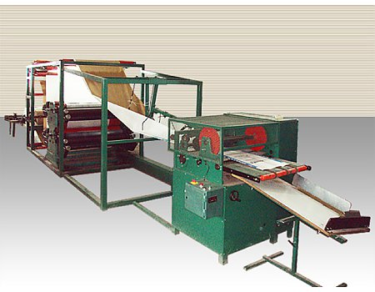
Resource
That’s a certain amount of something
That has been accumulated for future use
This is something that can be used in the future, a resource can mean an effort e.g.a work machine, but it can also affect certain assets

Slide 30
Human Resorce Managemant
The concept of management in the area of personal services. It assumes that human resources are an asset of the company and a source of competitiveness.
is the strategic approach to the effective management of people in an organization, so that they help the business gain a competitive advantage. Commonly known as the HR department, it is designed to maximize employee’s performance in service of an employer's strategic objectives.

Slide 31
Human Resorce Managemant
Features of human resources:
human resources can be a source of competitive advantage,
the human resources strategy is often integrated into the organization's strategy,
line managers should be active in planning and organizing, managing and controlling - a way of decentralization,
the importance of organizational culture
developing direct forms of participation.

Slide 32
QUESTIONS ☺
Who intrudeced a piecework pay system?
H. Gant b) E. Mayo c) F.W. Taylor
2) In which variant the employee is treated as a member of the organization?
clan variant b) bureucracy variant c) market variant
3) Who was the representative of the behavioral school?
a) E. Mayo b) M. Weber c) H. Fayol

Slide 33

Strategy in human resource management

Slide 34
Organising chaos
Strategy introduce coherent vision of organisation
Highlights need of both long-term and short-term planning
Sequence of actions
Maximizing profits and efficiency
Reduction of uncertainty

Slide 35
Strategies...
… overall plan of realisation of objectives of organisation in long-term perspective
… general mission of organisation
… include process of analysing strong and weak points of organistaion
… determines place of organisation in society

Slide 36
Types of strategy
The systematic approach
The processual approach
The evolutionary approach
The classical or rational-planning approach

Slide 37
The classical or rational-planning approach
Emerged in 1960's
Formal and planed strategy
Profit maximisation
Fitting internal plans to external contexts
Analitical character of process

Slide 38
The processual approach
Emerged in 1970's
Crafted and emergent strategy
Focus on internal politics
Acknowledging limitation of human being
Psychological factors

Slide 39
The evolutionary approach
Emerged in 1980's
Efficient strategy
Natural selection
Survival of the fittest
Market based aproach

Slide 40
The systematic approach
Emerged in 1990's
Shaped by social and cultural factors
Focusing on external condins conditions
Local character
Embedded strategy

Slide 41
Strategy in the context of human resource management
Employment policy
Plan of recruitment
Analasis and valuation of existing workplaces
Methods of mobilising employees
Training planning
Carrier planning

Slide 42
Strategic human resource management
Attracting, developing, rewarding, and retaining employees
Benefit of both te employees and the organisation as a whole
Interaction between departments
Increasing chance of success

Slide 43
Steps to strategic human resource management
1. Understanding objectives of organisation
7.Evaluation and corrective action
6. Implementation of human resource management strategy
5.Determining the tools required for employees to complete the job
4.Estimating frequency of future requirements
3. Analysis of current capacity of employment in context of mission and goals
2. Evaluation of capability

Slide 44
Links of photos
http://zarzadzaniekapitalemludzkim.blox.pl/2013/07/Zarzadzanie-zasobami-ludzkimi-w-sposob.html
http://www.swietlicachelmek.pl/wp-content/uploads/2013/11/ksi%C4%85zka1.jpg
http://virtualacademy.pl/blog/2015/03/10/zarzadzanie-zmiana/
http://www.piast.neostrada.pl/strona22.html
http://www.authorstream.com/Presentation/shafqalam-2099720-managment-mobilink/
https://opakowania.com.pl/oferta/mnv-maszyna-do-produkcji-workow-papierowych-547373.html
http://biblioteka.pelplin.pl/aktualnosci/grudniowe-pogadanki-filozoficzne-z-eureka/attachment/znak-zapytania/
https://library.stevens.edu/archives/special-collections/fwtaylorcollection
https://www.flickr.com/photos/lucgaloppin/6077586841
http://nextews.com/0f2f1818/
http://paulooliveiramartins1967.blogspot.com/2012/11/unit-1-michigan-model.html
https://gospodarka.dziennik.pl/praca/artykuly/461826,noz-w-plecy-tak-pracownicy-niszcza-firmy.html
https://m.interia.pl/biznes/news,1972138
http://www.praca.egospodarka.pl/135042,Wynagrodzenia-pracownikow-produkcyjnych-Jakie-stawki-i-premie,1,55,1.html
https://www.economist.com/news/2009/01/09/max-weber

