Slide 1

Human Resource Management
Lecture No 3
Justyna Mielczarek-Mikołajów PhD
mail: justynamielczarek5@wp.pl

Slide 2
What does it mean?
Management
Guidance
Targeting

Slide 3

Management?
Is managing a profession?

Slide 4
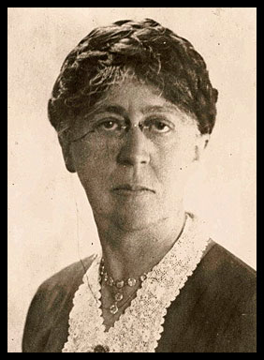
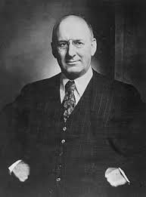
Management is art
Presentative | Argumentation
Marry Parker Follet | skill, skill, in the performance of something artistic; concept related to intuition, artistic vision.
Henry M. Bottinger | the art of ordering chaos, the components of management: the vision of the artist, knowledge of the craft effective communication; a real art can be mastered only when the innate skills are taught (e.g. the ability to sing, paint, direct)

Slide 5
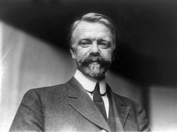

Management is knowledge
Presentative | Argumentation
Luther Halsey Gulick | It’s is a field of knowledge that allows a systematic understanding of the essence of collaboration between people to achieve goals and to increase the usability of interoperability systems; this knowledge could indicate to managers how to deal with specific situations
Daniel Katz | He was in favor of the dominance of knowledge over skills. He described technical skills that must be mastered by a candidate for a manager so that he can effectively manage subordinates; schools and fields of study are created regarding the teaching of organization and management

Slide 6
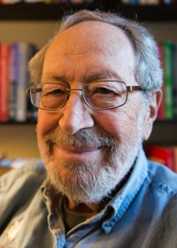
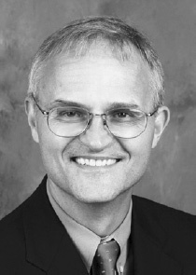
Is management a profession?
Presentative | Argumentation
Edgar H. Schein | It’ is a free-lance profession, because as in other free-lance professions, such as a lawyer or a doctor, managers should be guided by general rules of conduct, thanks to which they gain a professional position, they must follow a code of ethics to protect their clients.
Borje O. Saxberg | It is necessary to personally dedicate and give back commit to the profession - the regulations introduce the irregular working hours of employees.

Slide 7
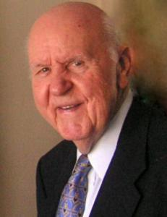
” The myth of educated managers”
1960s and 1970s (graduates of teaching schools connected with science of management were disappionted that knowledge alone is not enough)
Characteristics:
teaching puts emphasis on analytical ability (solution to the problem and making a decision); you should also teach how to predic problems and opportunities; features of an effective manager: has the need to guide, has the need for power (concept of J.S. Livingstone)
.

Slide 8
Result of questionnaire

Slide 9
Result of questionnaire
NO, because… | YES, because…
risk is too much | - like working with the team; respect others people and their opinions - want to be a manager who works with workers with pride as a teammate - contribute for the better and efficient team work - want to care about workers- be ready to listen, always curious about problem and spot talents
manager is under the boss and I wouldn’t like to be under someone | - want to control employees and give orders - want to control to business in every field - want to make decisions and be not only a worker - hope that renumeration for this job will be enough for such a responsability and highly time-consuming work
it’ s a difficult proffesion, too much responsability | -want to solve different problems
I have better skills to be a supporting member than manager | - being a manager all0ws to develop soft skills and creativity - have abilities and set of skills needed - it’s good way to improve competence and gain more knowledge - have already had the opportunity to be a manager
I want to be an international lawyer | - binge a manager gives a lot of joy, it’s an interesting job - love managing, oraganizing and taking responsability - enjoy leading and learning new skills - like being a leader

Slide 10
Features of a manager
What should a good manager mean?

Slide 11
Result of questionnaire
What features should a good manager have?
well-organized
open minded
should be able not to be influenced by emotions and personal opinions or other perjudices
should be decisive
self-confident
educated
kind
solution-oriented,
good at leading people,
have soft skills and hard skills (knowledge),
be a professional
open-minded, but decisive
creative, but not doing all the work by themselves
guiding, not commanding
demanding even to themselves in the first place
be an active listener, learner and navigator
personable and theire when needed
not look down on others who may not be as skilled or as fast
at a task , but rather encouraging
strong
is able to lay down the rules expected in a proffessional yet kind way
leadership
productivity
personal skills
should have good relations with workers and listen to employees
Should be a propagator for them
is a strong leader with a clear understanding of the situation inside and outside the company
is a critical thinker and a leader
should know how to solve conflicts
respect people and their opinions
be comunicative
have knowledge about business
take responsibility for decisions
have good relations
listen to his employees
should be prepered to make good decisions

Slide 12

Result of questionnaire
What features should a good manager have?
creativity
communication skills
intunition
has knowledge
leadership
discipline
organizational
keeping equality
creating friendly atmosphere
punctuality
fast reaction
good decision making
fair understanding
strict if it’s nesecary
strict
open mided
experienced
intelligent
humanity
has a knowledge, expierience
should be friendly, kind and nice
first leader
knows employees – can replace them in every case istead of just managing good working conditions
has cooperation skills
is decisive
is aware of responsability
is charismatic
responsible
thorough
wise
reliable
unbiased
objective
should have many features such as: leadership, communication, organizational, time management and additional certificates
has plenty of skills such as: expierience, knowledge, time managament, leadership – should lead employees
open-mided
organized
open to others opinions
making decisions
honesty
inspirational
comitted
decisive
listener
creative
leadership
knowledge
expierience
team management
reliability
respect for employees
has a good plan for employees
should have lots of patience
is able to work out each individual problem
is open to criticism
isn’t be afraid to make hard choices
is patient
get along with
energetic
searcher
open-mided
organised
open to others’ opinions
making decisions

Slide 13

Features of a good manager
coaches their staff and counsels those who need it
has comitted staff
delegates wherever possible
takes the lead
raises staff morale and is concerned about
staff wellbeing
actively likes to develop, empower and motivate staff and manage underperformers
is aware of the psychological contract
enjoys his work
seeks response and feedback to all communications with staff
knows how to resolve conflicts as they arise and handles negative behaviour effectively

Slide 14
The seven Qualities of a Good Manager
Negotiations - especially with external entities, eg suppliers, sponsors. It’ s also important how to negotiate and it’s your responsibility to find a technique that works
Team building - the manager must properly choose people for the team.
Time Management – Time is money and always has a deadline
Organization - the manager should be an expert in managing funds, money, time, team
Task Management – This one is obvious. It’s a critical project management skill. If a manager can’t get the tasks done, the project may fail.
Communication
is a two-way road, with as much emphasis on listening as there is on talking.
Conflict Resolution – conflict in an organization is normal. Manager should put a team together and there will be conflicts which you’ll have to resolve fairly and quickly to keep the project on track.

Slide 15
Features of a good manager
Managing people involves being in control
What does it mean?

Slide 16
Concept of managerial roles division
"The Nature of Managerial Work” H. Mintzberg
Information roles Intepersonal roles
Decision-making roles

Slide 17

Information roles
the role of a representative - usually includes more substantive activities. Manager acts as a company symbol ceremonial and symbolic than in relations with the environment, represents the company at national and international conferences, participates in public meetings
the role of the leader - achieves the company's goals through a specific type of motivation applied to employees. He trains, leads the group, company staff, manages, motivates and evaluates employees
the role of the connector (intermediary) - coordinates interpersonal, intergroup and international activities. It maintains relations between the company and the environment on which its functioning depends, advertises and promotes its company in order to acquire clients or contracts.

Slide 18

Interpersonal roles
the role of a spokesperson - it represents the interests of the ‘organization, presents specific issues and problems before outsiders. Manager talks with professionals and professional groups, representing a specific field of knowledge.
THE ROLE OF PROPAGATOR- it provides relevant information to their subordinates in order to enable them to carry out their tasks. Presents a plan of action to colleagues, compiles and sends reports, periodicals and letters.
the role of an observer (expert, specialist) - actively searches for data related to the functioning of the company, registers and analyzes information coming from inside and outside the organization. Manager reads professional magazines related to the specificity of the company, participates in business trips.

Slide 19

Decision-making roles
The role of entrepreneur –
voluntarily initiates changes,
uses all opportunities for the development of the organization. Manager develops new innovative ideas. a role that counteracts interference - it eliminates disturbances and conflicts that may occur in the organization. He deals with such matters as strikes, copyright infringement, etc.
THE role of resources' dispatcher - makes decisions on the method of distribution of resources. It reviews budget requests.
the role of negotiator – a manager negotiates with other groups or organizations as a representative of the company. He can both negotiate a contract with a contractor as well as act as a mediator in disputes between subordinates.

Slide 20
Result of questionnaire
How should the manager make decisions?

Slide 21
Result of questionnaire
Are there any issues in which the manager should make decisions himself?
Those decisions which need specific knowledge
Decissions connected with; budget, future investments
When the situation is hard/difficult and when workers aren’t competent enough to solve the problem and make decision
High-risk decisions
When the decisions should made quickly and honeslty
It’s hard to say- it’s depends on the situation
If it’s comes to a dissmising an employee
Last decision – because all responsibities are on him
The last word should by made by the manager
When there are no conectic answer from top managers
When the decision concerns on manager
Each of decisions should made by managers

Slide 22
Sources of power
intepersonal sources of power - the possibility of rewarding and punishing, the possibility of exerting influence on the basis of applicable law
structural sources of power - refer to the division of labor and human capital available to the manager. The manager may influence his subordinates in various ways: appeal, persuasion, consultation by developing various forms of participation, creating coalitions, pressure by making demands

Slide 23
Authority
It is hard to imagine that someone who does not have this authority is in charge.
M. Weber distinguished the authorities:
traditional - transferred from generation to generation
charismatic - resulting from the personal characteristics of the leader
bureaucratic - it results from the law and formal rules in force in the organization

Slide 24
Problems with the concept: managment
Meaning of managment:
Functional meaning:
(1) the process of supervision and/or control and coordination of social and production activity in the organization,
(2) managment (leadership)
Identical concepts: managment, leadership and governance – different interpretations of the concepts.

Slide 25
Managment and Leadership
M < L
(1) Managment is a narrower concept
(2) Managment is a broader concept
(3) Management and leadership mean the same
M > L
Z = K

Slide 26
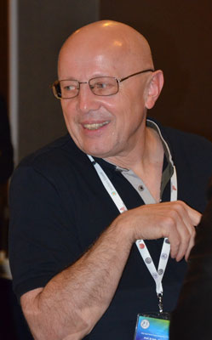
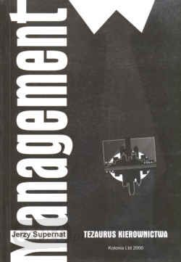
Managment and Leadership
The Polish eqivalent of
managment should in
general mean leadership
(because of its ambiguous: substansive and
operational meaning)
Jerzy Supernat, Management.
Tezaurus kierownictwa, Wrocław 2000, p. 287.

Slide 27

Management technique by purposes assumptions
achieving the organization's goals is
possible thanks to focusing on the
cooperation between the employer and the employees
achieving goals employees are rewarded for
employees who perform specific tasks achieve their goals
effects of work are measurable
problems that reduce the organization's efficiency are measurable

Slide 28
Harzburg model
The Harzburg Model illustrates a distinctive adaptation of Management by Objectives to the German cultural and economic condidions
The Harzburg Management Model based on:
knowledge,
performance,
delegation of competences,
advantages and limits,
improving proces.

Slide 29

Harzburg model
The main principle of this model is delegating responsibility.
This means that certain task areas should be transferred along with competences and personal responsibility to the lower levels of the organization
The superior bears managerial
responsibility.
The employee is responsible for
the actions taken by him/her.

Slide 30
Technique of managing people
Management by inspiration - passing patterns, behaviors;
inspiring subordinates
Management by exceptions - typical tasks are performed by employees at lower levels of the structure, non-standard tasks are performed by people occupying higher levels of the organization
Management by motivation – stimulating employees, engaging employees in many ways

Slide 31
Result of questionnaire
How should the manager be chosen
By directors, „higher ups”, head of the company (30%)
Shouldn’t be chosen by everyone
By employees (30%)
By employees and other managers
By voting on mutual decisions
It’s hard to say- depends on the situation

Slide 32

Leadership

Slide 33
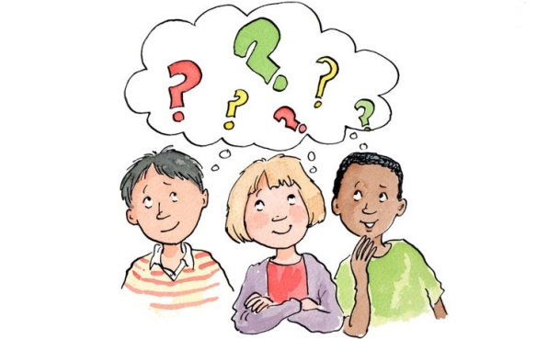
Leadership problems for discussion
Leadership – in the past and now
are there any differences
What does it mean to be a leader
Who is an ideal leader for you
Is leadership dependent on nationality and culture
Is there a universal definition of an ideal leader
?
?
?
?

Slide 34
Leadership theories
THEORY | DISCRIPTION
Great Man Theories | the capacity for leadership is inherent – that great leaders are born, not made; leaders are simply born with the necessary internal characteristics such as charisma, confidence, intelligence, and social skills that make them natural-born leaders
Trait Theories | People inherit certain qualities and traits that make them better suited to leadership. This theory often identifies a particular personality or behavioral characteristics shared by leaders. For example, traits like extroversion, self-confidence, and courage are all traits that could potentially be linked to great leaders.
Contingency theories | According to this theory, no leadership style is best in all situations. Truly effective leadership is not just about the qualities of the leader, it is about striking the right balance between behaviors, needs, and context. A leader should know how sobordinates take stock of the situation, and then adjust their behaviors accordingly to a situation.
Situational Theories | Leaders choose the best course of action based upon situational variables. Different styles of leadership may be more appropriate for certain types of decision-making.

Slide 35
Managing /leadership styles continuum of managing styl
An authoritative Democratic style of management style of management
The superior acts authoritatively The superior gives freedom to the subordinates
1 | 2 | 3 | 4 | 5 | 6 | 7
The superior makes a decision and announces it | The superior sells decisions | The superior offers ideas and expects questions | The superior offers examples of decisions that can be changed | The superior addresses the problem, looks forward to the proposal, then makes decisions | The supervisor indicates the boundaries; the group accepts decisions | The superior allows employees to operate freely within the limits set by the organization

Slide 36
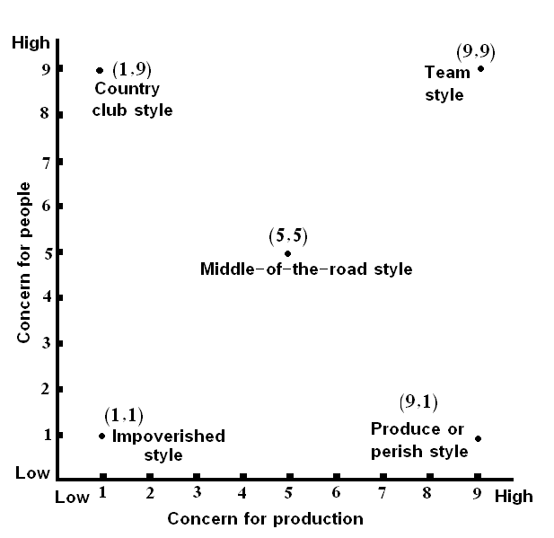
Concept’ s of Blake and Mounton
(management grid)

Slide 37
Concept’ s of Blake and Mounton
(management gird)
 | Name of style | Description
1.1 | The indifferent (impoverished or passive style ) | low human and task orientation, the style is not employee friendly; this style aims at preserving job and job seniority, protecting themselves by avoiding getting into trouble.
1.9. | The accommodating style (country club or club style) | yield and comply; great atmosphere at work; high concern for people and a low concern for production; this style devotes much attention to the security and comfort of the employees
9.1. | The dictatorial (autocratic) style | control and dominate; With a high concern for production, and a low concern for people
5.5. | The compromise (tatus quo, middle-of-the-road) style | balance and compromise; this style tries to find balance between company goals and workers' needs
9.9. | The involved style | high concern is paid both to people and production; this style encourages teamwork and commitment among employees.

Slide 38
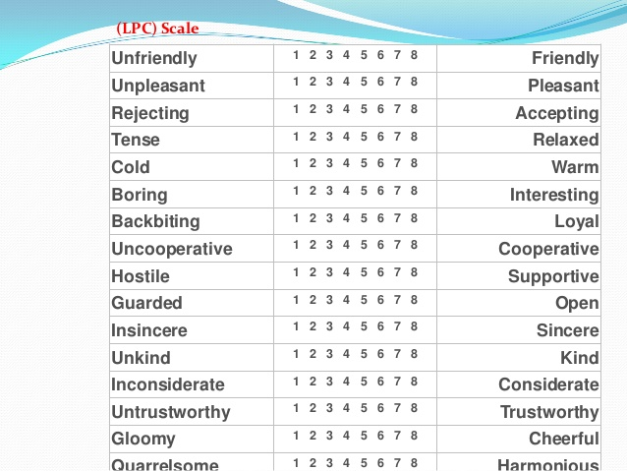
Fiedler's Contingency Model

Slide 39
Fiedler's Contingency Model
The Fiedler Contingency Model was created in the mid-1960s by Fred Fiedler, a scientist who studied the personality and characteristics of leaders.
The model shows that we can’t distinquash one best style of leadership. Instead, a leader's effectiveness is based on the situation. This is the result of two factors – "leadership style" and "situational favorableness" (later called "situational control").
Leadership style is fixed, and it can be measured using a scale he developed called Least-Preferred Co-Worker (LPC) Scale
Previously you estimate how you feel about this person for each factor, and add up your scores. If your total score is high, you're likely to be a relationship-orientated leader. If your total score is low, you're more likely to be task-orientated leader.
The model says that task-oriented leaders usually view their LPCs more negatively, resulting in a lower score. Fiedler called these low LPC-leaders. He said that low LPCs are very effective at completing tasks.

Slide 40
What’s the organizational conflict is ?
Organizational Conflict or otherwise known as workplace conflict, is described as the state of disagreement or misunderstanding, resulting from the actual or perceived dissent of needs, beliefs, resources and relationship between the members of the organization. At the workplace, whenever, two or more persons interact, conflict occurs when opinions with respect to any task or decision are in contradiction.

Slide 41
Why are there conflicts at work?
Unclear
responsability
Interpersonal Relationship
Communication Disruption
Conflict of Interest
Scarcity of Resources

Slide 42
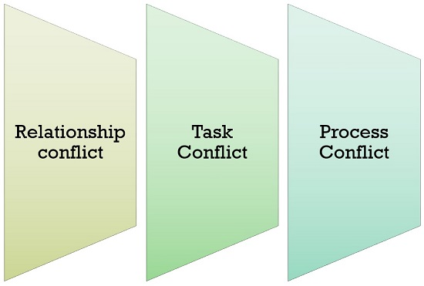
Types of Organizational Conflict
Source: https://businessjargons.com/organizational-conflict.html

Slide 43

Can conflict be avoided?

Slide 44
M.P. Follet’s concept
Mary Parker Follett is one of the representatives of the humanistic trend.
She advocated a new approach to management, defined as a comprehensive integration and situational approach. She was also one of the first people to analyze the psychological aspects of conflicts in organizations.
She formulated the so-called law of the situation that "commands should consist of decisions of those who give them and those who receive them". Associates should approach each situation as partners, not as subordinates and superiors. Follett thought that conflicts were something completely normal. What's more, they can even bring benefits to interested parties, if they can rationally solve it (through integration or compromise). Otherwise, a very dangerous phenomenon called "latency of conflict" may occur. Conflict can manifest itself in the least expected moment for the organization, with a force that will prevent its resolution. What's more, according to Follett, conflicts can not be avoided. You can try to get the potential and creativity out of them

Slide 45
Result of questionnaire
How should the manager react to a conflict between emplyees
Should resolve the probem so that it didn’t affect badly the employees work
Be nautral and solve the problem with the brain and without extra emotions
Should talk to employees and hear both sides (and then resolve the situation from his point of view)
Shold be honest, explain the problem, create friendly atmosphere between emplyees

Slide 46
Links (photos)
https://www.google.pl/search?q=role+interpersonalne&source=lnms&tbm=isch&sa=X&ved=0ahUKEwi8s-jAu4bhAhWmiIsKHT5GC0YQ_AUIDigB&biw=1366&bih=657#imgrc=H-BnH0QeobmcWM:
http://prawowity.pl/aktualnosci/18/1,,36/
https://www.google.pl/search?q=role+interpersonalne&source=lnms&tbm=isch&sa=X&ved=0ahUKEwi8s-jAu4bhAhWmiIsKHT5GC0YQ_AUIDigB&biw=1366&bih=657#imgrc=GICfCBDveNDutM:
https://analizafinansowa.pl/controlling/umiejetnosci-interpersonalne-w-pracy-analityka-i-kontrolera-finansowego-rola-i-znaczenie-2909.html
http://nf.pl/manager/6-zasad-kierowania-ludzmi,,15895,147
https://www.google.pl/search?q=przyw%C3%B3dca&source=lnms&tbm=isch&sa=X&ved=0ahUKEwjUw6L-qI3hAhUq_CoKHQUtDMUQ_AUIDigB&biw=1366&bih=657#imgrc=IkOMF_LR6oq3DM:

Slide 47
Links (photos)
Leaders are people who do the right thing; managers are people who do things right. – Professor Warren G. Bennis
https://www.lazarski.pl/pl/aktualnosci/aktualnosc/miekkie-zarzadzanie-czyli-wlasciwie-jakie/
https://www.google.com/search?q=delegowanie&client=firefox-b-d&source=lnms&tbm=isch&sa=X&ved=0ahUKEwiwz7vQ5I3hAhVD2aYKHZs_AMMQ_AUIDigB&biw=1920&bih=966#imgrc=pK_KaQyge54Y-M:
https://www.hbrp.pl/b/delegowanie-obowiazkow-moze-zwiekszyc-twoje-zyski/eebZOr5R?NO_COOKIES=1
http://cognilogos.blogspot.com/2013/02/rozwoj-zozonych-form-myslenia-u-dzieci.html
https://www.verywellmind.com/leadership-theories-2795323
https://en.wikipedia.org/wiki/Managerial_grid_model#/media/File:Management_Grid.PNG
https://noleggiaunmanager.com/default.aspx?id=3561&lng=2
https://businessjargons.com/organizational-conflict.htmlhttps://potrafiszschudnac.pl/o-motywacji/konflikty-czym-sa-i-dlaczego-sie-pojawiaja

