Slide 1
Introduction to Law
Criminal Justice – winter 2019/2020

Slide 2
For a starter…
https://www.youtube.com/watch?time_continue=4&v=rCxJhj7tMkc
This Court has already concluded that the Prime Minister’s advice to Her Majesty was unlawful, void and of no effect. This means that the Order in Council to which it led was also unlawful, void and of no effect and should be quashed. This means that when the Royal Commissioners walked into the House of Lords it was as if they walked in with a blank sheet of paper. The prorogation was also void and of no effect. Parliament has not been prorogued. This is the unanimous judgment of all 11 Justices.

Slide 3
The Law’s Empire
  'We live in and by the law. It makes us what we are: citizens and employees and doctors and spouses and people who owe things. It is sword, shield and menace: we insist on our wage, or refuse to pay our rent, or are forced to forfeit penalties, or are closed up in jail, all in the name of what our abstract and ethereal sovereign, the law, has decreed. (...) We are subjects of law's empire, liegemen to its methods and ideals, bound in spirit while we debate what we must therefore do.'
  Ronald Dworkin, Law's Empire

Slide 4
The course content
The concept of law. Law in the society and social functions of law.
Notions of legal order, legal culture, and legal practice.
Legal cultures and legal systems of the world.
Legal system. Various types of legal systems.
Main branches of law
Sources of law and law creating in various legal systems.
Legal rules and principles
Legal reasoning and interpretation. Interpreting statutes and precedents.
Application of law. Forms and structure of legal proceedings.
Systems of judiciary
Legal professions and legal science

Slide 5
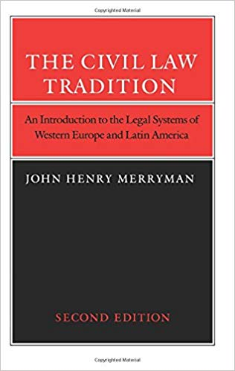
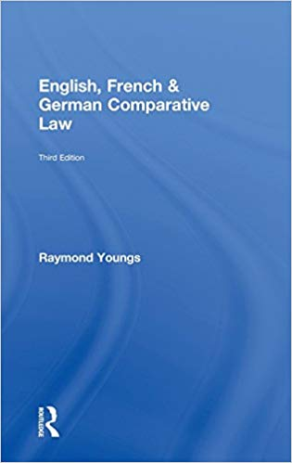
Basic reading
Supplementary reading
Raymond Youngs, English, French & German Comparative Law
Slides from lectures;
The textbook: https://prawo.uni.wroc.pl/node/26622

