Slide 1
The concept of law: lex et ius
Introduction to Law
Criminal Justice – fall & winter 2019/2020
Dr. Maciej Pichlak | Department of Legal Theory and Philosophy of Law | University of Wroclaw | Maciej.Pichlak@uwr.edu.pl

Slide 2
Legal reason – a controversy
'God had endowed His Majesty with excellent science, and great endowments of nature ...' still 'his Majesty was not learned in the laws of his realm of England, and causes which concern the life, or inheritance, or goods, or fortunes of his subjects, are not to be decided by natural reason but by the artificial reason and judgment of law, which law is an art which requires long study and experience, before that a man can attain to the cognisance of it.'
Sir Edward Coke to King James I, in 1607
The first thing we do, let's kill all the lawyers.
W. Shakespeare, Henry The Sixth, Part 2, about 1590

Slide 3
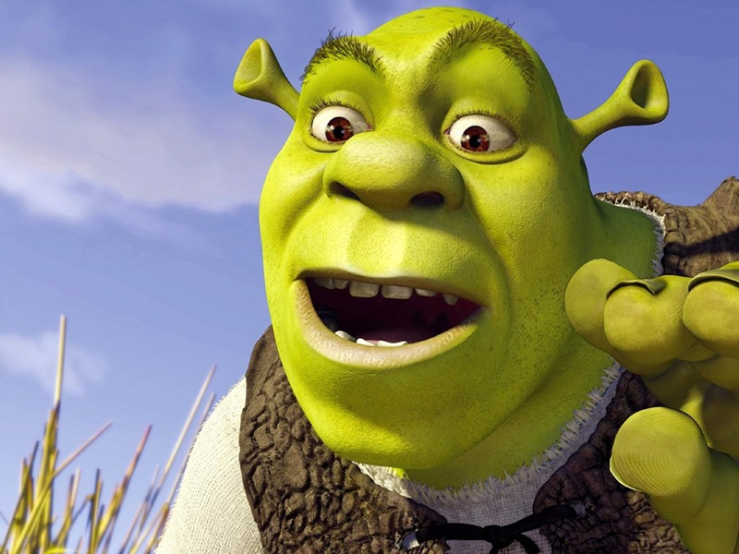
Law as a multi-layered system
„Shrek Principle”
'Typical' rules, that is legal provisions which are formulated in legal texts
(or other traditional sources of law), creates only a 'surface-level' of law.
Next to this level, law includes also other components.
Concepts of legal system and legal order

Slide 4
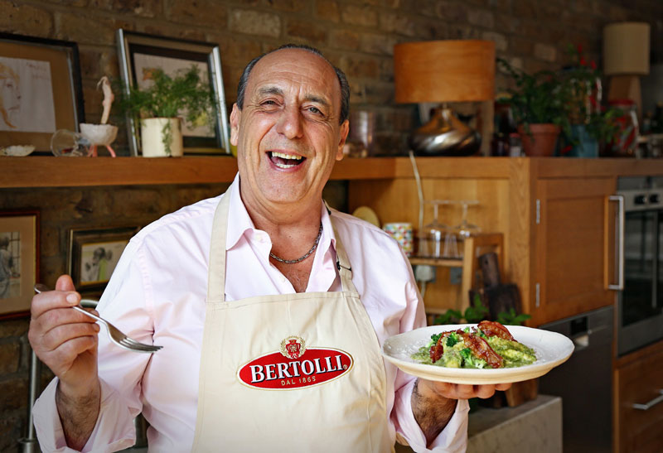
Lex et ius
Lex: formally
enacted law
Ius:
  ‚lawyers-made law’
  natural (moral) law
  (a) and/or (b) + lex
  final legal decision
  Ius est ars boni et aequi.
  Celsus

Slide 5
„Sources” of legal order
LAW
(as ius)
Legislation
(law as lex)
Legal
doctrine
Legal
practice

Slide 6
Legal culture
A set of beliefs, attitudes and customs related to the valid law.
Legal culture sensu largo and sensu stricto (culture of legal professionals).
Legal culture sensu stricto is created by legal practices, legal science, and legislation

Slide 7
Components of legal culture
methodical element (methods of legal reasoning)‏
conceptual element (basic concepts of law)‏
normative element (general legal principles)‏
general doctrines‏

Slide 8
Methodical component
Rules of validity
Rules of interpretation
[Rules of collisions]

Slide 9
Normative component: legal principles
‘Typical' rules
validity: formal criteria ('test of pedigree')‏
application: 'all or nothing' fashion
Principles
are a part of 'institutional morality'
validity: 'institutional acceptance'
application: 'more or less' fashion (dimension of weight)‏

Slide 10
„Deep culture” and identity of law
Alternative interpretations of deep culture:
- Deontological (basic principles)
- Teleological (telos - moral ideal of law)
- Formal (basic formal qualities of law)

Slide 11
Law as a multi-layered system
The role of legal culture (ius):
Positive (binding legal standards)
Negative (the limits of law)
Mediating (canons of interpretations)
Critical (a yardstick for criticism of law)
Discursive and practical knowledge
Components of legal culture and their discursive expressions.

