Slide 1
Legal Cultures (Legal Families) of the World
Introduction to Law
Criminal Justice – fall & winter 2019/2020
Dr. Maciej Pichlak | Department of Legal Theory and Philosophy of Law | University of Wroclaw | Maciej.Pichlak@uwr.edu.pl

Slide 2
Main legal families
Civil law (Romano-Germanic)
Common law (Anglo-American)
Far East
Islamic
Hindu
Scandinavian
[Post-soviet]

Slide 3
The concept of legal family
Criteria for distinguishing legal family (Koetz and Zweigert):
Historical background;
Methods of reasoning;
Institutions;
Sources of law;
Dominant ideology.
Other possibilities: language; territory; political system

Slide 4
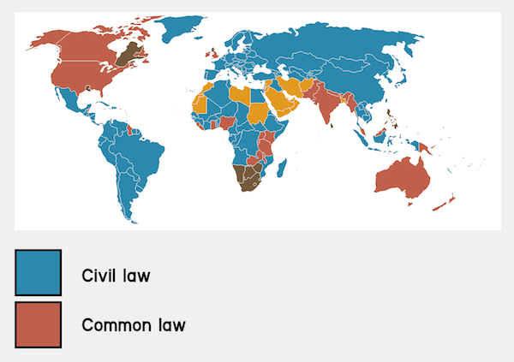
Civil law vs common law
Source: www.frenchentree.com

Slide 5
Civil law
Originates from the continental Europe
Based on the reception of the Roman law
Legislation is the primary source of law
Codifications (Code of Napoleon, BGB)
Similar methods of legal reasoning and interpretation
Abstract, systematic; the role of legal doctrine

Slide 6
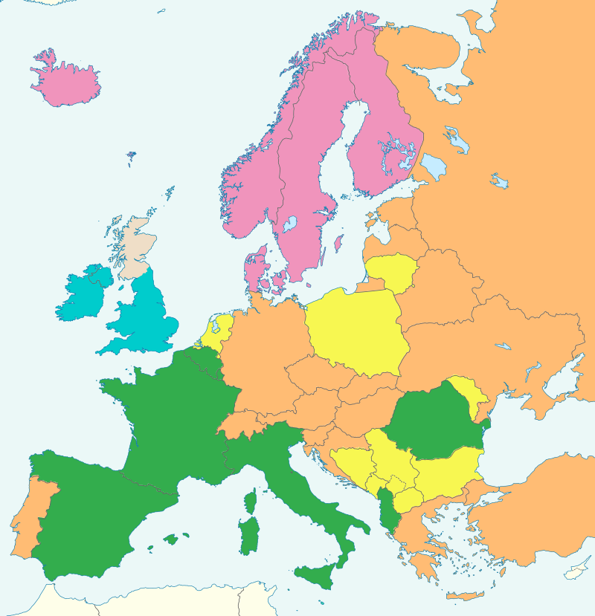
Civil law:
Germanic vs
Romanistic
Tradition
Germanic
Romanistic
Nordic
Mixed
Common law
Source: By Ain92 - Own work, CC BY-SA 3.0, http://commons.wikimedia.org/w/index.php?curid=26756779

Slide 7
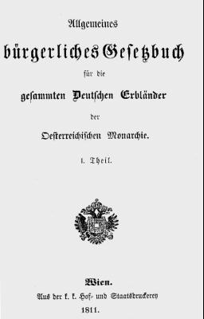
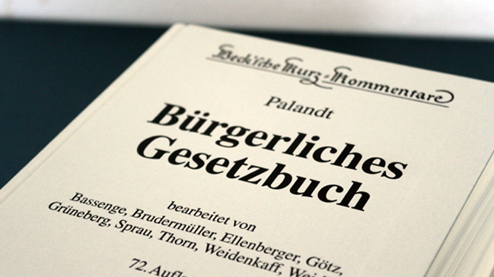

1900
1811
1804

Slide 8
Common law
Originates from England, adopted in its (former) colonies
Embraces legislation, regulations and judge-made law (precedents: common law in a strict sense)
Precedents might be based on common law or equity
Developed independently, without reception of the Roman law
Less codified and systematized
More casuistic and practically-oriented

Slide 9
Common law and civil law: further differences
The role of judges
The Rule of Law vs. Rechtsstaat
Separation of powers vs check and balance
Models of judicial constitutional control

Slide 10
Religious and traditional laws
Islamic law (Sharia and Fiqh), Hindu law (India), Halakha (Israel)
Distinct from the western idea of law
No clear separation of legal, religious, or moral standards
In contemporary legal systems their status varies

Slide 11
Islamic law
Sharia (rules) and Fiqh (jurisprudence)
Sources of sharia: Quran and Sunnah
Spheres of regulation:
  Religious obligations
  Family law
  Economic laws
  Criminal laws
  Dietary, hygiene, dress code etc.

Slide 12
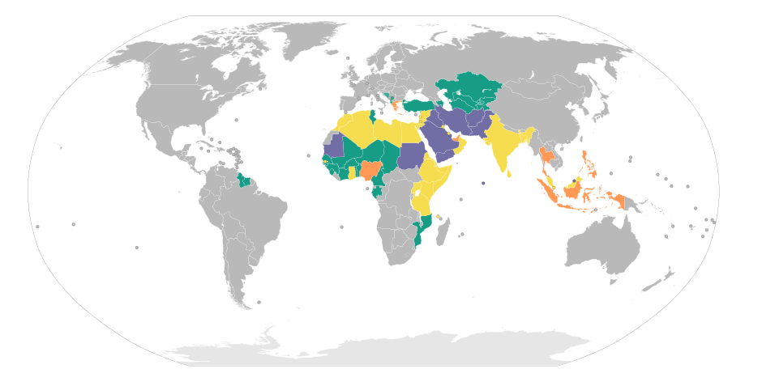
Application of sharia
Source: https://commons.wikimedia.org/w/index.php?curid=24745568
- none; - Muslim’s personal law - full; - others

Slide 13
Legal system of India vs. „Hindu law”
India is a federal state and laws may vary from one state to another
The legal system of India is called a hybrid system and includes:
  Common law
  Civil law (mainly on Goa)
  Various personal laws, according to ethnicity and religion (Hindu law, Muslim’s law, „Christian” law)

Slide 14
„Hindu law”
A post-colonial term; the more proper one is Dharma
Group of customs and traditional standards
Regarded to be the oldest jurisprudential system in the world
Based on a caste system
To some extent recognized by formal legal system and Indian courts
Relates mainly to personal laws, family (marrital) laws, some private contracts

Slide 15
Legal systems of Far East
Most relevant: Chinese law, Japanese law
Contemporarily usually a mixture:
  of western law and traditional customary law (Japan);
  of western law and socialist law (China).
Said to be more focused on harmony than justice, reconciliation than adjudication.
Less litigatory than in the so called Western world.

Slide 16
Legal system of China
Civil law (Mainland)
Common law (Hong Kong)
Socialist law
Tradition? (confucianism, legalists)

Slide 17
China: Traditions of legal thought
Confucius:
The idea of harmony and hierarchy
Li: traditional morality and customs, internalized by human nature
Less reliance in external regulations and sanctions
Legalists:
All people are equal
Neccessity of codification and strict punishment
Law is an external measure to secure social order
Stress on legalism and obeying the laws

