Slide 1
Subjects of law
Introduction to Law
Criminal Justice – fall & winter 2019/2020
Dr. Maciej Pichlak | Department of Legal Theory and Philosophy of Law | University of Wroclaw | Maciej.Pichlak@uwr.edu.pl

Slide 2
Legal entities
Every unit recognized by law
On the edge? Animals, artificial intelligence, natural areas, gods…
PERSONS |  | OTHER UNITS
PHYSICAL PERSONS (natural persons, private individuals) | LEGAL PERSONS - PERSONA FICTA (juridical, juristic, artificial, fictitious persons) Companies Corporations Partnerships States etc. | Units that lack legal personality Agencies Some kinds of partnerships etc.

Slide 3
The stucture of legal person
Addressee: a unit to whom the legal rule is addressed
Legal personhood: capability to posses legal rights and obligations
Legal capacity: capability to amends one’s own rights and obligations
Capacity to sue and to be sued

Slide 4
Capacity to sue and being sued
Legal
capacity
Legal
personhood
Being
an addressee

Slide 5
Liability
Liability (legal liability): responsibility in law
‚Liable’ as ‚legally obligated’
Liability and duty of care or duty to act
Ground for liability:
Criminal deed
Contract
Delict / tort
Obligations of public law (e.g. tax)

Slide 6
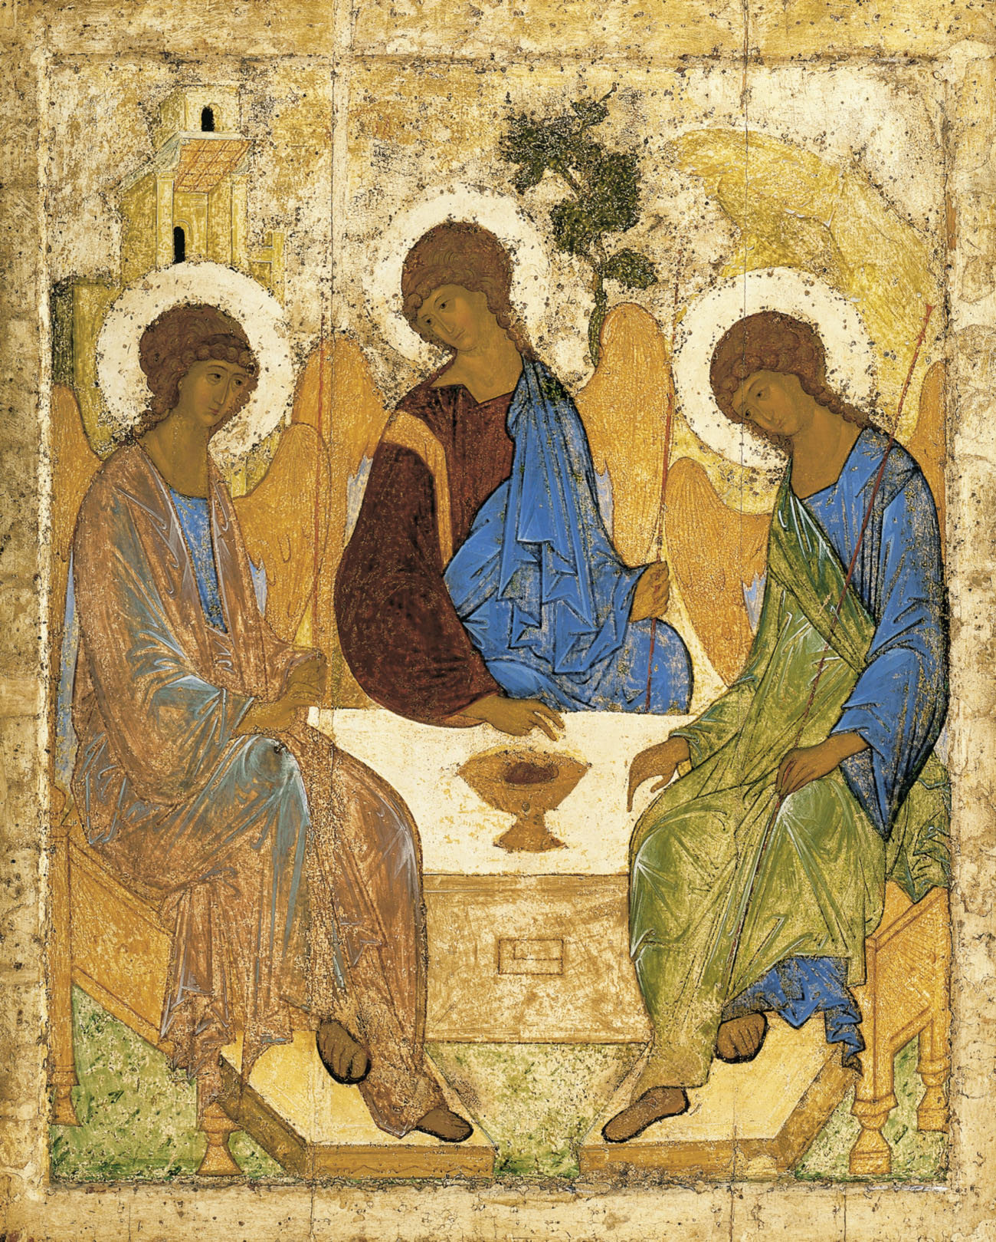
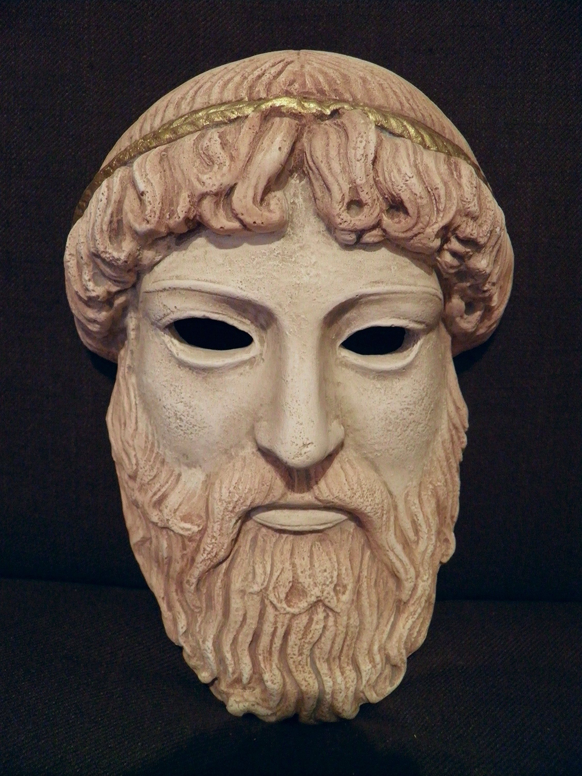
History of persona ficta
Roman law: collegia
The concept of person
Persona (prosopon) in the Greek theatre
Christian theology of person:
The God and a human being
Free will – Reason - Consciousness

Slide 7
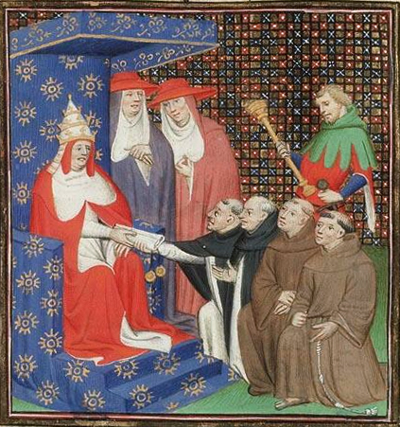
XIII century: monastery as persona ficta
Pope Innocent IV
The lack of soul –
no criminal nor delict liability

Slide 8
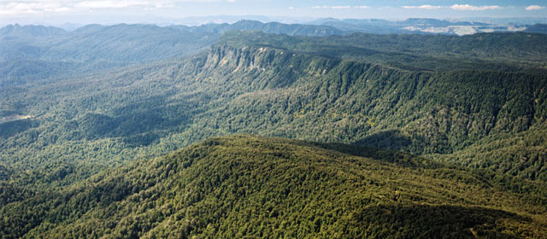
Can a stretch of land be a person in the eyes of the law? Can a body of water?
In New Zealand, they can. A former national park has been granted personhood, and a river system is expected to receive the same soon.
The unusual designations, something like the legal status that corporations possess, came out of agreements between New Zealand’s government and Maori groups. The two sides have argued for years over guardianship of the country’s natural features.
Chris Finlayson, New Zealand’s attorney general, said the issue was resolved by taking the Maori mind-set into account. “In their worldview, ‘I am the river and the river is me,’” he said. “Their geographic region is part and parcel of who they are.”
From 1954 to 2014, Te Urewera was an 821-square-mile national park on the North Island, but when the Te Urewera Act took effect, the government gave up formal ownership, and the land became a legal entity with “all the rights, powers, duties and liabilities of a legal person,” as the statute puts it.
https://www.nytimes.com/2016/07/14/world/what-in-the-world/in-new-zealand-lands-and-rivers-can-be-people-legally-speaking.html

Slide 9
The case of AI
The concept of electronic persons
The European Parliament's Committee on Legal Affairs 2016:
Autonomic robots may possess "specific rights and obligations, including that of making good any damage they may cause, and applying electronic personality to cases where robots make smart autonomous decisions or otherwise interact with third parties independently"
https://www.theguardian.com/technology/2014/dec/05/software-bot-darknet-shopping-spree-random-shopper
https://www.youtube.com/watch?time_continue=297&v=S5t6K9iwcdw&feature=emb_logo

