Slide 1
General Agreement on Tariffs and Trade (GATT) : legal principles
For BBA
© Łukasz Stępkowski

Slide 2
The system of the World Trade Organisation comprises several „components”, one of which is the General Agreement on Tariffs and Trade, in its 1994 version
In essence, the GATT 1994 is founded on 1947 GATT and subsequent developments in trade talks
The structure of GATT 1994 may be found here : https://www.wto.org/ENGLISH/docs_e/legal_e/06-gatt.pdf
And the full text version of matters on GATT with commentaries may be found here:
https://www.wto.org/english/res_e/booksp_e/agrmntseries2_gatt_e.pdf

Slide 3
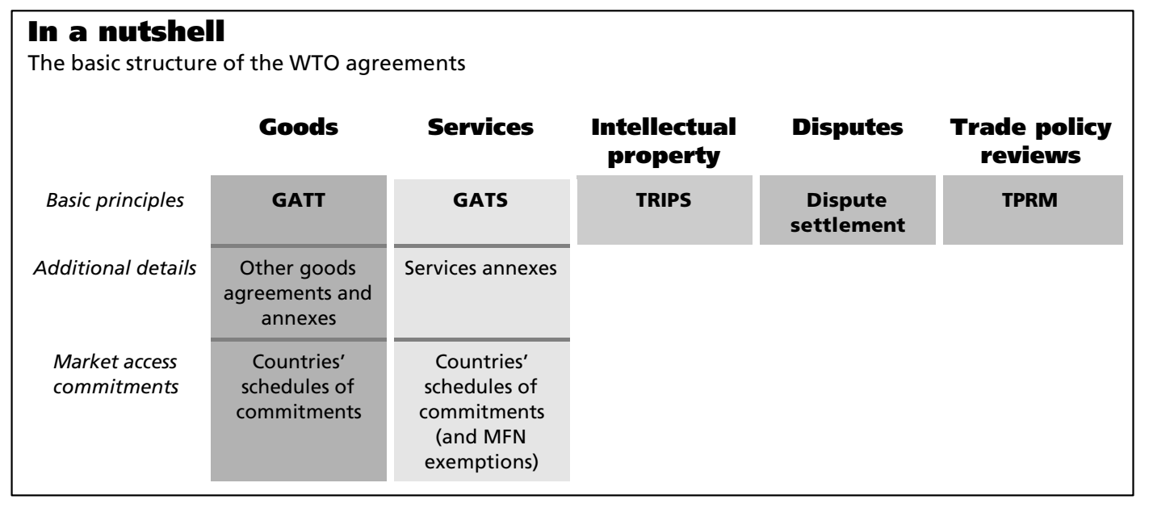
As such, the WTO system (see second link before) views itself like this in a nutshell:

Slide 4
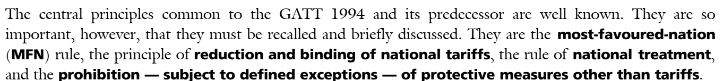
The WTO system is problematic (read: virtually incomprehensible) in that there is no single treaty and the „GATT 1994”
There are, however, certain legal principles enshrined within the GATT rules
From the WTO’s commentaries:

Slide 5
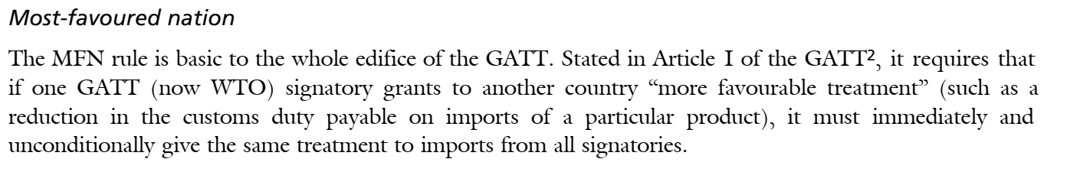
The Most Favoured Nation Clause
It is worth noting that the MFN clause does not mean that there should be a „special” treatment to some nation(s)
Rather, it is an equalizer for all WTO members who are to receive the same treatment as the „best” treatment applicable

Slide 6
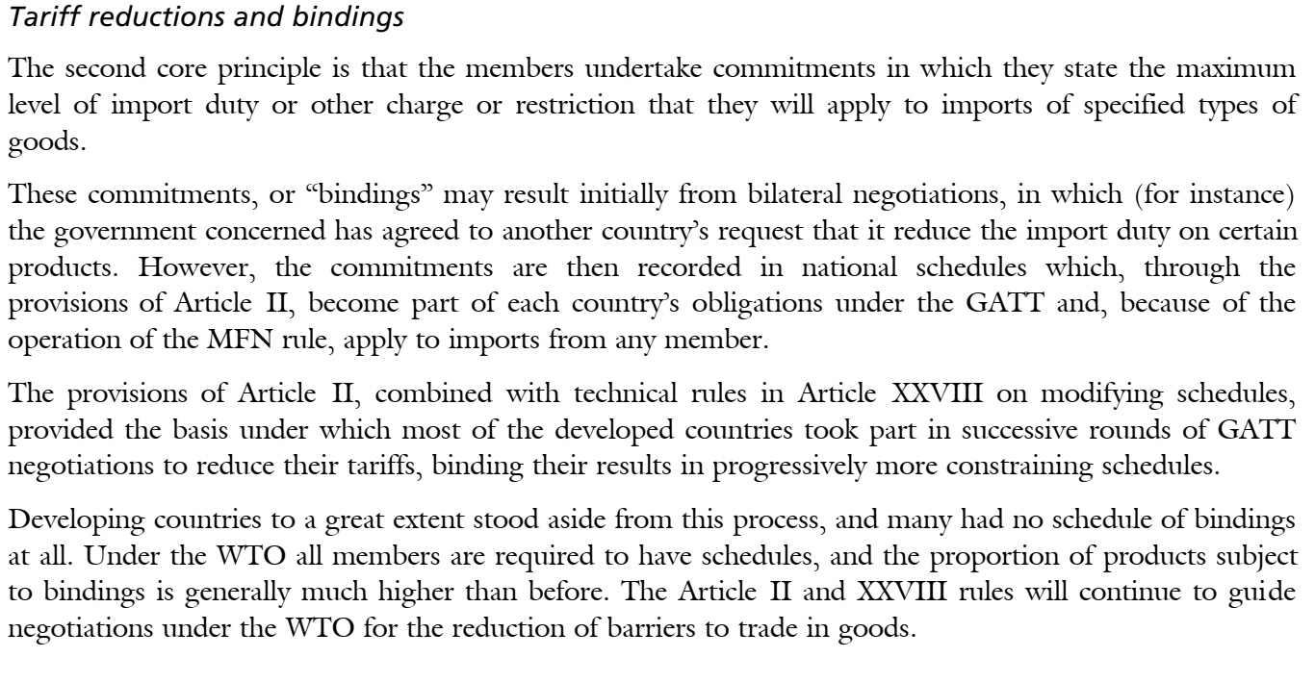

Slide 7
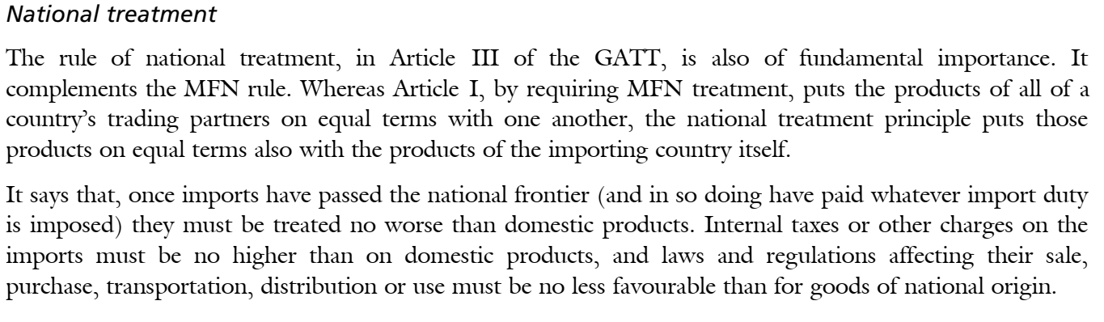
The principle of national treatment

Slide 8
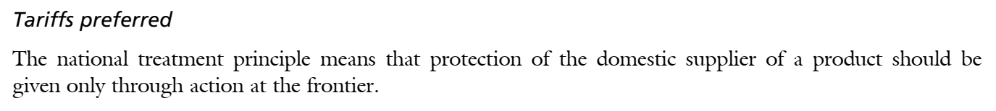
Preference for tariffs
The WTO’s GATT rules adopt a preference for tariffs as permissible restrictions on trade
In practice, states retain many forms of non-tariff restrictions, either overtly or disguised as non-discriminatory rules which nonetheless offer a benefit for incoming goods

Slide 9
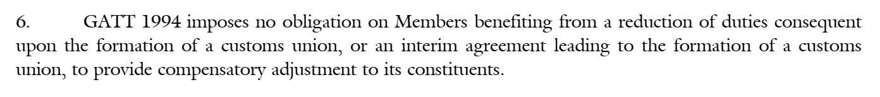
Article XXIV GATT and the Understanding : http://www.worldtradelaw.net/uragreements/articlexxivunderstanding.pdf
Under WTO rules, free trade areas (FTAs) and customs unions (and agreements leading thereto – interim agreements) may be introduced to raise the „level of protection” among its members
As such, EU Member States are trading between themselves not on WTO rules, but in accordance to, inter alia, their own customs union
However, there is no obligation to lower customs duties when applying Article XXIV GATT. From the Understanding, XXIV:6, para.6:

