Slide 1
Introduction to Criminology
Katarzyna Piątkowska, Ph.D.
Department of Criminology and Security Sciences
Faculty of Law, Administration, and Economics University of Wroclaw, Poland
Attorney at Law

Slide 2
What is criminology? How is criminology concerned with crime?

Slide 3
The term criminology was first coined by the Italian law professor Raffaele Garofalo in 1885 (in Italian, criminologia).
In 1887, French anthropologist Paul Topinard used it for the first time in French (criminologie).
In 1934, American criminologist Edwin Sutherland defined criminology as
the body of knowledge regarding crime as a social phenomenon. It includes within its scope the process of making laws, of breaking laws, and of reacting toward the breaking of laws. . . . The objective of criminology is the development of a body of general and verified principles and of other types of knowledge regarding this process of law, crime, and treatment or prevention.

Slide 4
Criminology is the scientific study of crime, especially why people engage in criminal behavior

Slide 5
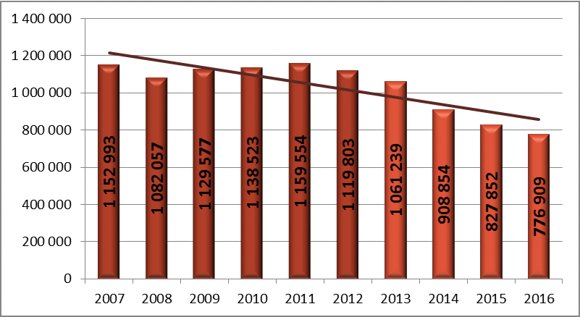
Total numer of reported crimes in the years 2007-2016
Source: the National Police Headquarters; The report on the level of security in Poland in 2016, Ministry of the Interior and Administration

Slide 6
Criminological theories
Why do we need theories in criminology?
Can any of the social theories be proven? Karl Proper (1959)
Why people conform to particular norms or values or are willing to breach them?
Why men commit more violent crimes than women?
Why women – in the case of murders – use poison much often than men?
Why some groups are at risk to commit crimes or to be victims of such?
A social structural explanation for commiting certain crimes – unemployment and poverty as common risk factors

Slide 7
Classical criminology
Tied up with the Enlightment.
Before that time problems were often solved by might or by the State and/or the Church and people were expected to accept their rule and their use of power.
Faith helped to keep people in line.
Punishment was harsh, often cruel and bloody and used to perpetuate the traditional power of State (monarch) and Church.
By the 18th century many crimes, even relatively minor offences, attracted either death penalty or transportation; others might be punished with flogging or burning of, for example, the hands.

Slide 8
The Enlightenment encouraged people to think for themselves.
The Enlightenment period ran from about 1650-1680 and included thinkers such as John Locke, Isaac Newton, Voltaire, Montesquieu.
Two most famous Englihtenment thinkers who had a hand in shaping crime control and crimonological thinking were Cesare Beccaria and Jeremy Bentham.

Slide 9
Cesare Beccaria
Beccaria – the social contract theory of State power – the Stare draws its power not from the monarchs acting as God’s power on earth but rather through the people. State’s power is to protect people.
Where is the crime, there should be a punishment.
More rights for suspects. Only if one proved guilty in a court of law, should then be punished.
Punishment should not be excessive, no more than it was necessary to remove the advantage derevied from the crime.
No forms of tortures, he also vigorously rejected the death penalty - the social contract did not give the State the right to take person’s life.

Slide 10
Jeremy Bentham
He was an utilitarian idealist.
Human behaviour is led by a desire to maximise pleasure and minimise pain, people make decisions about their behaviour based on individualism and self-interest.
Individuals choose crime in order to get something they like: money, goods, power, pleasue, excitement, sex etc.
A punishment should be proportionate.
Where the offender is of limited mental capacity or their act was not fully voluntary or otherwise truly chosen then punishment may not be acceptable.
While Beccaria totally rejected the death penalty, Bentham accepted its use in cases of murder where he saw death as a just and balanced punishment.

Slide 11
Positivist criminology
In the 19th century, industry and science came to the fore.
Classicis is based on rational thought and free will, positivism is based on science, knowledge.
Inventions, new medical practises
The so- called ’scientific’ criminology
Problem: classicism has reduced punishment

Slide 12
Cesare Lombroso (1835-1909) is often called the father of modern criminology.
The Criminal Man (1870) – biological causes of crime.
He called his new field of research ’criminal anthropology’.
The explanations in his work are now largely refuted but his link to scientific method lives on.
Criminals are a different biological type. People with criminal inclinations would therefore represent characteristic anthropological features - atavisms or degenerations.
Lombroso visited prisons in which he measured, among others, skulls and hands of criminals trying to find some differences from the people he considered as normal.
Cesare Lombroso considered others unusual or irregular head shape, eye and face asymmetry, large ears, prominent jaw, dental defects, receding forehead, long arms, dark complexion and thick hair as a significant warning.

Slide 13
https://pictures.abebooks.com/ANTIPODEAN/18957747734_2.jpg

Slide 14
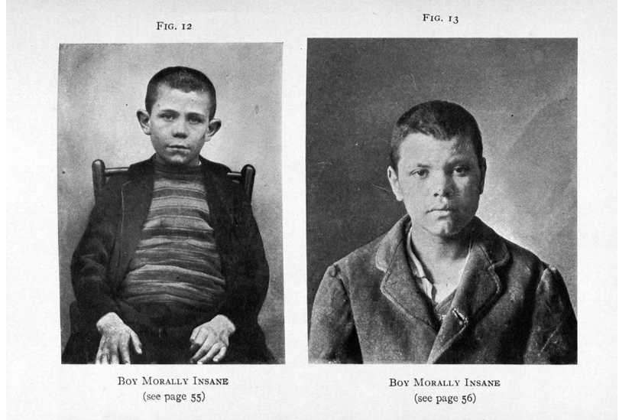
https://library.missouri.edu/exhibits/eugenics/lombroso.htm

Slide 15
Relations between criminology and substantive criminal law
Defining a crime. Legalistic approach
How to define what is criminal?
Acts of mala in se and acts of mala prohibita

