Slide 1
Legal Language
Introduction
Maciej Pichlak
Department of Legal Theory and Philosophy of Law
University of Wroclaw
Room 302A | maciej.pichlak@uwr.edu.pl
https://prawo.uni.wroc.pl/user/12147

Slide 2
For a starter…
https://www.youtube.com/watch?time_continue=4&v=rCxJhj7tMkc
This Court has already concluded that the Prime Minister’s advice to Her Majesty was unlawful, void and of no effect. This means that the Order in Council to which it led was also unlawful, void and of no effect and should be quashed. This means that when the Royal Commissioners walked into the House of Lords it was as if they walked in with a blank sheet of paper. The prorogation was also void and of no effect. Parliament has not been prorogued. This is the unanimous judgment of all 11 Justices.

Slide 3
The sequence of legal reasoning
Is the case justiciable?
What are the limits to the Government’s power in the case?
Did this prorogation have the effect of frustrating or preventing the ability of Parliament to carry out its constitutional functions without reasonable justification?
What the legal effect of that finding is?

Slide 4
The Law’s Empire
  'We live in and by the law. It makes us what we are: citizens and employees and doctors and spouses and people who owe things. It is sword, shield and menace: we insist on our wage, or refuse to pay our rent, or are forced to forfeit penalties, or are closed up in jail, all in the name of what our abstract and ethereal sovereign, the law, has decreed. (...) We are subjects of law's empire, liegemen to its methods and ideals, bound in spirit while we debate what we must therefore do.'
  Ronald Dworkin, Law's Empire

Slide 5
Language and reality
„The definitions and categories become part of the systematic legal structure that is employed by legal scholars, is taught to law students, and is thereby built into the law.”
John H. Merryman, The Civil Law Tradition
„The limits of my language mean the limits of my world.”
Ludwig Wittgenstein, Tractatus Logico-Philosophicus

Slide 6
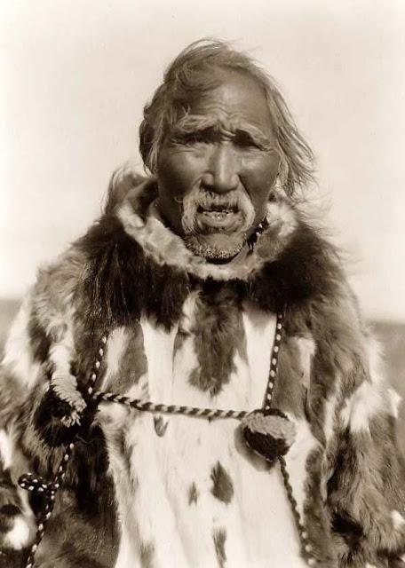

Language and reality: cognitive framework

Slide 7
The content of lectures
The concept of law. Law in the society and social functions of law.
Legal cultures and legal systems of the world. Common law and civil law.
Legal system. Main branches of law
Sources of law and forms of law creating.
Legal rules and principles
Systems of judiciary and structure of legal proceedings
Interpreting statutes
Interpreting precedents

Slide 8
The structure of the course
Lectures:
Please see the previous slide
THE EXAM
Seminar classes:
Further elements of legal reasoning, e.g.:
Types of legal rules
Methods of interpretation
Rules of collision
THE FINAL TEST

Slide 9
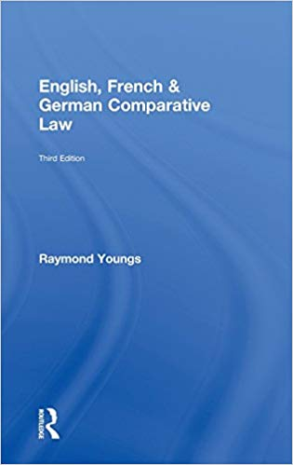
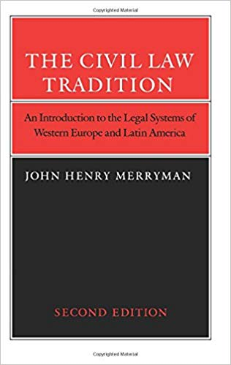
Basic reading
Supplementary reading
J.H. Merryman, The Civil Law Tradition
Slides from lectures;
The textbook: https://prawo.uni.wroc.pl/node/26622
R. Youngs, English, French & German Comparative Law
(Chapters 1 – 3)

