Slide 1
Horizontal markets and sustainable growth
Mateusz Machaj

Slide 2
What actually is a horizontal market?
Two types of markets: horizontal and vertical markets.
Horizontal markets have a much wider customer base.
Additionally they have usually a broader product offer
Broad range of activities can either be present in the production sector or the consumer sector

Slide 3
Example in the consumer sector
A good example would be computer business: Google
It opperates at the end of the production process.
Yet despite being in the last stages of value chain it has very broad range of customers.
People acquire various products through this engine etc.

Slide 4
Example in the production sector
Horizontal market can also happen in the production sector: Oracle corporation.
Highly successful technological corporation that offers database, software, cloud systems for management.
Customers are usually other companies.
Clearly a production sector and a horizontal market

Slide 5
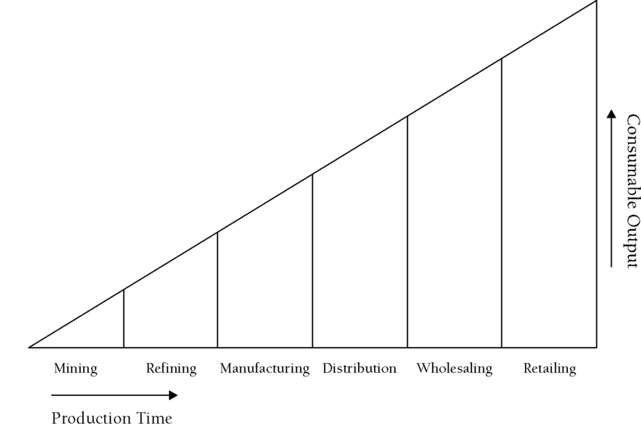
Structure of production
The structure of production presents how production goods are transformed into consumer goods
This happens in stages

Slide 6
Different companies at each stage
Various stages of the production structure may contain different firms
There is no reason to assume that horizontal markets are only at the very end of the structure.
They are also present in the early stages of production

Slide 7
Vertical markets
Vertical market is a narrower one.
Both in terms of number of clients and their character.
It is typically existing with higher margins
Because of lower turnovers
Specific markets and heterogeneous products

Slide 8
Examples
Example in the consumer market could be a University
Example in the producers’ market would be raw materials.
A rigid structure and specific feasibility.

Slide 9
How to understand a distinction?
As with many classifications they are arbitrary.
Therefore we cannot strictly divide horizontal markets and vertical ones.
Some markets resemble more of a horizontal structure.
Some do resemble a more vertical structure

Slide 10
Evolutionary character
Now, horizontal or vertical markets are not there forever.
Something which is a vertical market can become a horizontal one.
And the other way round.
A force behind such change is economic evolution.

Slide 11
Logic of growth
Logic of economic growth is to start off with some limited innovations.
Start with inventions.
Then apply as innovations.
And successfully expand the line of production.

Slide 12
Early startups
Are usually vertical
Because they concentrated on niches
That will expand in some time
Perhaps become horizontal in the future
Example: paypal.

Slide 13
Sustainable growth
Now we should place the idea of horizontal markets in the concept of sustainable growth.
Per se there is not such thing as sustainable growth!

Slide 14
Example: stable percentage
Works like a virus (or coronavirus…)
10% growth per years means doubling every 7 years.
After 7 years income of 100 is turned into 200.
After 14 years it is turned into 400.
After 49 years it becomes 128000.
Stable percentage ends up as an exponential

Slide 15
So maybe stable absolute?
Add 10 in each round.
Income 100 becomes 110. Then 120.
After 50 years we move from 600 to 610.
As a percentage growth clearly declines.
So it basically becomes no growth

Slide 16
So what is supposed to be „sustainable”?
Wikipedia „Sustainable development is the organizing principle for meeting human development goals while simultaneously sustaining the ability of natural systems to provide the natural resources and ecosystem services based upon which the economy and society depend. The desired result is a state of society where living conditions and resources are used to continue to meet human needs without undermining the integrity and stability of the natural system. Sustainable development can be defined as development that meets the needs of the present without compromising the ability of future generations to meet their own needs”

Slide 17
„Future generations”?
But what does that mean? Which generations? How to reach a golden proportion?
Earth will die some day.
The universe will end some day too.
So we simply cannot „sustain” over the very long run.
We have to make a „choice”

Slide 18
Sustainable growth in plain words
Actually… making sure that we do not destroy ourselves.
There are various threats that may jeopardize our existence and delicate eco-balance.
Perfect example… you guessed it: coronavirus!
Another one: global warming
Another one: natural resources (Malthusian traps)

Slide 19
Risk management
People are quite good in risk management.
There is, however, one type of risk which is tricky: systemic risk.
It is a risk for risk. Sort of.
Very often not acknowledged (except to some extent in the form of something called model risk).

Slide 20
Growth helps
Especially in solving the problem of systemic risk.
Example: colonizing space (not to put all „human eggs” into one basket!)
Example: more renewable resources (by the way there are no fully renewable resources!)
Example: big data to solve pandemic threats.

Slide 21
How do horizontal markets relate to growth
Biggest field for eco-technological progress is for implementing solutions in horizontal markets
Startups are taken over (or even simply started) by bigger horizontal companies.
Their achievements are diffused into the system.
Growth can increase (smartphones are perfect example)

Slide 22
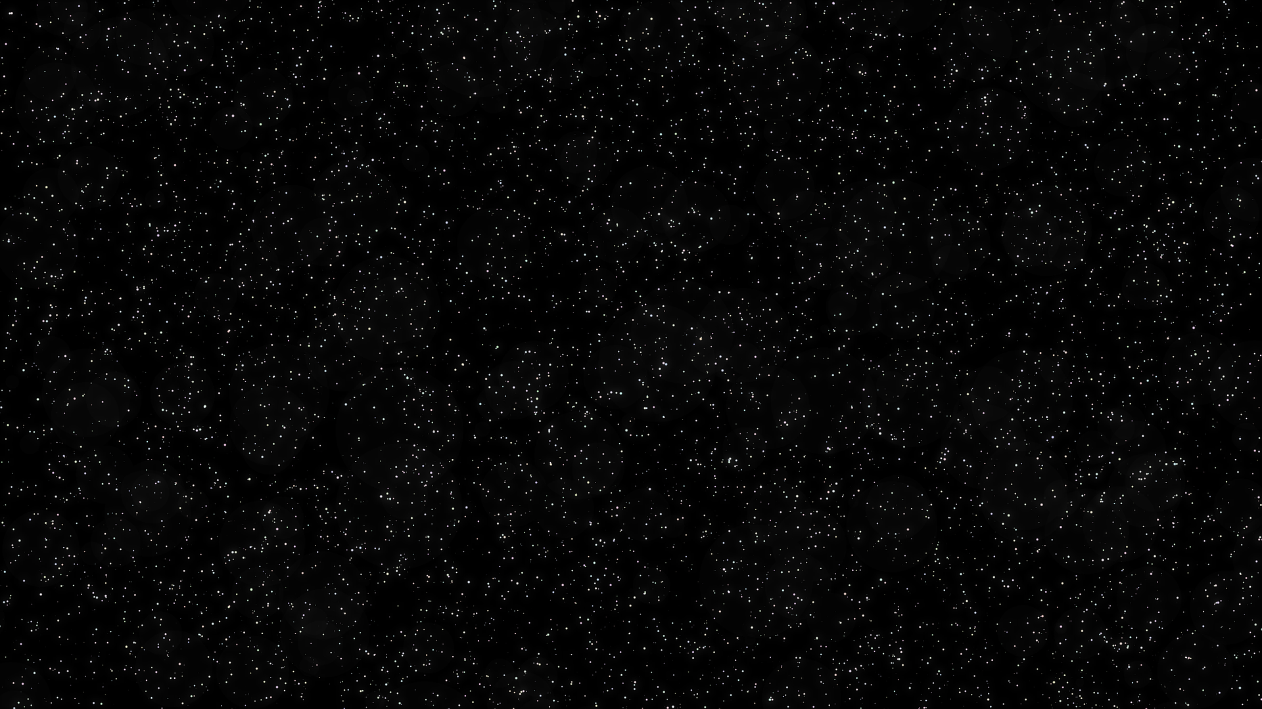
Dziękuję
Mateusz Machaj

