Slide 1
Ethics in Public Life lecture 1
Clarifying ethics
Mapping ethics
  Dr. Maciej Pichlak
  University of Wrocław
  Faculty of Law, Administration and Economics
  Department of Legal Theory and Philosophy of Law

Slide 2
Moral traditions and their practical applications
Other useful resources:
The Routledge Companion to Ethics, ed. By J. Skorupski, Routledge
Slides from lectures:
http://prawo.uni.wroc.pl/node/18811
Sandel’s lectures on the Youtube:
https://www.youtube.com/watch?v=kBdfcR-8hEY&list=PL30C13C91CFFEFEA6
Stanford Encyclopedia of Philosophy:
http://plato.stanford.edu/
Internet Encyclopedia of Philosophy:
http://www.iep.utm.edu/

Slide 3

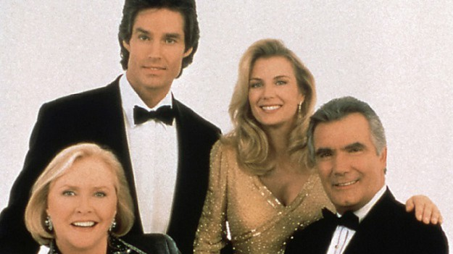

Why do we love soap operas?

Slide 4
The task of ethics
Ethics as a critical reflection on moral experience
The task of ethics:
to clarify and verify the existing moral beliefs.
Spaemann: 'It is an attempt to understand. Yet, this understanding does not leave that what is understood untouched.'

Slide 5

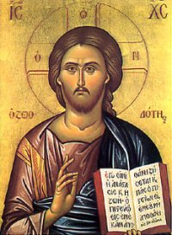
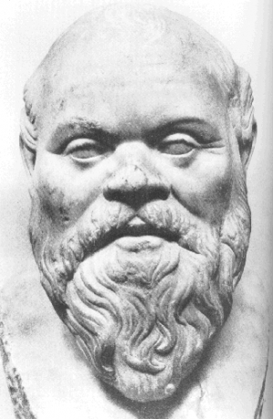
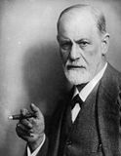
Between faith and scepticism
- no certain knowledge or ultimate authority; a need for argumentation
- practical (critical and/or normative) tasks, not merely descriptive or analytical

Slide 6
Mapping ethics

Slide 7
Morality of duty and of aspiration
Morality of duty embodies the most moral obvious demands of social living, which means basic requirements of social living. On another hand, the morality of aspiration is the morality of good life, of excellence, of fullest realization of human powers.
We do not praise men for doing their duties but we do praise them for moral excellence. On another hand, we do condemn people by breaching their duties but we may only feel sorry for those who do not realize their aspirations.
Morality of duty generally requires only forbearance while morality of aspiration is in some sense affirmative.
Morality of duty can be enforced more or less by law whereas morality of aspiration cannot.
Moral duties are ‘sticky and inflexible’ while it is the nature of all human aspirations towards perfection to be liable and responsive to changing conditions.

Slide 8
Mapping ethics
Deontology (morality) vs. Teleology (ethics)
Greek: beauty vs. good
Public morality vs. Private ethics?

Slide 9
Mapping ethics
Basic streams of moral philosophy:
TELEOLOGY DEONTOLOGY
ETHICS OF RIGHTS
CONTRACTUALISM
DISCOURSE ETHICS
UTILITARIANSM
VIRTUE ETHICS
ETHICS OF DIALOGUE
POSTMODERN ETHICS

