Slide 1
Ethics in Public Administration
AIO 2019
LECTURE 3

Slide 2

Deontology
(or can you throw a dwarf?)
Conseil d’Etat, 27 Octobre 1995, N° 136727

Slide 3

The Trolley Case

Slide 4
Definition
Deontology: "a type of moral philosophical theory that seeks to ground morality on a moral law or norm which moral agents have an obligation to conform to. Deontological ethics, in this sense, is law-based, and envisages the morally right and the good as determined through relevant norms."
O. Kuusela, Key Terms in Ethics
Greek deon - duty, what ought to be done

Slide 5
Problems of deontology
1. How to justify moral duties (rules)?
2. How to establish the content of moral duties?
3. How to reason from general rules to concrete cases?

Slide 6
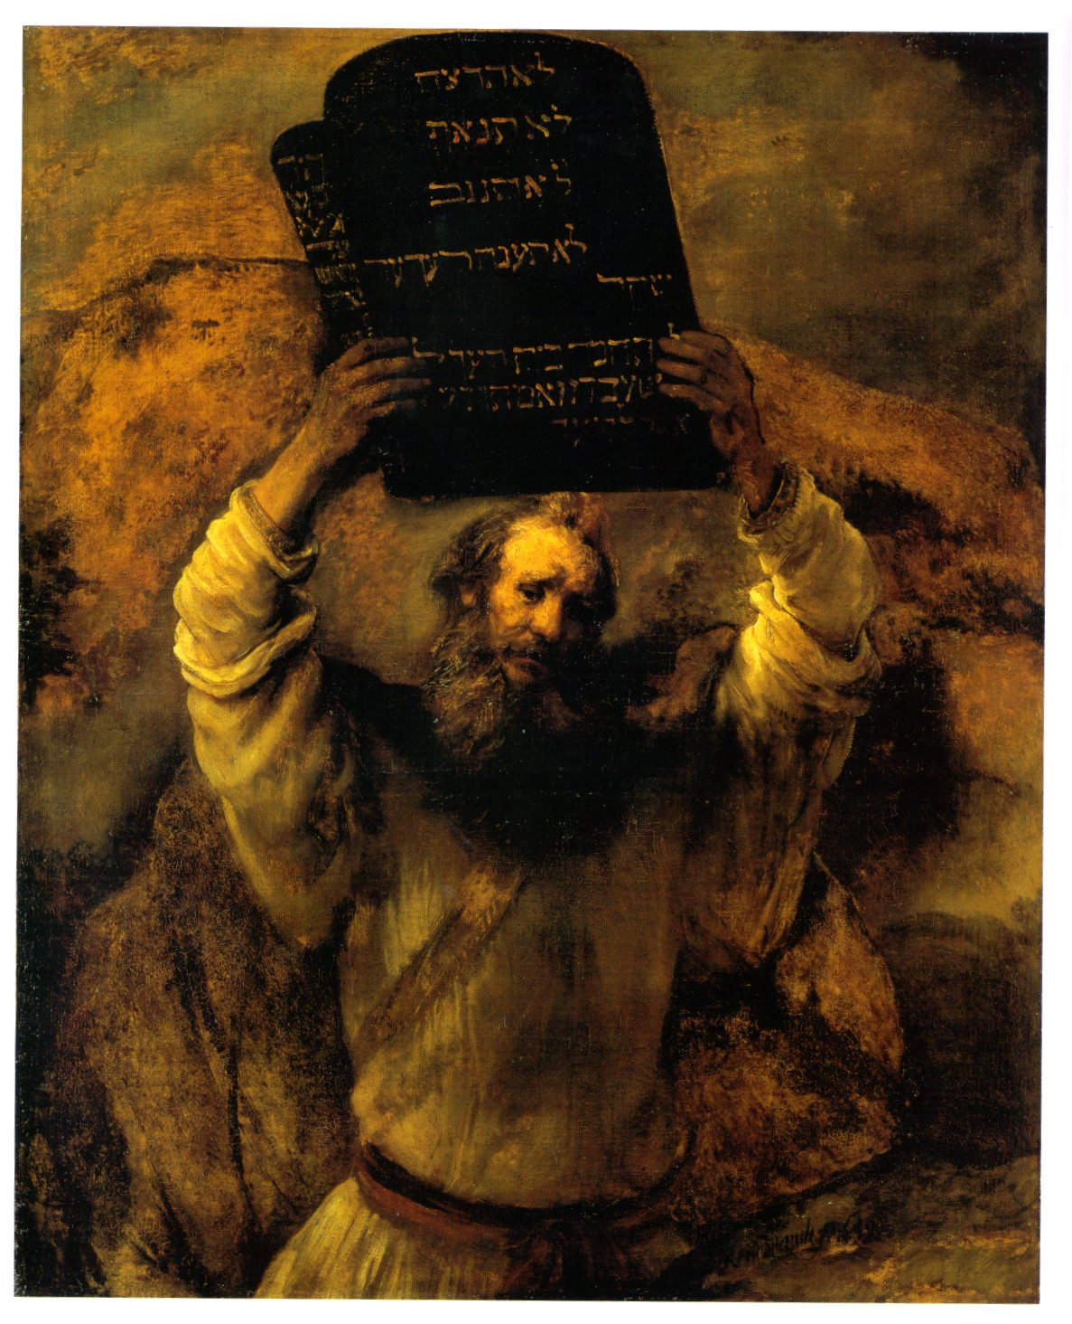
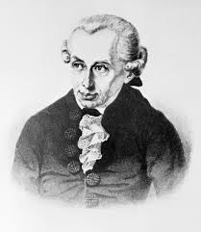
Versions of deontology
Heteronomous vs. Autonomous

Slide 7

Kantian deontology
Apriorical foundations of morality:
Good will
Duty vs. inclination

Slide 8
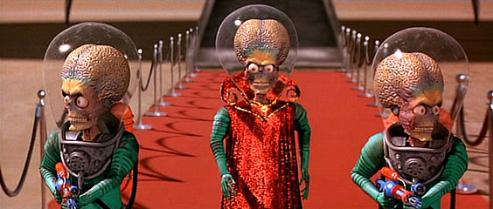
Why only duty may form an apriorical ground for morality?
Empirical character of inclinations
The concept of the autonomy
The concept of universality
(Kant as a S-F writer)

Slide 9
Kantian deontology
How do I know what a duty requires?
The test of universalization.
Categorical imperative:
Act only in accordance with that maxim through which you can at the same time will that it become a universal law.

Slide 10
Categorical imperative
Alternative formula:
So act that you use humanity, whether in your own person or in the person of any other, always at the same time as an end, never merely as a means.
Categorical vs. hypothetical imperative

Slide 11
Kant: objections
- rigorism of moral duties (mechanical application?)
- universalizability of almost any possible rule
- ficticious character of the moral autonomy
- The problem of conflict of duties

Slide 12


Lessons from Kant
The idea of autonomy of the subject

Slide 13


Lessons from Kant
Do not treat humanity instrumentally (as a means or an object)

Slide 14
Lessons from Kant
The requirement of univesalisation

Slide 15
When can I lie?
Kant, On a Supposed Right to Lie because of Philantropic Concerns
Would it be a crime to tell a lie to a murderer who asked whether our friend who is being pursued by the murderer had taken refuge in our house?
Kant’s three points:
Acceptance of „a right to demand that another should lie for the sake of one’s own advantage”; from this follows „a claim that conflicts with all lawfulness”.
„Whoever tells a lie, regardless of how good his intentions may be, must answer for the consequences resulting therefrom”
By telling the untruth, as far as it depends on me, „I bring it about that statements (declarations) in general find no credence, and hence also that all rights based on contracts become void and lose their force, and this is a wrong done to mankind in general.”

Slide 16
The Trolley case revisited

Slide 17
The Doctrine of Double Effect
A person may licitly perform an action that he foresees will produce a good effect and a bad effect provided that four conditions are verified at one and the same time:
that the action in itself from its very object be good or at least indifferent;
that the good effect and not the evil effect be intended;
that the good effect be not produced by means of the evil effect;
that there be a proportionately grave reason for permitting the evil effect.
Joseph Mangan,
A Historical Analysis of the Principle of Double Effect, Stanford Encyclopedia of Philosophy
http://plato.stanford.edu/entries/double-effect/

Slide 18
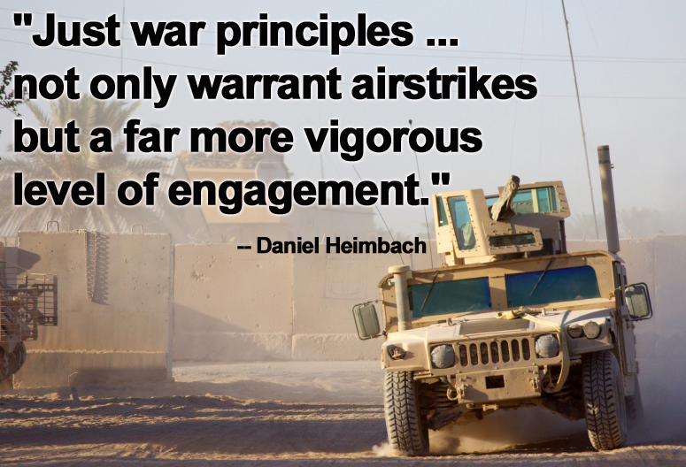
The doctrine of just war

Slide 19
Requirements for beginning just war
(ius ad bellum)
-- Just cause. There must be a specific act of injustice to be corrected.
-- Competent authority. The decision to wage war should only be made by the person or governing body responsible for maintaining a nation's civil order and security.
-- Right intention. The intended result of going to war must be to restore a previous state of peace and civil order.
-- Last resort. All realistic nonviolent alternatives must be exhausted before going to war.
--Probability of success. There must be a realistic hope of achieving victory.
-- Proportionality of projected results. The good expected upon attaining victory must be greater than estimates of what it will cost to achieve victory.

