Slide 1
Ethics in Public Life
Administration in International Organizations 2019
TELEOLOGY

Slide 2
Teleology: basic idea
Humans’ deeds are purposive by nature;
they aim at something.
An attempt to ground ethics on aspiration which should inspire moral agents to particular actions. The assessment of actions is ruled by the role they play in realization of the aspiration.

Slide 3
Main problems of teleology
1. What is such aspiration?
2. Is it possible to indicate one intrinsic aspiration for all the people?
3. How may we know what are the exact demands stemming from general aspiration?

Slide 4
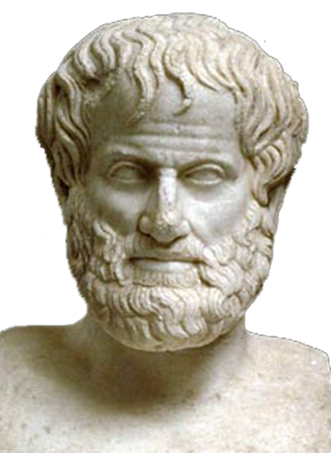
Good as aspiration
What is your aim, Professor Aristotle?

Slide 5
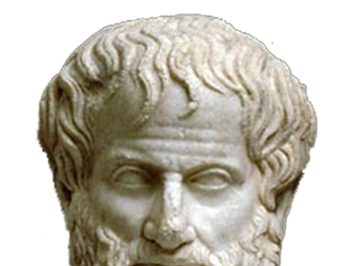
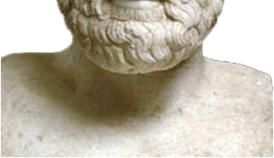
Good as aspiration
Every art and every inquiry, and similarly every action and pursuit, is thought to aim at some good; and for this reason the good has rightly been declared to be that at which all things aim.
Aristotle, Nicomachean Ethics

Slide 6
‘Good’ puzzles (a)
A) What is good?
The impossibility of defining good
(Moore 1903, Principia Ethica)
Aristotle: no such attempt. Practical way instead.

Slide 7
‘Good’ puzzles (b)
B) Is there any intrinsic good?
[Good] seems different in different actions and arts; it is different in medicine, in strategy, and in the other arts likewise. What then is the good of each? Surely that for whose sake everything else is done. In medicine this is health, in strategy victory, in architecture a house, in any other sphere something else, and in every action and pursuit the end; for it is for the sake of this that all men do whatever else they do. Therefore, if there is an end for all that we do, this will be the good achievable by action, and if there are more than one, these will be the goods achievable by action.
(…) we call final without qualification that which is always desirable in itself and never for the sake of something else.

Slide 8
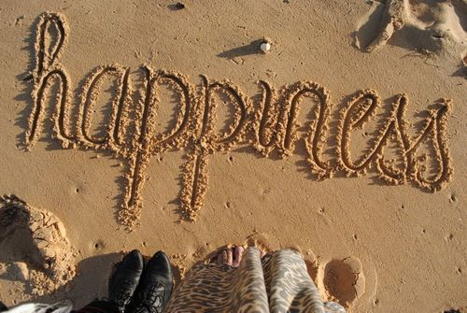
Now such a thing happiness, above all else, is held to be;
for this we choose always for self and never for the sake of something else, but honour, pleasure, reason, and every virtue we choose indeed for themselves (for if nothing resulted from them we should still choose each of them), but we choose them also for the sake of happiness, judging that by means of them we shall be happy. Happiness, on the other hand, no one chooses for the sake of these, nor, in general, for anything other than itself.
What are the demands of happiness?

Slide 9
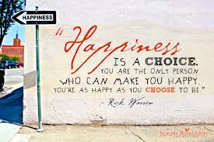
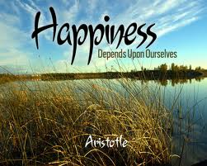
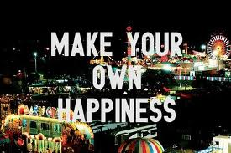
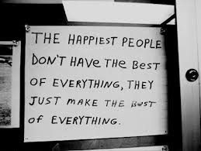

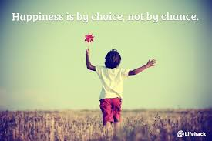
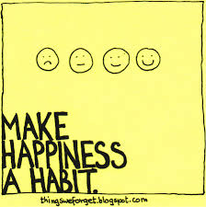
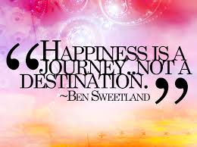
The Google theory of happiness

Slide 10
Moralizing happiness
Aristotle:
  A happy life is a virtuous life
  'the virtue of man will be the state of character [disposition] which makes a man good and which makes him do his own work well'
  [Nicomachean Ethics]
Utilitarianism:
  Social principle:
  What counts in moral considerations is not only an individual pleasure of an agent, but a happiness of every potentially involved person – 'the greatest happiness of the greatest number of people‘.

Slide 11
The change of perspective
Not what ought we to do, or what ought we not to do, but what kind of person we should become.
The main moral question is a question on a character of someone;
as well as: how one's character is shaped by their deeds
'[Virtue ethics asks about] virtues themselves, motives and moral character, moral education, moral wisdom or discernment, friendship and family relationships, a deep concept of happiness, the role of the emotions in our moral life and the fundamentally important questions of what sort of person I should be and how we should live.'
Stanford Encyclopedia of Philosophy, Virtue ethics

Slide 12
The role of phronesis
Phronesis: practical wisdom, prudence
'It is the mark of an educated man to look for precision in each class of things just so far as the nature of the subject admits; it is evidently equally foolish to accept probable reasoning from a mathematician and to demand from a rhetorician scientific proofs.'
Aristotle, Nicomachean Ethics
What is more important than an abstract moral code is a practical wisdom and life experience.

Slide 13
Relation between goods and virtues
By a "practice" I am going to mean any coherent and complex form of socially established cooperative human activity through which goods internal to that form of activity are realized in the course of trying to achieve those standards of excellence which are appropriate to, and partially definitive of, that form of activity…
A. MacIntyre, After Virtue

Slide 14

Practices and goods…
There are the goods internal to the practice of chess which cannot be had in any way but by playing chess or some other game of that specific kind. We call them internal for two reasons:
first, (…) because we can only specify them in terms of chess or some other game of that specific kind and by means of examples from such games (…);
and secondly because they can only be identified and recognized by the experience of participating in the practice in question.

Slide 15
Practices, goods, and virtues
A virtue is an acquired human quality the possession and exercise of which tends to enable us to achieve those goods which are internal to practices and the lack of which effectively prevents us from achieving any such goods.

Slide 16
Practices, goods, and virtues
A virtue is an acquired human quality the possession and exercise of which tends to enable us to achieve those goods which are internal to practices and the lack of which effectively prevents us from achieving any such goods.
A world champion in nose digging?
Social nature of virtues

Slide 17
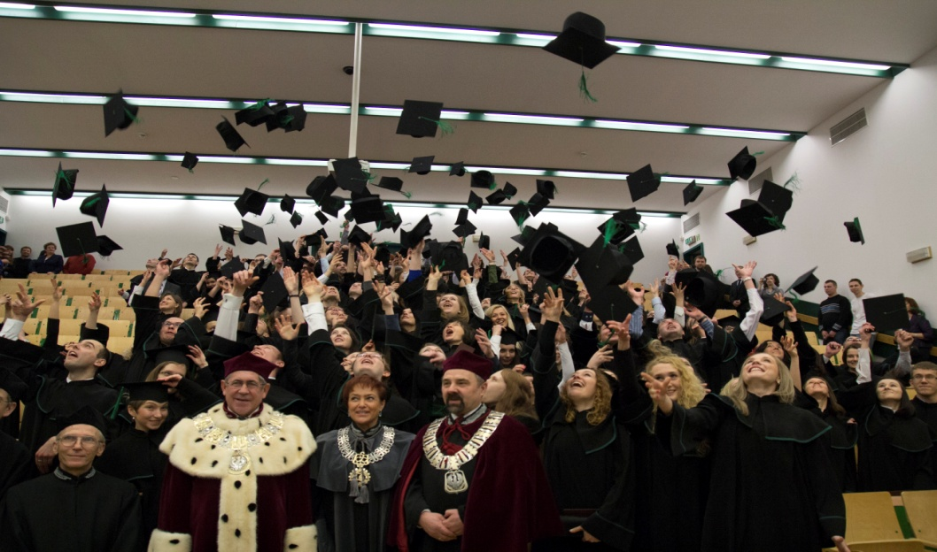
Just distribution

Slide 18

Who deserves an honour?
Nobel Prize for „a narrative imagination that with encyclopedic passion represents the crossing of boundaries as a form of life”.

Slide 19
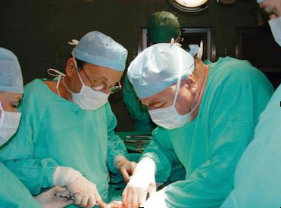
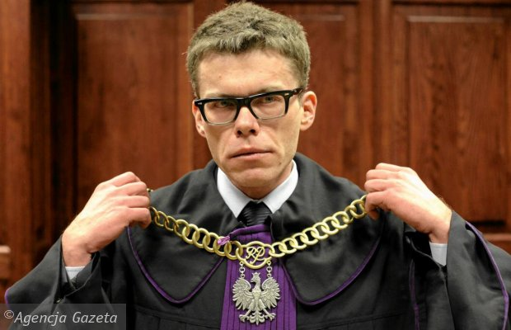
Professional telos

Slide 20

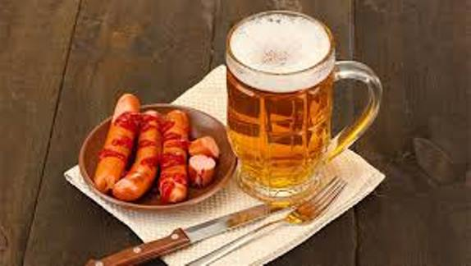
Eat, Drink, & Vote

Slide 21
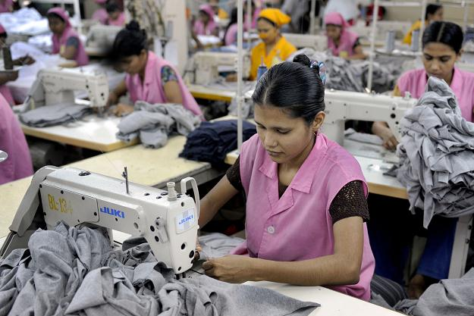
Labour & Slavery

