Slide 1
Female criminality

Slide 2
Introduction
In the past women were virtually insvisible in the literature on crime
Criminality was assumed to be a male charasteristics
Females were traditionally seen as law-abiding
As Katherine Williams points out, even in shoplifting, a crime which is traditonally linked to women, there are more males than women convicted.
This is a global phenomenon
They were marginalised

Slide 3
Biological, hormonal and psychological theories
Lombrosso (1895), his works on women criminality were kind of innovative
Even though we see flaws in his rather simplistic arguments his ideas were not wholly to discount
Results of atavistic throwbacks
He argued that the most advanced forms of human were white males and the most primitive are non-white females
He took tests in Sicily and based his theory on specific features of look: darker skin, being short, having dark hair
Females are less advanced than males
Lombroso’s theory therefore seems to point towards a higher female than male criminal rate but – according to statistics – it was not. So he argued that prostitution is the female substitution for crime
Lombroso claimed that women have a smaller cerebral cortex which means they are less inteligent and less capable of abstract reasoning.
Women, like animals, are more capable od surviving in unpleasant surroundings.
’pseudo-criminals’ vs born criminals (35% of all criminals)

Slide 4
Money and Enrhardt (1972) – suggested that the genetic passivity of females is related to the different brains of men and women and the difference in hormones between them
experiments were made on rats and monkeys
Soon after a birth a rat’s brain becomes either male (a predominance of androgens) of female (a predominance of oestrogens)
If in early life a female is injected with androgence she becomes agresive and indistuingishable from a male while an early castrated male will become more passive

Slide 5
’generative phases’ of women: this biological theory is based on the changes connected with the menstrual cycle
Although it is unclear whether women generally are involved in a higher incidence of criminality during their generative phases, it is clear that the law takes account on these elements in deciding some cases
Menstruation and menopause often were accepted as factors which should reduce sentences

Slide 6
In R v Craddock [1981]: the woman faced a murder charge which was reduced to manslaughter due to diminished responsibility attributed to the pre-menstrual tension (PMT), and had received a probationary sentence with a proviso that she undergo hormone treatment
Highly controversial
Most of scientist claim that if there are effects of the PMT they appear to be mainly psychological, such as tension, irritability, depression, tiredness, mood swings and feelings of loneliness
Infanticide – women’s mind and behaviour are affected by the hormonal changes in her body
Post natal-depression, lactation
Result of exhaustion, caring for the child, guilt for not feeling affetion to it, social presures
Hormonal imbalances sufferedby men do not normally affect their conviction or their sentence

Slide 7
Freud, 1973
Where Lombroso distinguished between born criminals and other people, Freud saw everyone as a potential criminal in the sense that all human beings are born amoral but most will learn to control their criminal designs
The central tenet of this theory tends to be sexual
Due to the lack of a penis the female feels inferior
Inferiority complex
A girl, who recognises that the has inferior sexual organd, believes it is a punishment
They become envious and narcisstic, try to be well-dressed and attractive in order to win love and approval from men
Women are passive, focused on the pursuit of men’s approval so therefore controlled
The birth of a child would be seen as particularly therapeutic as the baby is a substitute for a penis

Slide 8
Pollak’s theory (1950) is also sex-based.
Women are traditionally shy, passive and passionless, but can simulate a sexual orgasm to hide their true feelings
They can have sex without physical passion and they can learn to hide their montly menstruation
Their manipulate men with their sexual sphere
Pollak claimed that the criminal justice system also treaded females differently than men beacuse men generally have a protecitve attitude towards women
Men thus disliked making accusations towards women because they did not want women to be punished

Slide 9
Charles Tittle’s theory of the control balance – women were seen as suffering a severe control deficit (men – rather control surplus)
This can be seen in their general treatment in society, especially in terms of harassment, being regarded as objects, the lack of suport by authorities, and typically having little control in all kinds of situations
In domestic violence in particular, the rationale for non-intervention was tradionally that the family is a private place were the male often asserts his control

Slide 10
Feminist theories
In the 1970s it became obvious that one of the most striking features about female criminality and conformity was the lack of research and information available.
Female and gender issues were ignored, and attention focused on male criminality and the male.
The male was seen as independent, autonomous, inteligent, active, assertive, rational, unemotional, competetive, achieving and objective.
The woman was seen as dependent, passive, uncompetetive, immature, unachieving, unintelligent, emotional, subjective and irrational.
The view of women has been challenged by feminists in various ways.

Slide 11
Daly and Chesney-Lind (1988) outline certain central tenets of feminist thought:
Gender is not a natural fact nor it is dictated by biological sex differences (though it is associated with these) but rather is a product of society, history, culture and politics
Social life and State organs are heavily ordered through gender and gender relations, always premised on the superiority of men
Even radical criminological theories appear gender neutral but were actually theories of males comitting crimes, women’s behaviour did not fit these theories
Women should be central to all knowledge, equal with men

Slide 12
1) LIBERAL FEMINISM
– views women as an equal part of society;
-it centres on rights and non-discrimination
-equal work rights, equal pay
-Mary Wollstonecraft's ‚Call for Women's Rights’ from 1789.
-The ‚Subjection of Women’ by John Stuart Mill from 1869 is considered another classic work of early liberal feminism.
-The demands of first-wave liberal feminists concerned primarily changes in the law on marriage, property, education, work and electoral rights. After achieving its goals in the early twentieth century, first-wave feminism weakened significantly.
-Liberal feminism is criticized for its superficiality and focus on formal guarantees of equality.

Slide 13
2) RADICAL FEMINISM
One of the currents in the second wave of feminism
The second wave of feminism in the US was a consequence of disappointment with the current equality efforts focused primarily on formal legal guarantees.
Awareness of discrimination increased after President John F. Kennedy, at the request of Eleanor Roosevelt, set up committees to investigate the unequal treatment of women. The commission has publicized the goals of feminists.

Slide 14
Radical feminism is a perspective within feminism that calls for a radical reordering of society in which male supremacy is eliminated in all social and economic contexts.
Radical feminists view society as fundamentally a patriarchy in which men dominate and oppress women. Radical feminists seek to abolish the patriarchy in order to "liberate everyone from an unjust society by challenging existing social norms and institutions."
Catherine MacKinnon (1984) views male power being maintaned by a failure to prevent and control sexual violence (rape, domestic violence, sexual harrasment and pornography) and so MacKinnon and Moore (1993) have argued hard for the protection of women by the further criminalisation of pornography for its portrayal of women as second-class citizens.
Its criminalisation they see as necessary to restore to women their dignity, equality and power.

Slide 15
Female theories about female offending
Adler (1975) proposed that the emancipation of women during the 1970s increased economic opportunities for women and allowed women to be as crime-prone as men. While ’women have demanded equal opportunity in the fields of legitimate endeavours, a similar number of determined women have forced their way into the world of major crime such as white-collar crime, murder, and robbery’ (Adler, 1975). She suggested that as women were climbing up the corporate business ladder, they were making use of their 'vocational liberation' to pursue careers in white-collar crime. However, feminism has made female crime more visible through increased reporting, policing and the sentencing of female offenders and, even then, the statistical base is small in comparison to men

Slide 16
Farrington and Morris (1983) found some empirical evidence that women did receive less severe punishments, but female offenders are far more likely to be first-time offenders, and to have committed a less serious form of the relevant offence; they stole smaller or fewer items, used less violence, and so on. Prior history of offending, and seriousness of offence, are fundamental factors in determining severity of sentence, for any offender.

Slide 18
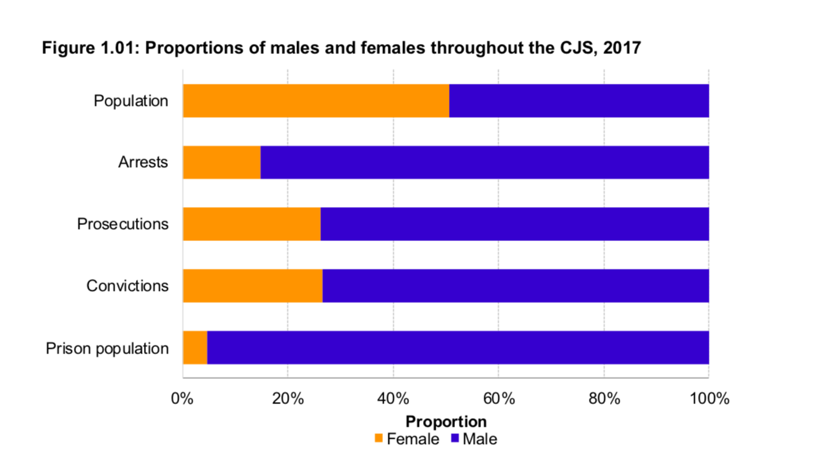
Source: Statistics on Women and the Criminal Justice System 2017; A Ministry of Justice publication under Section 95 of the Criminal Justice Act 1991, p. 3; https://assets.publishing.service.gov.uk/government/uploads/system/uploads/attachment_data/file/759770/women-criminal-justice-system-2017..pdf

Slide 19
Susan Atkins, Patty Hearst, Brenda Spencer, Aileen Wuornos, Rita Gorgonowa

