Slide 1
Contemporary management
Winter Semester 2019/2020
Class I Introduction

Slide 2
Organization
A group of people working together to achieve in structured and coordinated way to achieve a set of goals

Slide 3
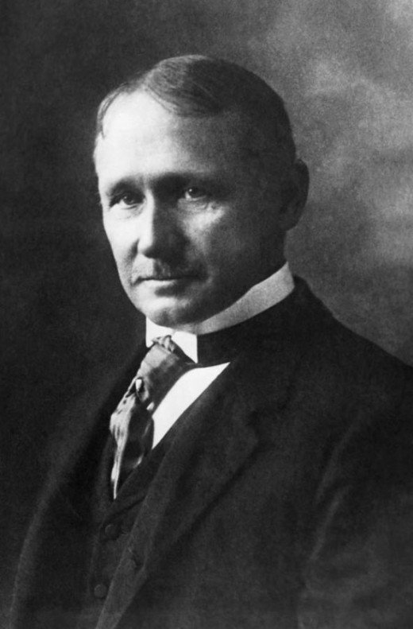
Management
Management is an art of knowing what is to be done and seeing that it is done in the best possible manner
- F. W. Taylor

Slide 4
Organization in resource-based perspective
Organization | Human resources | Financial resources | Physical resources | Information resources
Shell Group | Executives Drill platforms workers | Profits Investments of stakeholders | Refineries Office facilities | sales forecasts OPEC communications
University of Wrocław | Academic staff Auxiliary staff | tuition fees Subsidies | Computers Buildings | Research reports publications
Wrocław | Policeman, firefighters Communal workers | Taxes Fines Subsidies | Communal buildings | Economical forecasts Criminal statistics
Żabka | Salesman accountant | Profits investments | Building Sold goods, shelves | Suppliers price lists

Slide 5
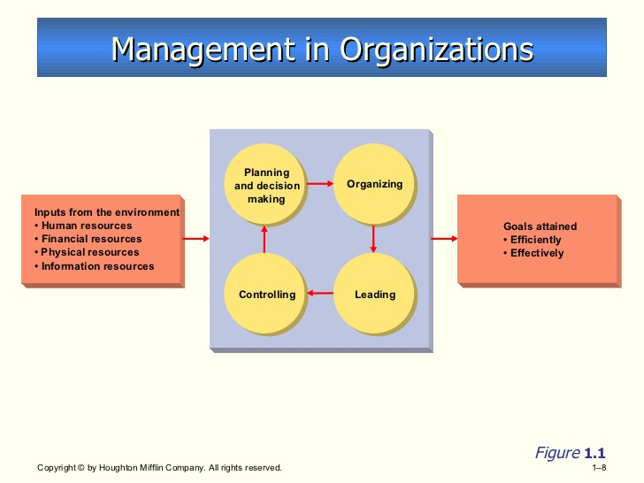

Slide 6
Management is a set of activities
Planning and decision making, organizing, leading, and controlling
Directed at an organization’s resources
Human, financial, physical, and information
with the aim of achieving organizational goals in an efficient and effective manner
Efficiently
Using resources wisely and in a cost-effective way
Effectively
Making the right decisions and successfully implementing them
Manager
Someone whose primary responsibility is to carry out the management process

Slide 7
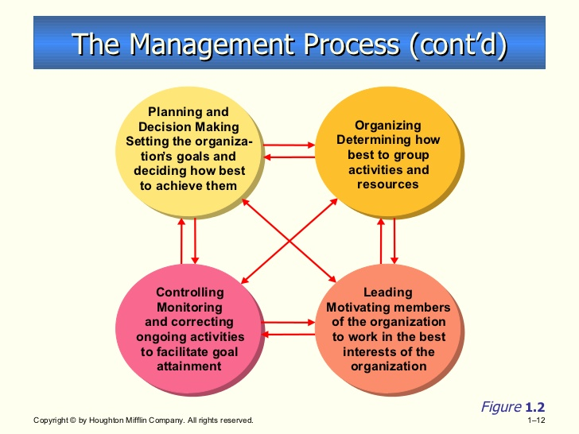

Slide 8
Kinds of Managers by Level
Top Managers
The relatively small group of executives who manage the overall organization. They create the organization’s goals, overall strategy, and operating policies.
Middle Managers
Largest group of managers in organizations who are primarily responsible for implementing the policies and plans of top managers. They also supervise and coordinate the activities of lower level managers.
First-Line Managers
Managers who supervise and coordinate the activities of operating employees.
Top Managers
Middle Managers
First-Line Managers

Slide 9
Kinds of Managers by Area
Marketing Managers
Work in areas related to getting consumers and clients to buy the organization’s products or services—new product development, promotion, and distribution.
Financial Managers
Deal primarily with an organization’s financial resources—accounting, cash management, and investments.
Operations Managers
Concerned with creating and managing the systems that create organization’s products and services—production control, inventory, quality control, plant layout, site selection.

Slide 10
Kinds of Managers by Area
Human Resource Managers
Involved in human resource planning, recruiting and selecting employees, training and development, designing compensation and benefit systems, formulating performance appraisal systems, and discharging low-performing employees.
Administrative Managers
Generalists who are familiar with all functional areas of management and who are not associated with any particular management specialty.
Other Kinds of Menagers
Organizations have developed specialized managerial positions (e.g., public relations managers) directly related to the needs of the organization.

Slide 11
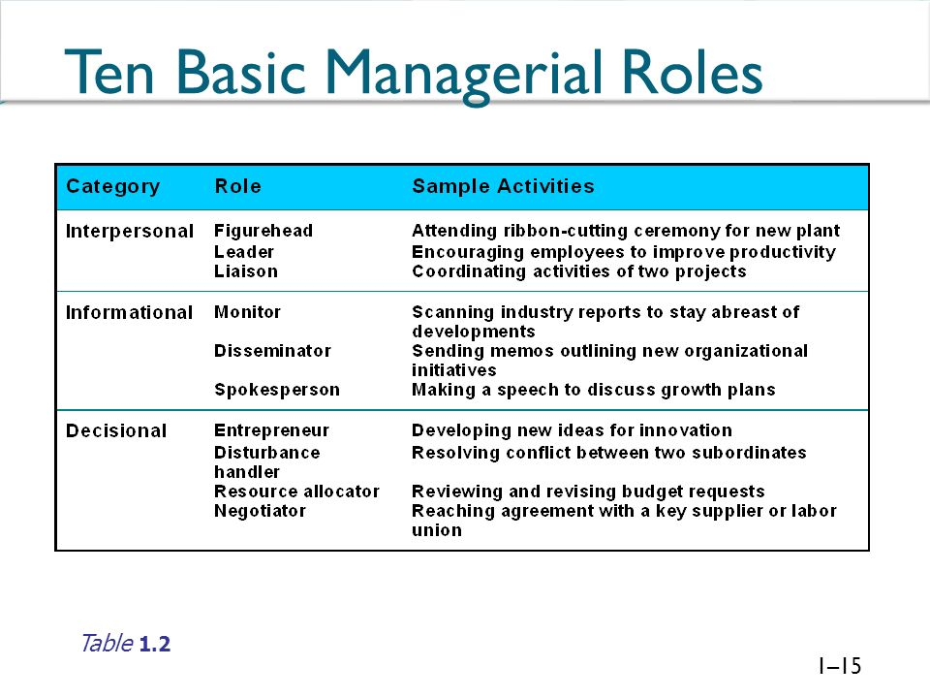

Slide 12
Managing in Organizations
For-profit Organizations
Large businesses
Industrial firms, commercial banks, insurance companies, retailers, transportation companies, utilities, communication companies, service organizations
Small businesses and start-up businesses
International management
Not-for-profit Organizations
Governmental organizations—local, state, and federal
Educational organizations—public and private schools, colleges, and universities
Healthcare facilities—public hospitals and HMOs
Nontraditional settings—community, social, spiritual groups

Slide 13
Homework ☺
List and describe managerial skills
Prepare to discuss them for the next meeting

Slide 14
Source
R. W. Griffin, Management, 12th ed., Boston: Cengage Learning, cop. 2017. pp. 34-64.

