Slide 1
Contract Law in Poland Monika Drela
Podtytuł

Slide 2

Essentials of valid contract
Contractual (legal) capacity
Free consent (authonomy)
Plurality of parties (promisor + promisee / offeror + offeree)
Proposal (offer) + acceptance without changes
They will create an obligation and that obligation will be enforceable at law
Possibility of performance
Legal formalities - formation of a contract

Slide 3
offer, counter-offer, rejection, acceptance
Art. 68 and 68 ¹ CC - an offer accepted with a stipulation of changes or supplements to its content is deemed a new offer. But between entrepreneurs when the changes do not materially change the content of the offer they are accepted if the other party immediately objects the changes made or if the offer states that it may be accepted without changes only

Slide 4
Case 1 (a)
The defendant gave the plaintiff an option to buy his car which could be exercised "by notice in writing". The plaintiffs posted a letter exercising this option but the letter was lost in the post and the plaintiffs claimed specific performance.
Had the option been validly exercised ?
Had the situation been different if the offer was delivered via email and the answer was sent immediately but was never opened nor read by the defendant ?

Slide 5
Art. 61 C.C.
A declaration of intent which is to be made to another person is deemed made at the time it reaches that person in such a manner that he could have read its content.
A declaration of intent expressed in electronic form is deemed made to another person at the time it is introduced to the means of electronic communication in such manner that the person could have read its content.

Slide 6
Case
A sends a written letter dated April 5th to B by post, offering to sell his five newborn pedigree dogs for 1000 euros per capita, saying the offer is open until April 9th and he must have heard from B by then.
B receives it on April 6th and immediately prepares email of acceptance – he wanted to buy only female dogs . Before B sends his acceptance in the morning of Aptil 7th , A changes its mind and calls B saying he cancels the offer.
Has the offer been accepted, rejected, revoked or changed ?

Slide 7
Jan owed to bank 1000 PLN falling due on March the 1st. Adam needed money in January. He would not care if Jan could not repay the same amount. Adam offered reduction of the debt, that can only be enforceable under the following manners:
★ Adam agreed to reduce it to 800 PLN, in return Jan would repay him before March1.
★ Adam agreed to abandon the debt, in return Jan gave him something of value, e.g., a
★ Jan’s friend, C agreed to pay to Adam 800 PLN, in return Adam would refrain from suing Jan.
★ Jan and Adam made the debt reduction agreement in writing

Slide 8
Defects in declaration of Intent
Lack of consciousness or freedom – art. 82
Ostensible nature – art. 83
Error , mistake – art. 84
Deceit with intention – art. 86
Threat – art. 87
Error, deceit & threat – party entitled to declare avoidance in writing within 1 year after discovery of error or deceit or ceasing threat

Slide 9
Classification of contracts
Valid – enforceable by law
Void – contract that ceases to be enforceable
Illegal – non existence, prohibited, forbiden by law
Nominate, innominate, mixed contracts
Among innominate contracts there are contracts that comprise elements of different kinds of nominate contracts (mixed contracts) and other contracts that have nothing in common with ‘nominate contracts’.

Slide 10
Classification of contracts
Reciprocal (Synallagmatic, Mutual) Contracts
Consideration equivalent
Article 487§2 CC,
the contract where the parties are obliged in such a manner that performance of one party corresponds to performance of the other party.
In literature and jurisprudence it is said there is no need for direct, economic equivalence of performances rendered by the parties. It is rather a matter of subjective equivalence, which means that according to the parties’ subjective appraisal the value of the rendered performances is equal.

Slide 11
Valid Contract
Legal capacity & representation
Lack of defects of intention
Legal performance
Formalities – forms of contract
Possibility of performance
Free will and consensus of intentions
Express contract only
Implied contract

Slide 12
Auction (bid = prices) and Tender (offer = price and other importent content)
The Polish Civil Code in Article 70¹ –70⁵ regulates auction and tender, which are two kinds of one procedure concerning conclusion of the contract.
The procedure is to agree the content of the declarations of will and to choose a party to the contract from a group of interested persons who are in the same legal position (it is a multilateral and eliminative procedure). The procedure consists of three stages: announcement, submission of tenders and acceptance.

Slide 13
Procedure: announcements, offers (bids), chosing
Article 70¹ §2 CC the announcement of the auction or the tender has to stipulate time, place, subject and conditions of the auction or the tender. The organizer and participants are bound by the stipulations of the announcement and conditions concerning the auction or the tender, which means that they have to comply with provisions of the announcement and conditions.

Slide 14
Auction Tender
The bids made by the particular participants are submitted sequentially and publicly. Each subsequent bid should be more beneficial for the organizer and each participant may submit any number of bids. The bid submitted by the participant is a definitive proposal to conclude the contract of a content specified in the announcement. It binds the participant in the same way as the offer submitted in the ‘offer and acceptance’ procedure and it is binding until a more beneficial bid is submitted.
The bids made by the particular participants are submitted sequentially and publicly. Each subsequent bid should be more beneficial for the organizer and each participant may submit any number of bids. The bid submitted by the participant is a definitive proposal to conclude the contract of a content specified in the announcement. It binds the participant in the same way as the offer submitted in the ‘offer and acceptance’ procedure and it is binding until a more beneficial bid is submitted.

Slide 15
Formalities Forms of contract
.

Slide 16
The basic principle is the freedom of form, expressed in Article 60 CC. This provision states that the declaration of will may be expressed in any form of sign or means of communication. However, there are some exceptions to this rule. Certain formal requirements apply to certain contracts by virtue of statutory provisions and the specific form for concluding a contract may be also stipulated by the parties (Article 76 CC).
Exemptions
a) An ordinary written form, which is observed if the parties append their signatures to the document containing the declaration of will or they exchange the undersigned documents, which contain their respective declarations of will (Article 78 CC).
Electionic form equivalent to ordinary written form

Slide 17
Qualified written forms that require additional features apart from the signature on the document containing declarations of will:
b) Written form with an authenticated date – which may occur in two ways:
(i) as a form of contract, that is, official (made by the notary) authentication of a date when the contract was concluded (Art. 81 §1 CC);
(ii) as a confirmation of the date, on which the document covering the juridical act existed, so that it may be implied that the contract was concluded at the latest at this date (notarial confirmation of the date of document’s presentation and other actions listed in Art. 81 §2 and §3 CC).
(c) Written form with authenticated signature – which means that the notary stipulates on the document a clause that states that the signature included in the document is made by a person whose identity is confirmed by the notary.
(d) Form of the notarial deed – the document that consists of the declaration of will, made by the notary on the basis of oral statement of the person who is conducting

Slide 18
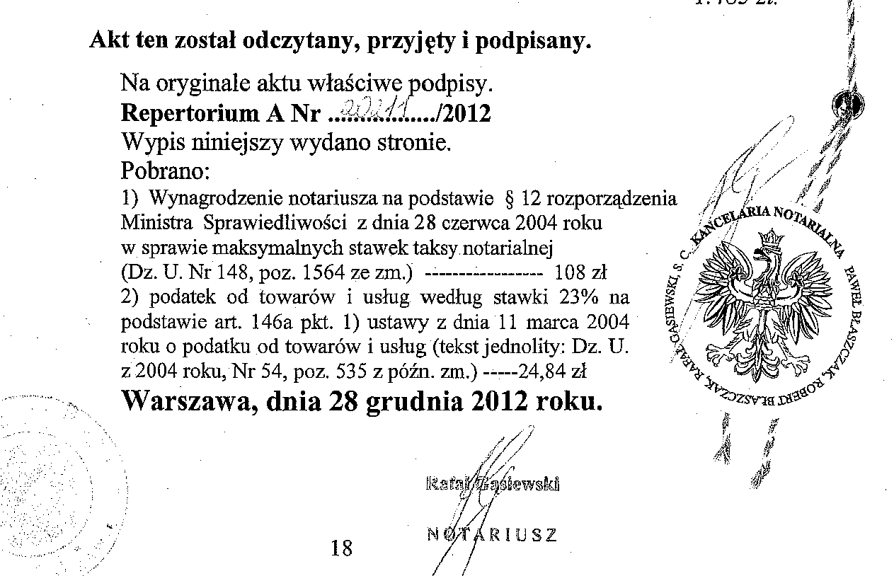
Notarial deed – AKT NOTARIALNY

Slide 19
Art. 158 C.C.
Contract creating obligation to transfer the ownership of real estate should be executed in the form of a notarial deed. The same applies to contracts transfering perpetual usufruct and ownership of premises, but the last two contracts are legaly effective only if the notary act was succesfullly entered into mortgage book of the real estate transfered.

Slide 20
Art. 155 C.C.
Sale, exchange, donation, real estate alienation or other contract creating an obligation to transfer the ownership of goods in specie transfers the ownership to the acquirer ubles a specific regulation provides otherwise or the partied decided otherwise.
If fungibles are the subject of abovementioned contract, transfer of possession is recquired. The same applies if the subject of the contract creating an abligation to transfer ownership is future thin.
FUNGIBLES: 1. things, which may be furnished or restored in kind, as distinguished from specific things; - called also fungible things.
2. movable goods which may be valued by weight or measure, in contradistinction from those which must be judged of individually.

Slide 21
Transfer of ownership of immovables. – art. 157 C.C.
The ownership of real estate may not be transferred on a condition or subject to time limit.
Double effect contracts
obligation + disposition
One effect
obligation
condition or time limit allowed
one effect disposition
Transfer of ownership

Slide 22
Case
Father bought a house on mortgage for his son and daughter-in-law and promised them that if they paid off the mortgage, they could have the house. They began to do this but before they had finished paying, the father died. His widow claimed the house.
Please specify whether this was a valid contract under Polish Law ?
Please form this contract so as to achive the best protection of the son’s and his wife’s interest.

Slide 23
Art. 73 § 1 and art.74 CC – written form ad probationem
a) It the law stipulates that a legal act be made in writing, an act made without observing the form is invalid only if the law provides for nullity clause
(example: general power of attorney – art. 99 § 2 CC)
b) Stipulation of written form without a nullity clause leads in diffilulties while presenting evidences in litigation (witness and parties evidences) concerning the performance of the act
c) The litigation difficulties do not apply to contracts entered between enterpreneurs.

Slide 24
Art. 73 § 2 CC forms qualified, in general, are stipuleted ad solemnitetem
If the law stipulates that a legal act be made in another specific form, an act made without observing this form is invalid - form ad solemnitatem. Examle: art. 158 CC – real estate sale
The rule does not apply if a specific form is stipulated only in order to produce the specified effects of a legal act – form ad eventum
Example: art. 660 CC – a real estate or premises tenancy contract of limited time for longer than one year should be executed in writing. If this form is not observed, the contract is deemed as a contract for a non limited time tenancy

Slide 25
Amandements, termination rescission

Slide 26
Pacta sunt servanda but……… not always.
Termination with both parties consent – always possible
Termination of continuous obligation – one declaration of will of one party, contract ceases to exist.
Art.. 365 (1) C.C. Obligation unlimited in time expires upon being terminated by debtor or creditor with observance of contractual, statutory or customary notice periods – and when there are none of such periods, immediately upon delivery of the notice
Rescission is the right to annulate the contract from its begining, as it has never been entered.
Contractual right – art. 395 C.C., art. 492 C.C.
Ex lege – art. 491 C.C. debtor defaults in performance and the contract is reciprocal

Slide 27
Art. 76 pactum de forma
If the parties decided in a contract that a specified legal act between them (ex. termination of contracts, amendments) should be made in a specific corm, that act takes effect only if the form is observed.
However, if the parties stipulated form in writing without specifying the consequences if the form is not observed, it is assumed the the form is recquired only for evidence purposes.

Slide 28
Change of contract – amendments Formalities
Art. 77 C.C.
§ 1 Contract may be supplemented or amended only in the form stipulated by the law or agreed by the parties for its creation.
§ 2 If the contract was made in writing, its termination with the consent of both parties and also its rescission or termination by one party should be stated in writing (ad probationem)
§ 3 If a contract is made in another form qualified, termination with the consent of both parties must be made in the same form (ad solemnitatem), however rescission or termination by one party onlly should be stated in writing (ad probationem)

Slide 29
Preliminary agreement
Art. 389 and art. 390 C.C.

Slide 30
Preliminary agreement
Specified – definitive contract
Preliminary contract – obligation to enter definitive contract
essential provisions of the future contract
may contain a date, when the definitive contract is to be concluded, but if the date is not specified, each party, which can demand conclusion of the future contract, may set a proper date by announcement presented to the other party.

Slide 31
Consequences of not fulfilling the promise to enter definitive contrct If the definitive contract is not concluded within the date set in preliminary agreement, the other party may: 1) seek damages or 2) in some circumstances - demand from a court issuance of a judgment that substitutes for the definitive contract (64 C.C.)

Slide 32
1) The damages are calculated by comparing the creditor’s assets that would have existed in case of not undertaking any actions in order to conclude the future contract and condition of creditor’s assets, which was caused by the fact that the creditor concluded the preliminary agreement and hoped for conclusion of the specified contract. 2) Demand a judicial decision that fills in for the definitive contract. If the validity of the definitive contract depends on meeting special form of the contract, the said claim may only be raised if the preliminary agreement has met the special form.

Slide 33
Claims that arise on the grounds of the preliminary agreement are barred by limitation of one year from the date on which the definitive contract was to be concluded. However, if the creditor demands to issue judgment that substitutes for the definitive contract, the limitation period for damages claims commences on the day in which the decision concerning dismissal of claim becomes valid.

