Slide 1
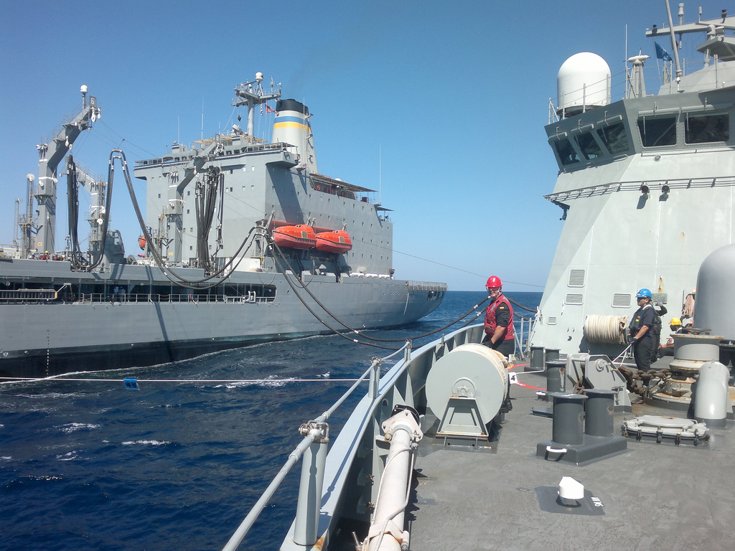

EU NAVAL POWER PROJECTION IN CFSP
ŁUKASZ STĘPKOWSKI
Some Photos CC (=) EUNAVFOR
secure.flickr.com/photos/eunavfor

Slide 2
SCOPE OF THIS PRESENTATION
ACTIVITIES OF THE EUROPEAN UNION THAT ARE UNDERTAKEN IN THE FIELD OF COMMON FOREIGN AND SECURITY POLICY (THAT IS, ON THE INTERNATIONAL SCENE), ESPECIALLY WITHIN THE COMMON SECURITY AND DEFENCE POLICY, CONCERNING AN EXTERNAL DISPLAY OF POWER
  SUCH ACTIVITES NEED TO BE CONDUCTED AT SEA OUTSIDE THE TERRITORY OF MEMBER STATES OF THE EUROPEAN UNION

Slide 3
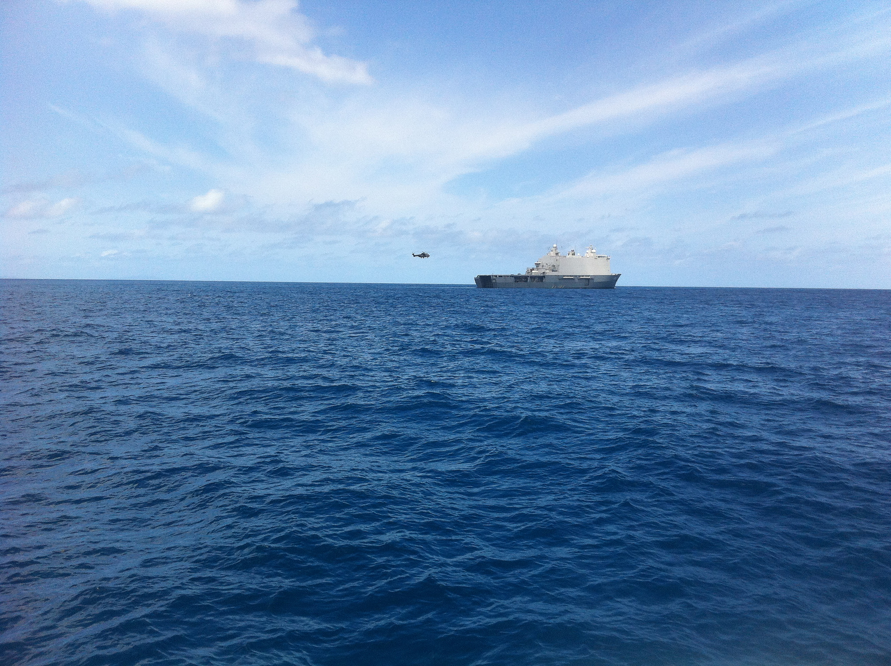
POWER
„ABILITY OF ONE ACTOR (WHETHER A PERSON OR A STATE) TO ENCOURAGE OTHERS TO ACT IN A CERTAIN WAY”
(McCORMICK, POLITICS OF THE EU, 2011)
  HARD POWER
  SOFT POWER
  CIVILIAN AND MILITARY POWER

Slide 4
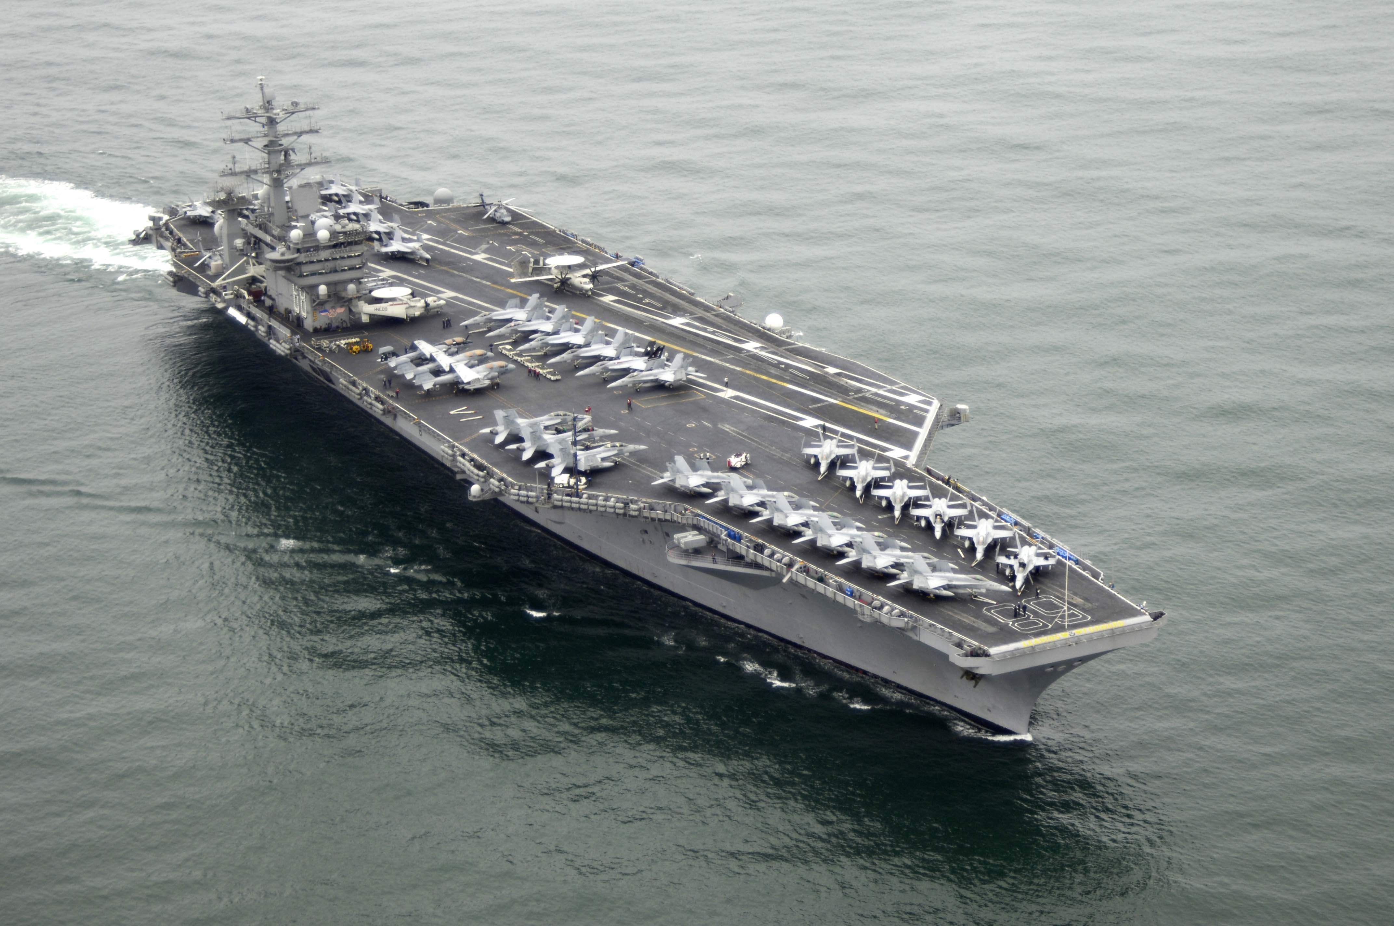
WHY SHOULD ONE PROJECT ?
OTHERS
ADVANCEMENT OF EU’s PRINCIPLES AND VALUES
FULFILLMENT OF EU’s AIMS
OTHERS DO IT
I GUESS WE WERE GOOD AT GUNBOAT DIPLOMACY BEFORE, WERE WE NOT ?

Slide 5
LEGAL BASIS – PRIMARY LAW
TREATY ON EUROPEAN UNION – TITLE V
  GENERAL PROVISIONS
  CHAPTER 2 - SPECIFIC CFSP PROVISIONS
  „The union's competence in matters of common foreign and security policy shall cover all areas of foreign policy and all questions relating to the union's security, including the progressive framing of a common defence policy that might lead to a common defence”
  INSTITUTIONAL PLAYERS : THE EUROPEAN COUNCIL, THE COUNCIL, THE HIGH REPRESENTATIVE

Slide 6
SECONDARY LAW
NON-LEGISLATIVE ACTS OF THE EUROPEAN COUNCIL AND THE COUNCIL
DECISIONS OF THE POLITICAL AND SECURITY COMMITTEE
SOFT LAW
OF NOTE : THE ATALANTA JOINT ACTION
COUNCIL JOINT ACTION 2008/851/CFSP OF 10 NOVEMBER 2008 ON A EUROPEAN UNION MILITARY OPERATION TO CONTRIBUTE TO THE DETERRENCE, PREVENTION AND REPRESSION OF ACTS OF PIRACY AND ARMED ROBBERY OFF THE SOMALI COAST (OJ L 301, 12.11.2008, P.33)
AVAILABLE AT EUR-LEX.EUROPA.EU/EN/CONSLEG/LATEST/CHAP18.HTM

Slide 7
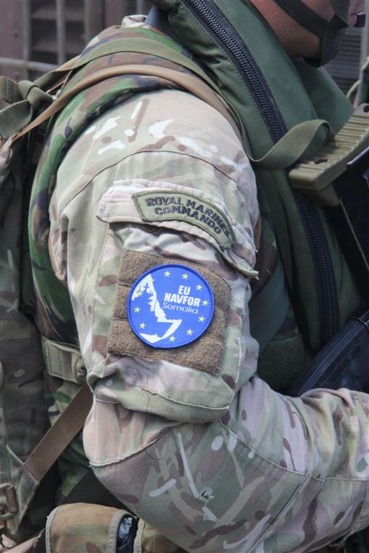
ATALANTA OPERATION
THE FIRST EUROPEAN UNION EXTERNAL NAVAL ACTION
MILITARY CHARACTER
AREA OF OPERATIONS : SOMALI COASTAL TERRITORY AND INTERNAL WATERS, AND THE MARITIME AREAS OFF THE COASTS OF SOMALIA AND NEIGHBOURING COUNTRIES WITHIN THE REGION OF THE INDIAN OCEAN, IN ACCORDANCE WITH THE POLITICAL OBJECTIVE OF AN EU MARITIME OPERATION, AS DEFINED IN THE CRISIS MANAGEMENT CONCEPT APPROVED BY THE COUNCIL ON 5 AUGUST 2008

Slide 8
EUNAVFOR
EUROPEAN UNION NAVAL FORCE SOMALIA (EUNAVFOR) – THE NAVAL FORCE CONDUCTING OPERATION ATALANTA
ACCOMPANIED BY :
CIVILIAN REGIONAL MARITIME CAPACITY BUILDING MISSION IN THE HORN OF AFRICA AND THE WESTERN INDIAN OCEAN – EUCAP NESTOR
EU TRAINING MISSION SOMALIA (EUTM SOMALIA)
http://eunavfor.eu

Slide 9
MISSION OVERVIEW
CONTRIBUTION TO :
— THE PROTECTION OF VESSELS OF THE WFP DELIVERING FOOD AID TO DISPLACED PERSONS IN SOMALIA, IN ACCORDANCE WITH THE MANDATE LAID DOWN IN UNSC RESOLUTION 1814 (2008), AND
— THE PROTECTION OF VULNERABLE VESSELS CRUISING OFF THE SOMALI COAST, AND THE DETERRENCE, PREVENTION AND REPRESSION OF ACTS OF PIRACY AND ARMED ROBBERY OFF THE SOMALI COAST, IN ACCORDANCE WITH THE MANDATE LAID DOWN IN UNSC RESOLUTIONS 1846 (2008) AND 1851 (2008)
— MONITORING OF FISHING ACTIVITIES OFF THE COAST OF SOMALIA.

Slide 10
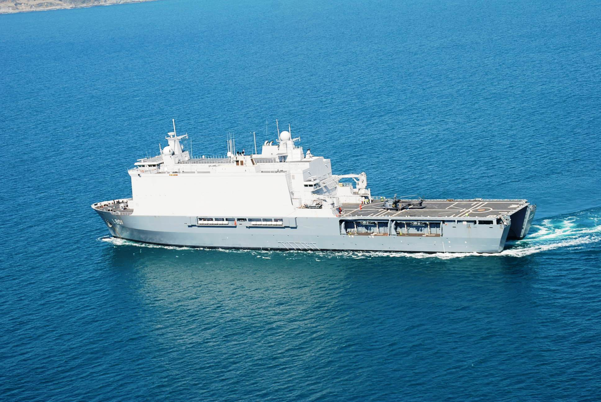
UNITS CURRENTLY DEPLOYED
HNLMS JOHAN DE WITT – FLAGSHIP, AMPHIBIOUS TRANSPORT SHIP, PICTURED (THE NETHERLANDS)
FGS NIEDERSACHSEN – FRIGATE (GERMANY)
ITS LIBECCIO – FRIGATE (ITALY)
ESPS TORNADO – FRIGATE (SPAIN)

Slide 11
EUNAVFOR ACTIVITIES SINCE 2009
WORLD FOOD PROGRAMME VESSELS PROTECTED : 243
AMISOM (AFRICAN UNION MISSION TO SOMALIA) VESSELS PROTECTED : 127
TONNES OF FOOD/AID DELIVERED BY WFP : 867,8003
PIRATES TRANSFERRED TO COMPETENT AUTHORITIES WITH A VIEW TO THEIR PROSECUTION : 149
REMANDED PIRATES : 28
CONVICTED PIRATES : 121
http://eunavfor.eu/key-facts-and-figures/

Slide 12
PIRATE ATTACKS SO FAR

Slide 13
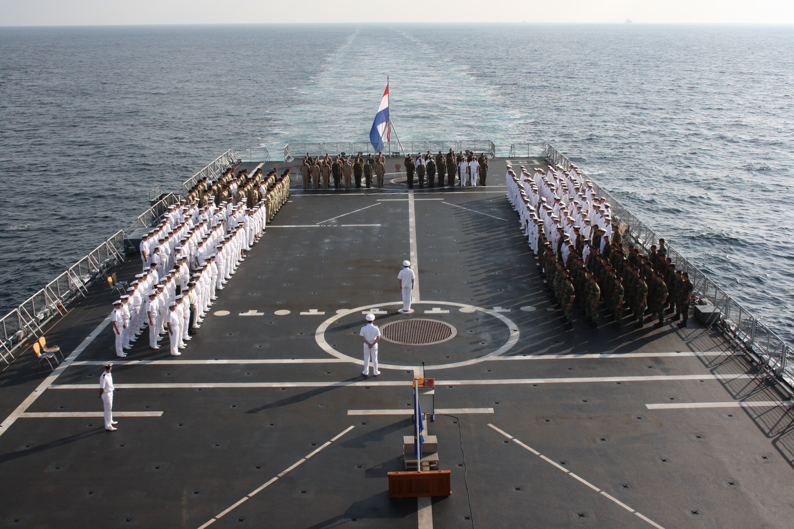
EUNAVFOR ACHIEVMENTS
No successfully pirated vessels since 31st of May 2012
Number of currently pirated ships down to one
And great photo ops.

Slide 14
CURRENT MISSION STATUS
Mission mandated to last until 12th of December 2014
Current EU Operation Commander : Rear Admiral Robert Tarrant (UK)
Current EU Force Commander : Commodore Peter Lenselink (NL)
Current amount of hostages held by pirates : 50

Slide 15
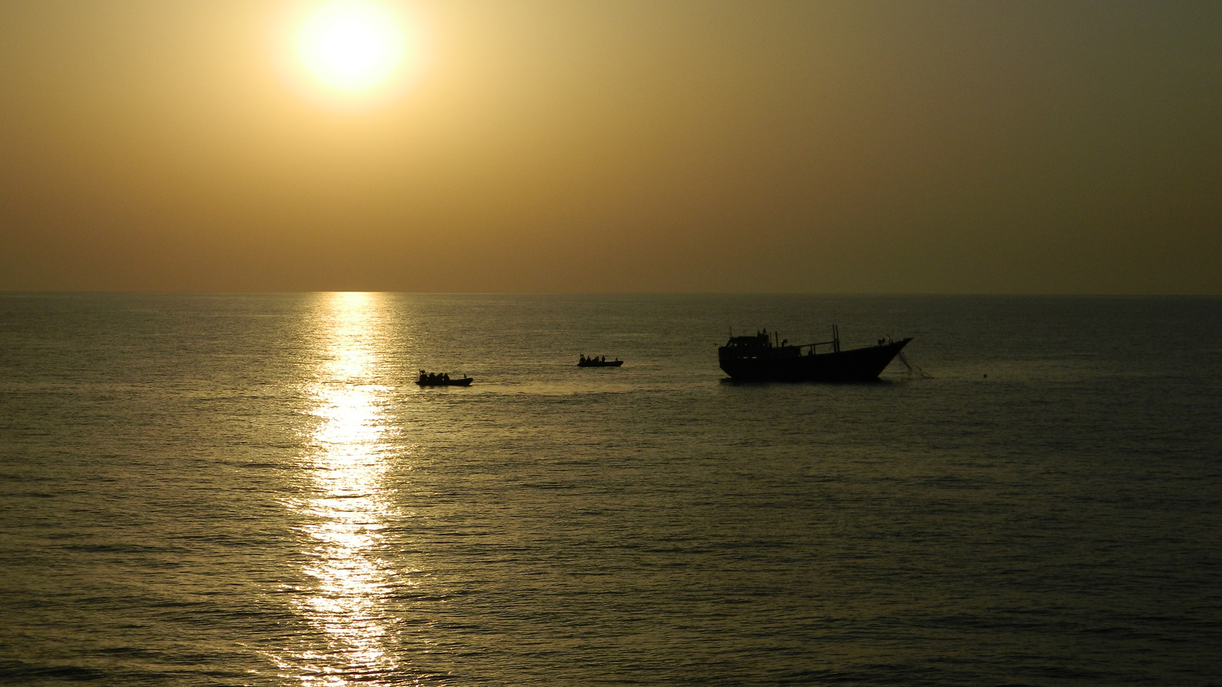
the end

