Slide 1
Licencje Creative Commons

Slide 2
Lawrence Lessig
amerykański profesor nauk prawnych i działacz społeczny. Zyskał sławę jako zwolennik reformy systemu praw autorskich na rzecz większej jego otwartości i zagwarantowania większych swobód użytkownikom utworów (Wikipedia)
2001 r. oficjalnie utworzenie projektu Creative Commons

Slide 3

All rights reserved
Some rights reserved
©

Slide 4

Czym jest otwarty dostęp?
Otwarty dostęp (ang. Open Access, OA) – wolny od barier technicznych, bezpłatny, powszechny, trwały i natychmiastowy dostęp do cyfrowych form zapisu danych i treści naukowych oraz edukacyjnych.

Slide 5
Modele otwartego dostępu
Model OA gratis = Dozwolony
użytek
Model OA Libre = Wolne licencje
„ darmowy i otwarty dostęp -rozpowszechnianie utworu w taki sposób, aby każdy mógł mieć do niego dostęp w miejscu i w czasie przez siebie wybranym oraz możliwość nieodpłatnego i nieograniczonego technicznie korzystania z nich zgodnie z właściwymi przepisami”¹
„ darmowy i otwarty dostęp -rozpowszechnianie utworu w taki sposób, aby każdy mógł mieć do niego dostęp w miejscu i w czasie przez siebie wybranym wraz z udzieleniem każdemu licencji na nieograniczone, nieodpłatne i niewyłączne korzystanie z nich oraz z ich ewentualnych opracowań…”²

Slide 6
Licencje Creative Commons (CC)
Creative Commons offer creators licenses that allow them to keep their own rights and at the same time share their work with others:
1. operate on the principle of "certain rights reserved" – as an extension of the "all rights reserved" principle
2. are granted in advance by the copyright owner by determining the rights to use the licensed work
3. allow you to specify the conditions under which others may exercise the right to copy the work.

Slide 7




Licence features
Attribution (always) – wskazanie autorstwa
No Commercial Use – brak użytku komercyjnego
No Derivative Works – bez utworów zależnych
Share Alike – po wykorzystaniu udostępnione na tych samych warunkach
6

Slide 8
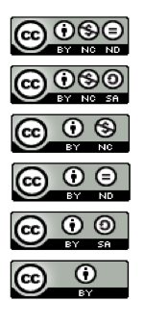
Creative Commons Licenses
6 variations:
Attribution Non-commercial No Derivatives
Attribution Non-commercial Share Alike
Attribution Non-commercial
Attribution No Derivatives
Attribution Share Alike
Attribution
7

Slide 9


Each CC licence grants a world-wide, royalty-free, non-exclusive,perpetual licence to the user
website offers a selection of free downloadable licences that are intended to reduce the costs for users of applying for permissions for every use of creative work.
1. Attribution (CC BY) Licence. This is the least restrictive licence and permitsothers to add to or amend the work, even for commercial reasons, providedthey acknowledge the original author. Once modified the work does not have to be licensed under a Creative Commons licence.
      2. Attribution Share-Alike (BY-SA) Licence. Others may modify the work but must acknowledge the original author
when disseminating the work and must distribute the derivative work under the same Creative Commons licence as the original work. The derivative work may be used for commercial or non-commercial purposes.

Slide 10


3. Attribution Non-commercial (BY-NC) Licence. Others may modify the work but must acknowledge the original author when disseminating the work and the derivative work may be used only for non-commercial purposes.
4. Attribution Non-commercial Share Alike (CC BY-NC-SA) Licence. Others may modify the work but must acknowledge the original author when disseminating the work and must distribute the derivative work under the sameCreative Commons licence as the original work. The derivative work may beused only for non-commercial purposes.

Slide 11


5. Attribution No Derivative Works (CC BY-ND) Licence. Other users must acknowledge the original author and may not make derivative works. They may copy and distribute the work for commercial and non-commercial purposes.
6. Attribution Non-commercial No DerivativeWorks (CC BY-NC-ND) Licence.This is the most restrictive licence. It allows others to download and share theoriginal work with others so long as they mention the original author, but theycannot change the original work in any way or use it commercially.

Slide 12
CC0
“No Rights Reserved”
CC0 enables scientists, educators, artists and other creators and owners of copyright- or database-protected content to waive those interests in their works and thereby place them as completely as possible in the public domain, so that others may freely build upon, enhance and reuse the works for any purposes without restriction under copyright or database law.
In contrast to CC’s licenses that allow copyright holders to choose from a range of permissions while retaining their copyright, CC0 empowers yet another choice altogether – the choice to opt out of copyright and database protection, and the exclusive rights automatically granted to creators – the “no rights reserved” alternative to our licenses.

Slide 13
The Problem
Dedicating works to the public domain is difficult if not impossible for those wanting to contribute their works for public use before applicable copyright or database protection terms expire.
Few if any jurisdictions have a process for doing so easily and reliably. Laws vary from jurisdiction to jurisdiction as to what rights are automatically granted and how and when they expire or may be voluntarily relinquished.
More challenging yet, many legal systems effectively prohibit any attempt by these owners to surrender rights automatically conferred by law, particularly moral rights, even when the author wishing to do so is well informed and resolute about doing so and contributing their work to the public domain.
https://creativecommons.org/share-your-work/public-domain/cc0/

Slide 14


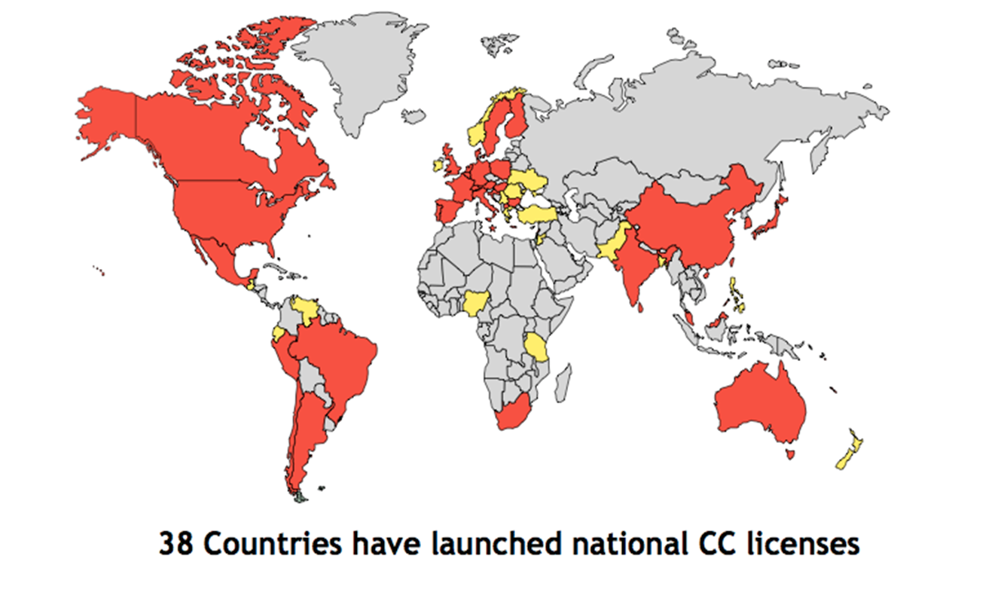

Slide 15
Źródła:
www.creativecommons.org
Modele otwartego dostępu Katarzyna Panasiewicz
Corbett, S. (2011). Creative commons licences, the copyright regime and the online community: is there a fatal disconnect?. The Modern Law Review, 74(4), 503-531.

