Slide 1
Mortgages
Mortgage law:
Legal act dated: 06.07 1982 r. o księgach wieczystych i hipotece.

Slide 2
Mortgage
Common law GB – over unregistered land or registered
- can be granted over any interest in land, not just freehold estete
- legal or ecquitable
Civil law – civil code or special legal acts

Slide 3
A mortgage loan is a loan (contract of credit ) by real property through the use of a mortgage agreement which evidences the existence of the loan and grants a mortgage which secures the loan.
Borrower (usually the owner of land - mortgagor)
Lender (usually a bank - mortgagee)
Third person may mortgage his property as security for the performance of an obligation by another person.

Slide 4
Creation of a morgage in PL
First there must be a debt created (debtor and creditor). It is possible to estabilish mortgage to secure a future claim also, but it is recquired to appoint existing legal relationship.
1) enter an agreement (contract) creating mortgage, notary form or written form accepted by bank director signature
2) obligatory mortgage register: entry into mortgage book (land register) called „księga wieczysta” – division IV.

Slide 5
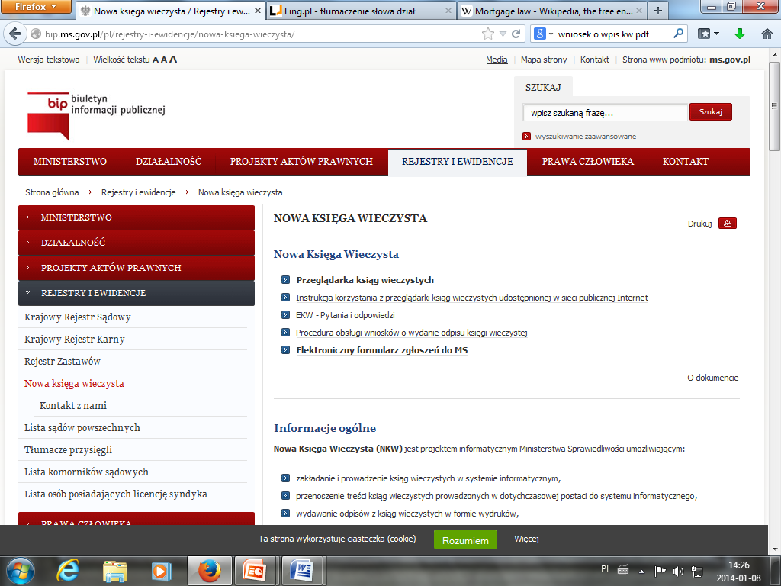

Slide 6
Land register book – morgages register
www.ms.gov.pl
Number: WR1O/00024757/9
Division I - basic information of the land – area of plots, map data,
Division II - owner’s name, information of possible premises separated from the eventual building
Division III – various informations ( third persons rights – easments, third person’s claims securties)
Division IV – mortgages.

Slide 7
Mortgages:
Regular mortgage – the owner has accepted the contract creating mortgage
Forced (imposed) morgages – there is a court judgement or administrative decision (valid and final) referring to a debt of a debtor, who is simultanously the owner of the land.

Slide 8
The mortgages function
In order to secure a claim, the land may be encubered with the right of the creditor to enable him to seek satisfaction from the land sale regardless of whose property it has become .
The mortgagee is entitled to be paid out of the mortgaged property in preference to ordinary creditors regardless as to whether or not the ownership of the property has been transferred to a third person.
If a mortgaged property is divided into parcels (plots), the mortgage continues to extend to each and all of such parcels.
There could be several mortgages set on one piece of land (plot) – the first has its full priority.

Slide 9
Enforcement of morgage
Mortgagee may enter an legal action in Court for a judgment ordering the mortgaged property to be seized and sold by public auction.
When one and the same property is mortgaged to several mortgagees, they rank according to the respective dates and hours of registration, and the earlier mortgagee shall be satisfied before the later one.
The net proceeds of the auction shall be distributed to the mortgagees according to their ranks, and the surplus, if any, shall be delivered to the mortgagor.

Slide 10
A mortgage is extinguished:
By extinction of the obligation secured, otherwise than by prescription.
By release of the ownership of the land granted in notary form to the mortgee
By action sale of the mortgaged property by order of the
Court as a result of enforcement or removal of mortgage
By resignation of the creditor mortgee.
By the time laps if the morgage was created as a right limited in time.

Slide 11
Great Britain
The United Kingdom is considered as the largest reverse mortgage market in the world and the largest market in the European Union (the value of loans is estimated at over 205 billion pounds). There are offered two types of annuities: those based on the sale and purchase agreement, as well as those based on the loan contract (called. lifetime mortgage).
The most important informations connected with mortgages and registers are included in Law of Property Act 1925 Part III Mortgages, Rentcharges, and Powers of Attorney articles 85 – 120.

Slide 12
Great Britain – types of mortgages
Legal Mortgage - occurs when the owner gives legal title of property to a creditor to secure payment of the owner's debt. In a typical mortgage, once the debtor pays off the debt, legal title to the property will revert to the original owner.
Equitable Mortgage - courts of equity evolved to redress injustices caused by legal courts' strict adherence to the law. Courts of equity thus recognize "equitable" mortgages, which occur when a transaction does not fulfill all legal requirements of a mortgage, but still looks and operates like a mortgage; in other words, property is offered to a creditor to secure debt.

Slide 13

The creation of legal mortgage in GB
3. FORMALITIES NEEDED FOR ACTUAL LEGAL STATUS
A deed (s.52 LPA 1925)
Registration at Land Registry if Borrower’s title to the land is registered
Registration at Land Registry if it is a FIRST mortgage of an unregistered title (triggers first registration)

Slide 14

The creation of an equitable mortgage
1. Where there is a contract for the grant of a mortgage:
an actual contract; or
a written mortgage made by no/defective deed; which
- complies with s.2 LP (MP)Act 1989 +
- is specifically enforceable
2. Failure to register a legal mortgage in registered land
3. A mortgage of an equitable interest

Slide 15

Art. 2114 of French Civil Code:
a right in rem on immovables allocated to the discharge of an obligation. It is, by its nature, indivisible and subsists in entirety on all the immovables allocated, on each one and on each portion of those immovables. It follows them, in whatever hands they may pass.
May alone be mortgaged:
1° Immovable property which may be the subject matter of legal transactions between private individuals, and its accessories deemed immovable;
2° The usufruct of the same property and accessories for the time of its duration.

Slide 16
France – types of mortgages
The French law provides for three distinct categories of mortgages:
The statutory mortgage, which is entitled without prior legal action required; results from a state;
The judicial mortgage resulting from judgments, it must come from a judge and be obtained by court;
The conventional mortgage resulting from agreements, it presupposes a genuine agreement between the parties and to be formalized in a special agreement.

Slide 17
Statutory mortgage
- described in French civil code Section I - Of Statutory Mortgages Art. 2121 -2122.
Independently of statutory mortgages resulting from other Codes or from particular statutes, the rights and claims to which a statutory mortgage is granted are:
1° Those of one spouse, on the property of the other;
2° Those of minors or adults in guardianship, on the property of a guardian or statutory administrator;
3° Those of the State, of departments, of communes and of public institutions, on the property of collectors and accounting administrators;
4° Those of a legatee, on the property of the succession, under Article 1017
5° Those stated in Article 2101, 2°, 3°, 5°, 6°, 7° and 8

Slide 18
The legal effects of mortgages
Between creditors, a mortgage, either statutory, or judicial, or conventional, ranks only from the day of the registration made by the creditor at the land registry, in the form and manner prescribed by law.
Where several registrations are required on the same day as to the same immovable, that which is required by virtue of the instrument of title bearing the remotest date shall be deemed of prior rank, whatever the order resulting from the register provided for in Article 2200 may be.

Slide 19

Germany
In Germany the most important informations connected with mortgages are included in BGB German Civil Code Division 7 called Mortgage, land charge, annuity land charge sections 1113- 1190.
According to article 1113:
1)A plot of land may be encumbered in such a way that the person in whose favour the encumbrance is created is to be paid out of the land a specific sum of money to satisfy a claim to which he is entitled (mortgage).
2)The mortgage may also be created for a future or a conditional claim.

Slide 20
Types of mortgages
In Germany, the general term is Grundpfandrecht („real security on real property“). It encompasses the Grundschuld (§§ 1191 ss. BGB) and the Hypothek (§§ 1113 ss. BGB). The Hypothek is an accessory security whereas the Grundschuld is a non-accessory security. In the Civil Code, the default model is the Hypothek whereas the Grundschuld is regulated largely by references to the rules on the Hypothek.
In practice, however, the Grundschuld prevails, as it is more flexible and may also be used to secure later debts with the same creditor.
- Further subtypes of the Hypothek are the Sicherungshypothek (§§ 1184 ss. BGB), a strictly accessory mortgage
- and the Höchstbetragshypothek (§ 1190 BGB).

Slide 21
Legal nature
Mortgage and land charge are both a ius in rem. They entitle the creditor to enforce paymentof a claim of money from the real estate (§ 1147 BGB). Satisfaction by execution
The satisfaction of the creditor from the plot of land and from the objects to which the mortgage extends is effected by execution.
However, the creditor still needs a title for encorcement: If the owner has not declared submission to enforcement the creditor first has to go to court to get an enforceable title before he may start a forced sale.

