Slide 1
Persons in Polish Civil law
Civil Code
Comercial Companies Code
Legal act – ustawa

Slide 2
Natural person
Nasciturus
0-13 years – no capacity exept minor contracts
13- 18 (16) years – limited capacity
Adults – full capacity for legal acts
Natural person may be incapacitated fully or partially – District Court sentence.

Slide 3
Personal interests art. 23 – 24 C.C.
Personal interests of a human being in particular health, freedom, dignity, freedom of conscience, name or pseudonim, image, privacy of correspondence, inviolability of home and scientific, artistic, inventice or improvement achievements are protected by civil law, independently of protection under other regulations

Slide 4
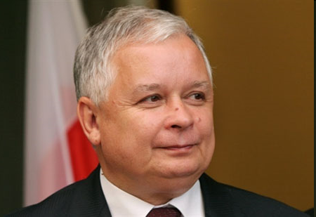
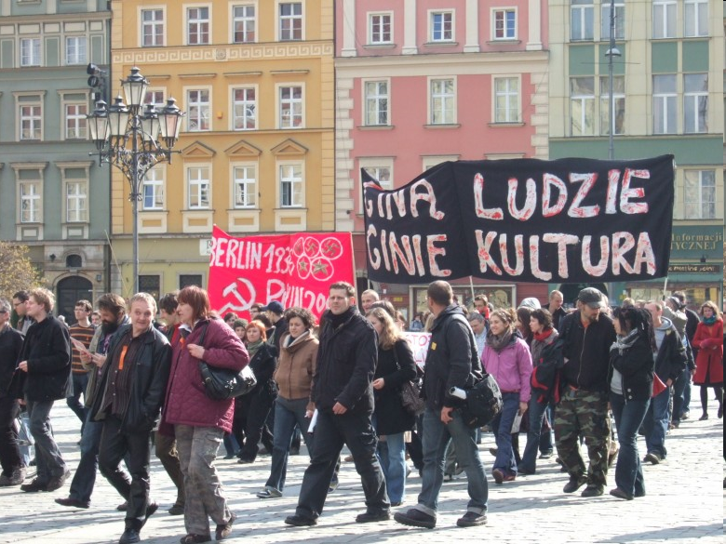
The act of divulging a picture of natural person
Art. 81 Polish Copyright statute of 4.2.1994
1.
Publishing a picture recquires the preson’s consent
If the model has been payed the consent is presumed unless otherwise stated in contract
2. Consent is not recquires when publishing a picture of :
Public person – when the picture is taken while performing official function / work, social, political duties
2) When the person is merely a detail of a bigger composition as for example: assembly, landcape, scenery, public meeting

Slide 5
Legal persons
Art. 33 CC legal persons are the State Treasury and organizational units, wchi are accorded legal personality by specific regulations
Legal personality attained upon its entry in a relevant register : KRS.
Legal person acts through its bodies – management boards generally
Invalid legal act when unauthorized reprezentation – remedy of damages only

Slide 6
Proper body of legal person!
If lack of due bodies – court appoints a conservator for the legal person who should immediately set up proper bodies or liquidate the person

Slide 7
Enterpreneurs
Natural person
Legal persons
Imperfect legal persons – companies
What is a branch ? (oddział)
Conducting business of professional activity on its own behalf.
Business name and business name of a branch
Registers:
KRS and CEDIG firma.gov.pl

Slide 8
Private
cooperative society - housing
Companies: lilited liability (z o.o.)
joint-stock company - per actions (akcyjna)
Foundations
Association if registered

Slide 9
Public legal persons
State Treasury and state legal persons
High schools (university)
Local goverments units : gmina (municipality), powiat (district), województwo (voivodship)
Statio fisci - headquarters of Police, Courts etc.
Statio municipii (primary school)

Slide 10
Imperfect legal persons
Companies:
Spółka jawna, (general model of partnerships) s.j.
Spółka partnerska partnership s.p.
Spółka komandytowa : general (limited) partnership – s.k.
(komandytowo akcyjna – s.k.a.
Wspólnota mieszkaniowa - Condominium Association – private apartments

Slide 11
Imperfect legal persons
No legal personality but they are granted legal capacity under the law
Subsidiary liability for obligations ot the unit is borne by its members (associate)

Slide 12
Attorneys in Poland
The public licence legal professions (Wikipedia) :
judge (Polish: sędzia);
public attorney (Polish: prokurator), legal representative of the State, with the exception of trials involving the Treasury, their primary duties include prosecution, supervision over police investigations and acting on behalf of public interest in all trials;
attorney of the Treasury (Polish: radca Prokuratorii Generalnej Skarbu Państwa), legal representative of the Treasury where significant State property is at stake, their representation is also mandatory in all trials involving the Treasury at central courts,
advocate (Polish: adwokat), whose main function is to provide legal assistance, prepare legal opinions and drafts of legislative acts, and represent persons before court in civil, administrative and criminal trials;
legal advisor (Polish: radca prawny), whose main function is to provide legal assistance, prepare legal opinions and drafts of legislative acts, and represent persons before courts in civil, administrative and - in a limited scope - criminal trials;
notary (Polish: notariusz), whose job consists of mixture of civil law notary and notary public duties;
bailiff (Polish: komornik), a public officer (but not an official) whose main function is to execute court's decisions concerning civil claims.

Slide 13
Attorney-at-law Procedural law representation
Advocate, Legal Advisio – both entitled to represent the party under all courts and administrative bodies.
Highest Court (Sąd Najwyższy) and Administrative Highest Court (NSA) – obligatory attorney at law

Slide 14
Attorney-in-fact material law representation
Legal act may be performed by representative within the limits of his authorisation
Authorisation to act on behalf of another person
based on the law – staturory representation
guardian (full reprezentation), custodian (limited custody)
based on a declaration made by the person represented (power of attorney)

Slide 15
Presumption
Art. 97 CC – a person acting on the premises of an enterprise whose purpose is to serve the public is deemed, in case of doubt, authorised to perform the legal acts that are usually perfomed with persons using the enterprise’s services.

