Slide 1
Persons in Polish Civil law
Civil Code
Comercial Companies Code
Legal act – ustawa

Slide 2
Natural person
Nasciturus
0-13 years – no capacity exept minor contracts
13- 18 (16) years – limited capacity
Adults – full capacity for legal acts
Natural person may be incapacitated fully or partially – District Court sentence.

Slide 3
Personal interests art. 23 – 24 C.C.
Personal interests of a human being in particular health, freedom, dignity, freedom of conscience, name or pseudonim, image, privacy of correspondence, inviolability of home and scientific, artistic, inventice or improvement achievements are protected by civil law, independently of protection under other regulations

Slide 4
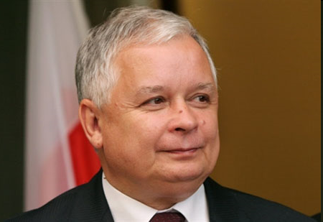
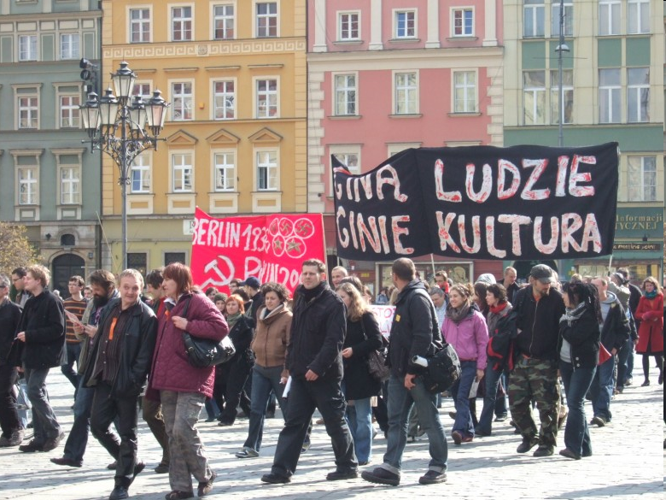
The act of divulging a picture of natural person
Art. 81 Polish Copyright statute of 4.2.1994
1.
Publishing a picture recquires the preson’s consent
If the model has been payed the consent is presumed unless otherwise stated in contract
2. Consent is not recquires when publishing a picture of :
Public person – when the picture is taken while performing official function / work, social, political duties
2) When the person is merely a detail of a bigger composition as for example: assembly, landcape, scenery, public meeting

Slide 5
Legal persons
Art. 33 CC legal persons are the State Treasury and organizational units, wchi are accorded legal personality by specific regulations
Legal personality attained upon its entry in a relevant register : KRS.
Legal person acts through its bodies – management boards generally
Invalid legal act when unauthorized reprezentation – remedy of damages only

Slide 6
Proper body of legal person!
If lack of due bodies – court appoints a conservator for the legal person who should immediately set up proper bodies or liquidate the person

Slide 7
Enterpreneurs
Natural person
Legal persons
Imperfect legal persons – companies
What is a branch ? (oddział)
Conducting business of professional activity on its own behalf.
Business name and business name of a branch
Registers:
KRS and CEIDG firma.gov.pl

Slide 8
Private
Cooperative society - housing
Companies: limited liability company (z o.o.)
joint-stock company - per actions (akcyjna)
Foundations
Association if registered

Slide 9
Public legal persons
State Treasury and state legal persons
High schools (university)
Local goverments units : gmina (municipality), powiat (district), województwo (voivodship)
Statio fisci - headquarters of Police, Courts etc.
Statio municipii (primary school)

Slide 10
Imperfect legal persons
Partnerships:
Spółka jawna, (general model of partnerships) s.j.
Spółka partnerska (partnership) s.p.
Spółka komandytowa : general but with limited liability of one associate partnership – s.k.
Spółka komandytowo akcyjna – s.k.a. - partnership limited by shares
Wspólnota mieszkaniowa - Condominium Association – private apartments

Slide 11
Imperfect legal persons - partnerships
No legal personality but they are granted legal capacity under the law
Subsidiary liability for obligations ot the unit is borne by its members (associates)
In spółka jawna
each partner is liable for the partnership’s debts without any limitation – jointly and severally with the other partners and the partnership. Yet his liability arises only when the partnership’s property is not sufficient to cover the debts.

Slide 12
Spółka partnerska
only certain professionals may become partners of such a partnership (e.g. medicine doctors, architects, advocates, accountants etc.);
other partners are not liable for mistakes of another partner resulting in damadges, if they were connected solely to his professional services;
professional partnership may be managed by a management board (if the partnership contract provides so).

Slide 13
Spółka komandytowa
Debt liability of some partners is unlimited. Liability of the other partner (named: komandytariusz) is limited to an amount indicated in the partnership contract (‘suma komandytowa’).
The name of this partnership should not contain the name of any of the partners whose liability is limited. Otherwise their liability becomes unlimited. The name should include a name of at least one of the partners whose liability is unlimited.

Slide 14
Spolka z ograniczona odpowiedzialnoscia ("limited liability company") Sp. z o.o.
In English: private company limited by shares,
in German: Gesellschaft mit beschränkter Haftung.
Shareholders own shares in the company. It is a registered legal person, but does not have to meet numerous obligations that are imposed on spolka akcyjna.
The mandatory body are: the management board and shareholders meeting. It is possible to establish a supervisory board as well, but it is mandatory only in companies that have the share capital higher than PLN 500,000 and have more than 25 shareholders.
It may be created by a single shareholder. However, it cannot be another company z o.o.
The members of management board bear liability in some particular cases. Read the following article:
http://www.hg.org/article.asp?id=32239
Minimum share capital is just PLN 5,000 (approximately 1,200 euro)

Slide 15
Comercial Companies Code
Article 299. § 1. If the execution against the company proves ineffective, members of the management board shall be jointly and severally liable for the company's liabilities.
§ 2. A member of the management board may be discharged from liability referred to in § 1 above if he proves that the petition in bankruptcy was timely filed or arrangement proceedings were initiated, or that a failure to file the petition in bankruptcy or a failure to initiate arrangement proceedings occurred through no fault on his part, or that despite the failure to file the petition or initiate arrangement proceedings the creditor suffered no damage.

Slide 16
Spółka Akcyjna SA
Joint Stock Company
Management Board
Shareholders Assembly
Supervisory Board

Slide 17
The end of partnership or company
Dissolution – resolution, transferring the seat abroad
Liquidation – resolution of shareholdres, court decision
Bancrupcy – application filed to the court, proceeding regulated in Bancruptcy Law. Syndyk – bancruptcy manager appointed by the judge
Removal from National Court Register (KRS) is always recquired

Slide 18
Civil Law partnership – Spółka cywilna
Partners enter a written form contract, in which they oblige themselves to achieve a common economic goal by acting in a manner indicated in the contract, it may be by making contributions (transfer of property or other rights into the common property of partnership) or by providing services.
Each partner is entitled and obligated to run the partnership’s business. Each of them is also entitled to conclude contracts on behalf of the partnership, unless otherwise provided for in the partnership contract or in a partners’ resolution.
All partners are jointly and severally liable for the partnership’s debts and fiscal liabilities. Their liability is unlimited.
It is the only partnership that is regulated in the Civil Code, yet this partnership is not formally registered.

Slide 19
Attorneys in Poland
The public licence legal professions (Wikipedia) :
judge (Polish: sędzia);
public attorney (Polish: prokurator), legal representative of the State, with the exception of trials involving the Treasury, their primary duties include prosecution, supervision over police investigations and acting on behalf of public interest in all trials;
attorney of the Treasury (Polish: radca Prokuratorii Generalnej Skarbu Państwa), legal representative of the Treasury where significant State property is at stake, their representation is also mandatory in all trials involving the Treasury at central courts,
advocate (Polish: adwokat), whose main function is to provide legal assistance, prepare legal opinions and drafts of legislative acts, and represent persons before court in civil, administrative and criminal trials;
legal advisor (Polish: radca prawny), whose main function is to provide legal assistance, prepare legal opinions and drafts of legislative acts, and represent persons before courts in civil, administrative and - in a limited scope - criminal trials;
notary (Polish: notariusz), whose job consists of mixture of civil law notary and notary public duties;
bailiff (Polish: komornik), a public officer (but not an official) whose main function is to execute court's decisions concerning civil claims.

Slide 20
Attorney-at-law
Procedural law representation
Advocate, Legal Advisor – both entitled to represent the party under all courts and administrative bodies.
Highest Court (Sąd Najwyższy) and Administrative Highest Court (NSA) – obligatory attorney at law

Slide 21
Attorney-in-fact material law representation
Legal act may be performed by representative within the limits of his authorisation
Authorisation to act on behalf of another person
  based on the law – staturory representation
  guardian (full reprezentation), custodian (limited custody)
  based on a declaration made by the person represented (power of attorney)

Slide 22
Prokurent in Polish Law
Shown in register
Commercial proxy - individual
branch commercial power of attorney
joint regular commercial power of attorney (two holders of the commercial power of attorney acting jointly)
It used to be admissible to grant commercial power of attorney where its holder was only authorised to act jointly with a management board member or a partner. It was called: joint irregular commercial power of attorney. In 2015 the Highest Court previously stated that a this solution restricts the management board member's right of representation and not that of the holder of the commercial power of attorney.

Slide 23
Presumption
Art. 97 CC – a person acting on the premises of an enterprise whose purpose is to serve the public is deemed, in case of doubt, authorised to perform the legal acts that are usually perfomed with persons using the enterprise’s services.

