Slide 1
GUN VIOLENCE

Slide 2
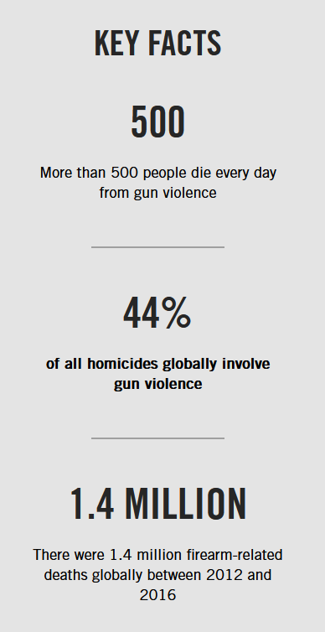
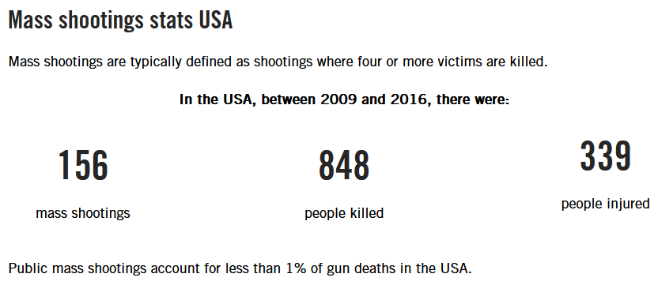
Source: Amnesty International

Slide 3
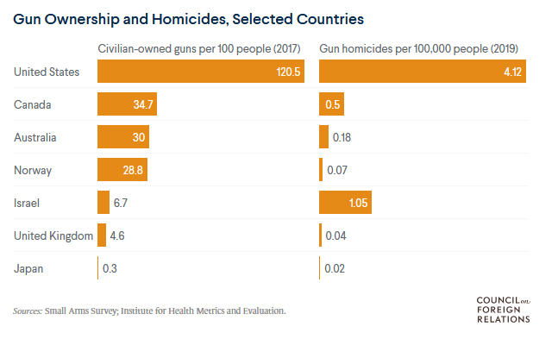
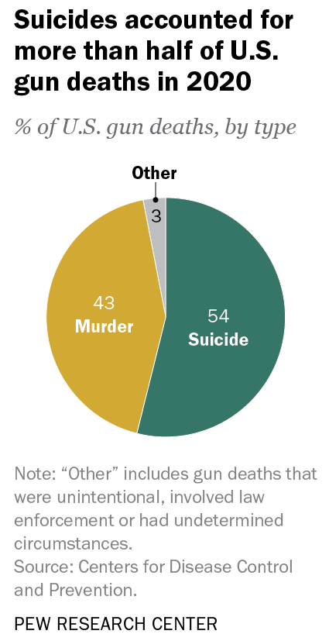
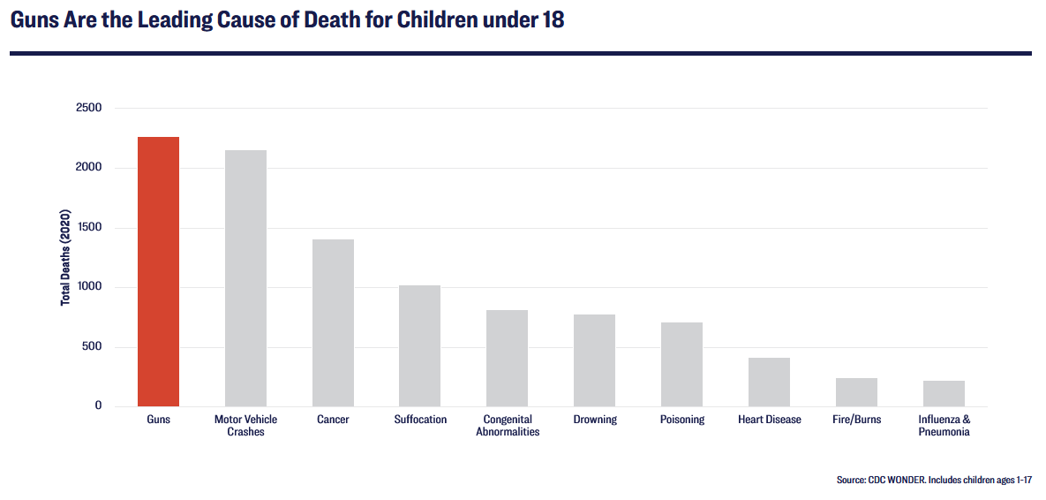

Slide 4
LET’S DEBATE
Thesis: Reduction of violence depends on stricter gun control laws
Analyse the issue from three following perspectives:
necessity
beneficiality
practicability

