Slide 1
Human Resources Management
dr Karina Pilarz

Slide 2
Basic information about the recruitment process
The recruitment and selection process is concerned with identifying, attracting and choosing
suitable people to meet an organisation’s human resource requirements.
They are integrated activities. The moot point is where recruitment stops and selection begins.
Whitehill (1991) describes the recruitment process as a positive one, ‘building a roster of potentially qualified applicants’, as opposed to the ‘negative’ process of selection.
So, a useful definition of recruitment is ‘searching for and obtaining potential job candidates in sufficient numbers and quality so that the organisation can select the most appropriate people to fill its job needs’.
Selection is concerned more with ‘predicting which candidates will make the most appropriate contribution to the organisation – now and in the future’ (Hackett).

Slide 3
The processes of recruitment and selection take place within a framework of external and internal influences.
EXTERNAL LABOUR MARKET FACTORS
When organisations choose to recruit externally rather than internally, the search takes place in local, regional, national and/or international labour markets, depending on:
numbers, skills, competences and experiences required,
the potential financial costs involved and the perceived,
benefits involved to the organisation concerned.

Slide 4
RECRUITMENT DIFFICULTIES
a lack of the specialist skills required;
a lack of experience required;
applicants want more pay than can be offered;
no applicants.

Slide 5
Another external factors:
government policy and legislation (like acts specifically designed to prevent discrimination in employment);
technological developments.

Slide 6
THE INTERNAL CONTEXT
Factors within organisations also affect the way recruitment and selection is handled.
business strategy
organisation’s approach to HRM
financial position of the organisation
size of the organization
organizational culture

Slide 7
The key stages of a systematic approach to recruitment and selection
defining the vacancy,
attracting applicants,
assessing candidates,
making appropriate decisions,
evaluating the effectiveness of the process

Slide 8
Online recruitment
The key advantages of online recruitment are that it can:
provide a shorter recruitment cycle and streamlined administration;
reduce recruitment costs if used instead of rather than as well as other methods;
reach a wide pool of applicants;
provide the image of an up-to-date organisation;
provide global coverage 24/7;
be a cost-effective way to build a talent bank for future vacancies;
help handle high volume job applications in a consistent way;
make internal vacancies known across multiple sites and separate divisions.

Slide 9
The key disadvantages are that online recruitment can:
limit the applicant audience as the internet is not the first choice for all job seekers;
cause applications overload or inappropriate applications;
exclude those who cannot or do not want to search for a new job online;
give rise to allegations of discrimination, particularly in the use of limited key words to screen CVs;
make the process impersonal which may be off-putting for some candidates;
turn off candidates if the website is badly designed;
lose out on candidates particularly if the organisation’s website is below the search engine ranking of competitors.

Slide 10
Examples of selection techniques
TRADITIONAL
press advertising
interviews (i.e. telephone interviewing)
SOPHISTICATED
psychometric tests
assessment centres
references

Slide 11
Assessment centres
An assessment centre is not a place but rather a process that ‘consists of a small group of participants who undertake a series of tests and exercises under observation, with a view to the assessment of their skills and competencies, their suitability for particular roles and their potential for development’ (Fowler);
a variety of individual and group assessment techniques are used, at least one of which is a work simulation;
multiple assessors are used (frequently the ratio is one assessor per two candidates);
these assessors should have received training prior to participating in the centre;
selection decisions are based on pooled information from assessors and techniques;
job analysis is used to identify the behaviours and characteristics to be measured by the assessment centre.
the assessment centre process allows organisations to observe candidate behaviour in a work-related setting;
the combination of techniques used helps to improve the consistency and objectivity of the selection process;
the use of such a sophisticated technique can also help the organisation to display a positive image to potential candidates.

Slide 12
The drawbacks primarily relate to the costs and resources required. For this reason, assessment centres are most likely to be used in public sector organisations and by larger private sector employers.

Slide 13
One of the more unconventional and controversial selection tools is graphology, based on the idea that handwriting analysis can reveal personal traits and characteristics.

Slide 14
OUTSOURCING
‘Outsourcing’ is the term used to describe the transfer of a distinct business function from inside the business to an external third party;
the activities likely to be outsourced are at the early stages of the process, i.e. advertising, managing responses from applicants and undertaking an initial sift of applications.

Slide 15
THE MAIN REASONS WHY EMPLOYERS HAD DECIDED TO OUTSOURCE RECRUITMENT ACTIVITIES:
to speed up recruitment;
to gain access to greater expertise;
to help make HR more strategic;
to make recruitment more flexible and responsive;
to achieve cost savings.

Slide 16

Discussion
What’s a CV?
What to include in your CV?
To zdjęcie, autor: Nieznany autor, licencja: CC BY

Slide 17
Job search
Job search is the process of gathering information about potential job opportunities;
it is the individual corollary of recruiting and together they form the basis for successful person–job matching;
job search is sequential, and jobs are evaluated against preestablished standards on a few important criteria, such as:
the nature of the work required,
the rewards the job offers,
the degree of person–organization ‘‘fit’’ based on job requirements, values, personality, or needs.

Slide 18
CV
short for the Latin phrase “curriculum vitae” meaning “course of life”;
is a detailed document highlighting professional and academic history;
typically includes information like work experience, achievements and awards, scholarships or grants, coursework, research projects and publications;
typically two or three pages long (can be much longer for mid-level or senior job applicants).

Slide 19
CV format
CV sections
Contact information
Academic history
Professional experience
Qualifications and skills
Awards and honors
Publications
Professional associations
Grants and fellowships
Licenses and certificates
Volunteer work
Personal information (optional)
Hobbies and interests (not necessary but appreciated)

Slide 20
How to write a CV
Include your contact information
Detail your academic history in reverse-chronological order
Record your professional experience
Include relevant skills and qualifications
List honors and awards
Include relevant publications and presentations
List your professional associations and affiliations
Check your CV for errors

Slide 21
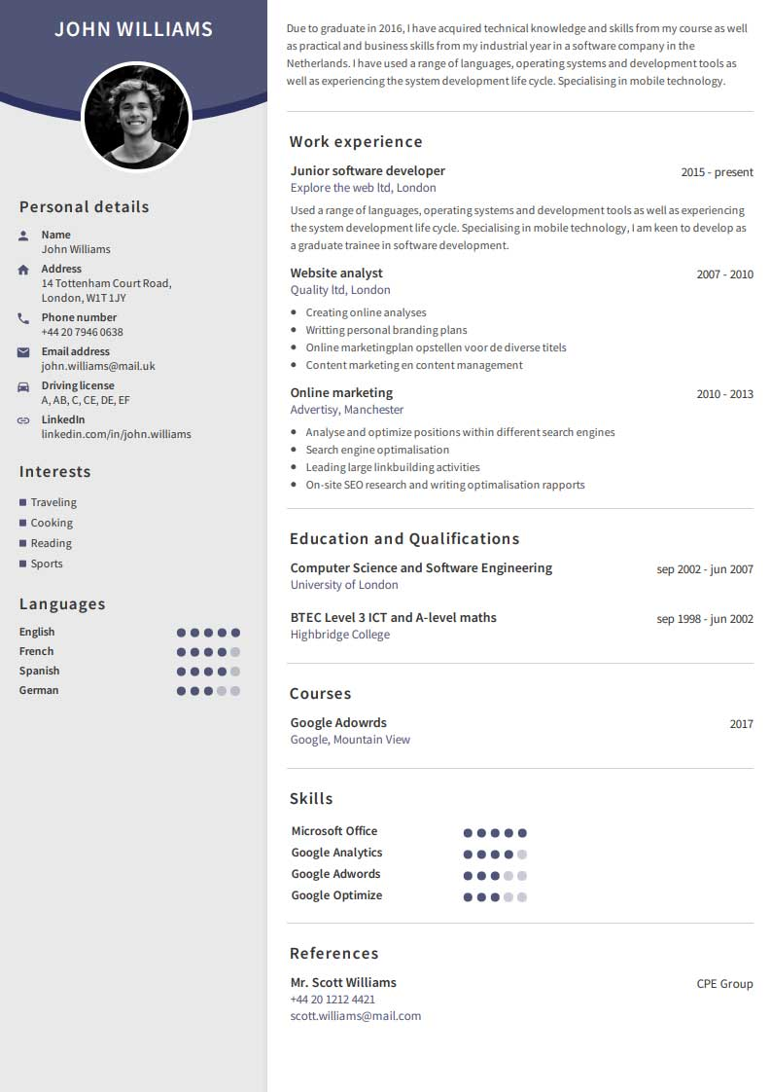
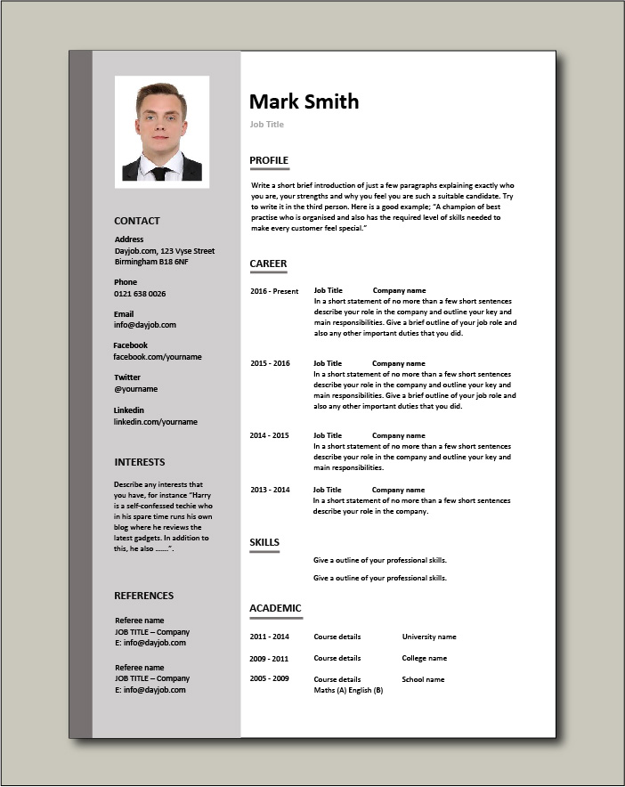
CV examples

Slide 22

CV mistakes
Having spelling errors and bad grammar (you can put your application through a spell and grammar checker);
Exaggerating the truth/lying (never assume that recruiters won’t make enquiries to corroborate the facts);
Poor formatting (you need to pay close attention to detail);
Making CV too long (more than 1-2 pages);
An unoriginal personal profile (writing a short personal statement at the top of a CV is essential, it should give an idea to a prospective employer of the type of person, work ethic, values);
Putting the wrong contact information, using an inappropriate email address;
Not including hobbies and interests (hobbies can show teamwork, leadership, time management and communication skills);
Not tailoring CV to the specific role.
To zdjęcie, autor: Nieznany autor, licencja: CC BY-SA-NC

Slide 23
Resume
A CV and resume are similar – they’re both documents that summarize your professional history, education, skills and achievements;
primarily in the United States resumes and CVs are not interchangeable;
a resume is typically a one-page document that provides a concise overview of your previous roles, skills and details about your education – you can call it “abstract” or “summary”;
a CV – typically a longer, more detailed document focused largely on academic coursework and research;
however, for example in India, South Africa and Australia, the terms CV and resume are interchangeable.

Slide 24

Cover letter
A cover letter is a document sent alongside your CV when applying for jobs;
it acts as a personal introduction and helps to sell your application;
a cover letter is necessary as it gives you the chance to explain to an employer why you're the best candidate for the job;
you do this by highlighting relevant skills and experience;
therefore you should always write your cover letter with the position you're applying for in mind;
cover letters should complement your CV but not duplicate it;
typically three to five short paragraphs, cover letters should not exceed one A4 page.
To zdjęcie, autor: Nieznany autor, licencja: CC BY-NC-ND

Slide 25
How to address a cover letter
Always try and address your cover letter directly to the person who will be reading it;
you're more likely to receive a reply if you send it to the right person;
if you're struggling to find a named contact you can use a general greeting such as:
Dear Sir/Madam,
Dear Hiring Manager,
Dear Human Resources Director;
general greetings should only be used once you have exhausted methods of finding a named contact.

Slide 26

Job interview

Slide 27
The employment interview is defined as a dialogue initiated by one or more persons to gather and evaluate information on the qualifications of a job applicant. Except for reference checks and application blanks, this is the most frequently used technique of personnel selection.
Even when other selection procedures are used, information often influences the final decision only after it has been filtered through interviewer judgments.

Slide 28
How to prepare for a job interview
Read and review the job description (a list of the qualifications, qualities and background the employer is looking for in an ideal candidate)
Consider why you are interviewing (you should be prepared to explain your interest in the opportunity and why you’re the best person for the role)
Research the company (company website, culture, competitors)
Consider your answers to common interview questions (Why do you want to work here?, What are your greatest strengths?)
Plan your journey to the job interview (make sure you arrive on time, search the location in advance)

Slide 29
How to act in a job interview
It’s important to make great first impression
Make sure your clothes are clean, ironed and presentable
Make eye contact (this will signal your confidence)
Remember your CV details
Make a note of your questions
Don’t volunteer your weaknesses
Don’t criticise your current or previous employer
Sit still, with your feet firmly on the ground (this will help you maintain your posture and avoid fidgeting)

Slide 30
https://www.youtube.com/watch?v=uG2aEh5xBJE
https://www.youtube.com/watch?v=hrZSfMly_Ck
https://www.youtube.com/watch?v=HG68Ymazo18

Slide 31
Job loss - outplacement
Outplacement is the process by which an individual whose employment has been terminated makes the transition from one employer to another work situation with the assistance of reemployment professionals and appropriate support services, provided by the former employer;
in its most basic form, the purpose of outplacement is to help a terminated employee find a new job or career;
while assistance is offered, the responsibility for finding a new job or changing careers remains with the employee;
in addition to job and career counseling, outplacement services typically include some form of emotional support and assistance in coping with the stress of job loss.

Slide 32
Outplacement is a well-established service in the UK, adopted by thousands of responsible organisations who recognise the importance of supporting employees as they leave the business.
Historically, outplacement was predominantly focussed on those in senior positions but in a modern context, organisations now provide employees with Outplacement Support at all levels and grades.

Slide 33
Outplacement support is there to help employees move on quickly and effectively, helping with a broad range of areas including:
Establishing career priorities and assessing their options
Developing their own personal career plan
Revitalising their personal brand
Networking their way to success
Preparing for self-employment, interim or portfolio careers
Mastering the art of modern job searching
Creating great CVs that get them noticed
Transforming their interview performance
Harnessing the power of LinkedIn
Preparing for retirement of the ‘Third age’ of their careers

Slide 34
Why is outplacement important?
OUTPLACEMENT SERVES THREE MAIN INTERRELATED PURPOSES FOR ORGANIZATIONS:
strengthening brand reputation,
reducing business costs,
creating a positive company culture.

Slide 35
Tasks
Prepare short answers to common interview questions (choose 2):
Why do you want to work at this company?
Why should we hire you?
What can you bring to the company?
What are your greatest strengths?
Write a CV and cover letter for manager position (can be an imaginary person).

Slide 36
HOMEWORK
 | ADVANTAGES | DISADVANTAGES
OUTPLACEMENT

