Slide 1
Violent crimes. introduction
dr Alicja Limburska

Slide 2
What is a criminal offence?
different definitions in common law and in continental law
criminal act might be defined by:
  its consequences
  its structural elements/characteristic
Basic features of criminal acts
harmful nature
Prohibition and punishment
conviction as distinctive aspect of criminal law

Slide 3
Crime is an event that is prohibited by law, which can be followed by a prosecution in criminal proceedings and, thereafter, by punishment on conviction
Crime is an act usually deemed socially harmful or dangerous and specifically defined, prohibited, and punishable under criminal law

Slide 4
Structural elements of criminal offence
substantially different in common law and continental law
however, there are some common elements:
  some kind of human conduct as a basis
  distinctive, external features (other than non-criminal conduct)
  some type of mental awareness or at least possibility of such
  possibility of avoiding liability due to moral reasons, some kind of justification or excuse

Slide 5
Elements of criminal offence in continental law systems
  defining criminal offence by listing its structural elements consisting so-called dogmatic structure of criminal offence
the number of elements creating criminal offence is not agreed upon

Slide 6
Classical definition of criminal offence in
continental legal systems
  human conduct
    naturalistic concept of an act
  unlawfulness
    includes lack of justification
  guilt
    psychological concept of guilt

Slide 7
Example of contemporary definition of criminal offence in Polish law (by A. Zoll)
human conduct (act or omission)
unlawfulness
punishability
social harm (higher than minimal)
guilt (culpability)

Slide 8
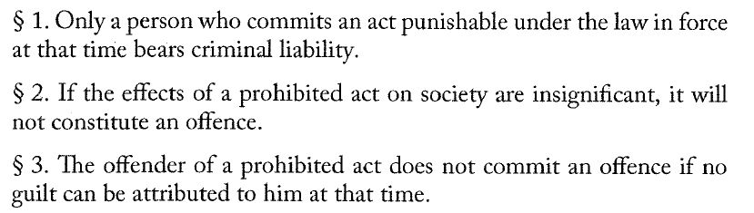
In this concept, criminal offence is a natural person’s conduct (act or omission), which is unlawful (in violation with law), punishable by criminal law, which causes social harm higher than minimal, if the guilt might be attributed to the offender.
Those elements might be found in Polish criminal code (art. 1):

Slide 9
Elements of criminal offence in common law systems
actus reus
mens rea
(lack of) defences
actus reus + mens rea = prima facie offence

Slide 10
actus reus
external („objective”) element
an event or conduct which causes the harm that the law is designed to prevent
mens rea
internal („subjective”) element
„guilty mind” such as intention, knowledge or recklessness
actus non facit reum nisi mens sit rea – an act does not make a man guilty unless his mind is (also) guilty
fault element + state of mind (they are seen as separate in continental law)
varies for each offence

Slide 11
the absence of a valid defence
defences do not deny actus reus nor mens rea
defences – special circumstances that cause a prima facie offence not to be a criminal act
it’s not an alibi in a common understanding („defence” means something else in criminal procedure and substantive criminal law)
justifications - negate the wrongfulness of the conduct (eg. self-defence, necessity)
excuses – negates culpability/fault (eg. insanity, duress)

Slide 12
ACTUS REUS
one of constituent/obligatory elements of a criminal offence
an event prohibited by law
material / physical / objective element
does not refer to the defendant’s mental state

Slide 13
Elements of actus reus
in common law
  behaviour
  circumstances
  consequences
in continental (Polish) criminal law
  behaviour – mandatory („who kills a man shall be punished”)
  circumstances – optional („who kills a man with excessive cruelty shall be punished”)
  causality and consequences (outcome) - optional

Slide 14
Behaviour as a basis of actus reus
in general it’s a mandatory element of actus reus
  (with some exceptions in common law, eg. possessory offences, state of affair offences)
no criminal liability for merely an intent/thoughts
behaviour takes place in a form of an act or ommission

Slide 15
Circumstances as an optional element of actus reus
non-mandatory
most of the offences do not include specific circumstances as element of actus reus
circumstances might be reflected as additional element of actus reus

Slide 16
Classification of offences depending on circumstances:
  the basic type – based on the general characteristics of a given prohibited act; this type refers to the ‘standard’ degree of social harm the act presents
  the privileged type – in comparison to the basic type, it contains additional elements within a prohibited act’s description that result in a more lenient assessment of the social harm the act presents
  the aggravated type – in comparison to the basic type, it contains additional elements of a prohibited act’s description that result in a more severe assessment of the social harm the act presents

Slide 18
  Concecuences/outcome as an optional element of mens rea
  conduct crimes – actus reus consists only of behaviour (breaking and entering, theft, reckless driving)
  result crimes – cannot be committed unless the defendant’s actions cause the specified result or consequence actually to occur
  (murder, assault, criminal damage)

Slide 19
MENS REA
part of the offence referring to the defendant’s mental state
moral / mental element of criminal offence
requirement of „guilty mind”
substantial differences between common law and continental (Polish) law

Slide 20
  Mens rea in common law
  it is possible for an offence to contain a variety of actus reus elements which the corresponding mens rea requirements differ
  includes guilt (not only psychological but also moral element)
  Examples of mens rea states:
  purpose, intention, recklessness, wilfulness, knowledge, belief, suspiction, reasonable cause to believe, maliciousness, fraudulence, dishonesty, corruptness
  neglicence

Slide 21
In common law, for the majority of offences it is not necessary to prove that the actus reus was intended, since recklessness will normally suffice for a conviction.
  Some exceptions:
    murder
    theft
    burglary
    wounding with intent

Slide 22
Main differences between intention and recklessness
  in both cases the defendant foresees the possibility of realising the actus reus
  the defendant acting recklessly does not seek and is not motivated to bring it about
  recklessness is established only if the defendant risked doing the actus reus unreasonably, while there’s no condition of unreasonableness attaching to intention

Slide 23
Two types of negligence
  ordinary negligence
  gross negligence
the defendant is negligent if a reasonable person in the same circumstances:
  would have been aware of the risks of doing the actus reus, and
  would not have run those risks
gross negligence – the defendant’s conduct not merely fails to meet the standard set by the reasonable man test, but falls short of that standard by a considerable margin
  „not merely unreasonable, but very unreasonable”

Slide 24
  Mens rea in continental (Polish) law
  an offence might only be intentional or unintentional (as a whole)
  guilt (culpability) and intentionality are separated
    normative understanding of guilt: ability to impute to a perpetrator a defectiveness of his or her motivational process: a perpetrator decides to perform a given act whereas in accordance with socially acceptable rules of conduct, he or she should have behaved differently (transl. K. Kremens, W. Jasiński)

Slide 25
Possible mens rea states in continental (Polish) law:
  intention
    direct intention (one „wants”)
    oblique intention (one „foresees and accepts”)
  unintentionality
    recklessness
    (no intent but one is aware of being incautious)
    negligence
      (no intent, one is not aware of incautiousness, however should be aware; foreseeability)

Slide 26
Two layers (basic requirements) of intention:
  awareness of the perpetrator
    the perpetrator needs to be aware of every element of actus reus
  will (willingness) of the perpetrator
    the perpetrator wants (direct intention) or accepts (oblique intention) certain behaviour or the consequence

Slide 27
VIOLENCE - basic questions
Try to define what violence is. Can you think of different definitions?
Is violence a homogeonous or heterogenous phenomenon?
Can you distinguish different types of violence? What are they?
Is every case of a violent behaviour a criminal act? Why/why not?
Is there – in your opinion – a lot of violence in the today’s world? From your experience is violence rate rising or rather declining?

Slide 28
Ad. 1. DEFINITION OF VIOLENCE
World Health Organization: “the intentional use of physical force or power, threatened or actual, against oneself, another person, or against a group or community, that either results in or has a high likelihood of resulting in injury, death, psychological harm, maldevelopment or deprivation”
National Research Council: “behaviors by individuals that intentionally threaten, attempt, or inflict physical harm on others”
Encyclopedia Britannica: „act of physical force that causes or is intended to cause harm; the damage inflicted by violence may be physical, psychological, or both”

Slide 29
Ad. 2 and 3. VIOLENCE IS A COMPLEX SOCIAL PHENOMENON
The nature of violence is heterogenous:
physical
psychological
sexual
economic
Self-directed violence/interpersonal violence/collective violence
Gender-based violence/rase-based violence/structural violence
Familiy (domestic) violence/child abuse/elderly abuse
Workplace violence (bullying)/hate speech/cyberviolence
Warfare/terrorism

Slide 30
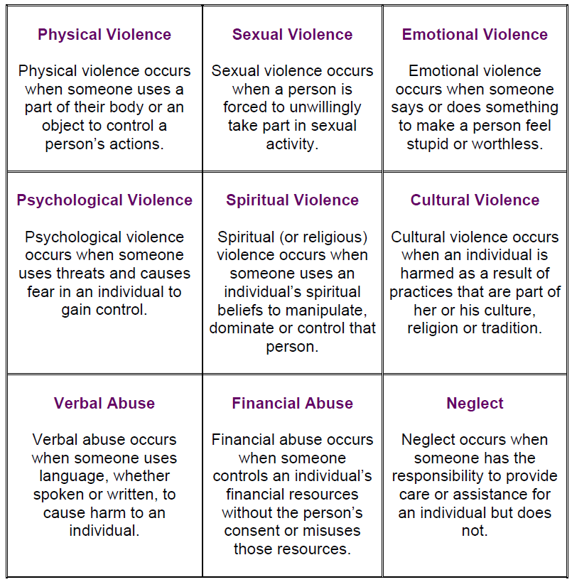
Source: Violence Prevention Initiative

Slide 31
Ad. 4. VIOLENCE ≠ VIOLENT CRIME(s)
violence is rather a sociological/criminological term – not legal
criminal law refers to specific types of violent behaviour not to violence in general
violent crimes are violations of criminal law that involve the intentional use of violence by one person against another
Is a criminal penalty also a form of violence (accepted by state)?

Slide 32
Ad. 5 VIOLENCE IS EVER-SEEN SOCIAL PHENOMENON
the most ancient traces of violence that have been found are those resulting from the practice of cannibalism
collective violence seems to have appeared with the sedentarization of communities at the end of the Palaeolithic era, around 13,000 BC in the Near East
corporal punishment can be traced back to the earliest civilizations, eg. the early law “code” of Ur-Namma, ruler of the Sumerian city of Ur (2112–2095 BCE, Mesopotamia)
Source: https://en.unesco.org/courier/2020-1/origins-violence

Slide 33
Interesting trends in violence rates:
https://www.ted.com/talks/steven_pinker_the_surprising_decline_in_violence

