Slide 1
Personal Finance
Seventh Edition
Chapter 18
Asset Allocation
Slides in this presentation contain hyperlinks. JAWS users should be able to get a list of links by using INSERT+F7
Copyright © 2020, 2017, 2014 Pearson Education, Inc. All Rights Reserved
Notes:
If this PowerPoint presentation contains mathematical equations, you may need to check that your computer has the following installed:
1) MathType Plugin
2) Math Player (free versions available)
3) NVDA Reader (free versions available)

Slide 2
Chapter Objectives
18.1 Explain how diversification among assets can reduce risk
18.2 Describe strategies that can be used to diversify among stocks
18.3 Explain asset allocation strategies
18.4 Identify factors that affect your asset allocation decisions
18.5 Explain how asset allocation fits within your financial plan

Slide 3
How Diversification Reduces Risk (1 of 6)
Benefits of portfolio diversification
Asset allocation: the process of allocating money across financial assets with the objective of achieving a desired return while maintaining risk of a tolerable level
Building a portfolio
Portfolio: a set of multiple investments in different

Slide 4
How Diversification Reduces Risk (2 of 6)
Determining portfolio benefits
Compare return on the investments within the portfolio to the overall portfolio
Diversification reduces the exposure of your investments to the adverse effects of any individual investment

Slide 5
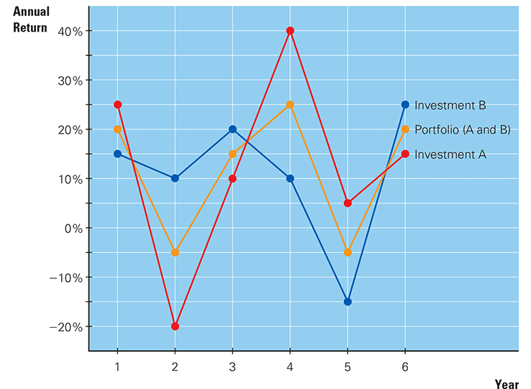
How Diversification Reduces Risk (3 of 6)
Exhibit 18.1 Example of Portfolio Diversification Effects

Slide 6
How Diversification Reduces Risk (4 of 6)
Factors that influence diversification benefits
Volatility of each individual investment
Impact of correlations among investments
Highly correlated stocks limit diversification
Consider stocks that are not influenced by the same conditions

Slide 7
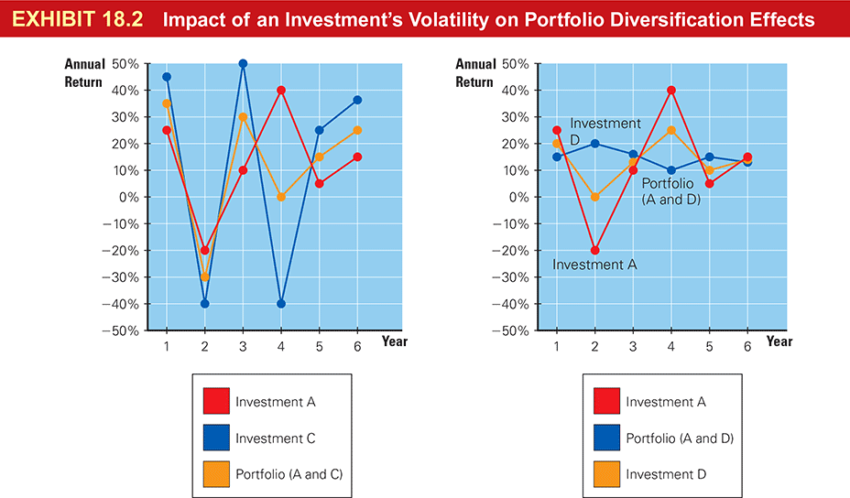
How Diversification Reduces Risk (5 of 6)
Exhibit 18.2 Impact of an Investment’s Volatility on Portfolio Diversification Effects

Slide 8
How Diversification Reduces Risk (6 of 6)
Exhibit 18.3 Impact of Correlations on Portfolio Diversification Effects

Slide 9
Financial Planning Online (1 of 2)
Go to the finance section of
Yahoo.com
Click “Get Quotes” after inserting a stock ticker symbol.
This Web site will give you a trend of the stock price. Notice that you can customize the trend to focus on the period in which you are interested

Slide 10
Strategies for Diversifying (1 of 3)
Diversification of stocks across industries
Less risky than a portfolio of stocks all from the same industry
Limitations of industry diversification
Even such a portfolio is still susceptible to general economic conditions
Cannot prevent losses but may limit them

Slide 11
Strategies for Diversifying (2 of 3)
Diversification of stocks across countries
Economic conditions tend to vary among countries
Foreign stocks typically more volatile than U.S. stocks so it is best to diversify among stocks within each foreign country
Many advisors recommend an 80/20 split between U.S. and foreign stocks

Slide 12
Strategies for Diversifying (3 of 3)
Economic impact on global diversification benefits
International diversification does not completely insulate investors from a weak economy
During 2008-2009, even non U.S. stock markets performed poorly

Slide 13
Asset Allocation Strategies (1 of 8)
Including bonds in the portfolio
Bond and stock returns are not highly correlated
Investing in more bonds lowers market risk but increases interest rate risk
Including real estate investments in the portfolio
Real estate investment trusts (R E I Ts): trusts that pool investments from individuals and use the proceeds to invest in real estate

Slide 14
Asset Allocation Strategies (2 of 8)
Similar to closed-end mutual funds
Managed by real estate professional
Types of R E I Ts
Equity R E I Ts: R E I Ts that invest money directly in properties
Mortgage R E I Ts: R E I Ts that invest in mortgage loans that help to finance the development of properties

Slide 15
Asset Allocation Strategies (3 of 8)
Role of R E I Ts in asset allocation
Highly influenced by real estate conditions
Exposes investors to high risk
Investors in R E I Ts may want to further diversify their portfolios

Slide 16
Asset Allocation Strategies (4 of 8)
Including stock options in the portfolio
Stock option: an option to purchase or sell stocks under specified conditions
Traded on exchanges
Call option: provides the right to purchase 100 shares of a specified stock at a specified price by a specified expiration date

Slide 17
Asset Allocation Strategies (5 of 8)
Exercise (strike) price: the price at which a stock option is exercised
Premium: the price that you pay when purchasing a stock option
Put option: provides the right to sell 100 shares of a specified stock at a specified price by a specified date

Slide 18
Asset Allocation Strategies (6 of 8)
The role of stock options in asset allocation
Very risky; should only play a minimal role in asset allocation
Covered call strategy: selling call options on stock that you own
How asset allocation affects risk
To maintain a low risk, asset allocation should emphasize low risk investments

Slide 19
Asset Allocation Strategies (7 of 8)
In 2008, stocks, real estate and low-rated corporate bonds experienced losses
This type of asset allocation strategy would have resulted in a large loss
An affordable way to conduct asset allocation
Invest in different types of mutual funds and E T Fs

Slide 20
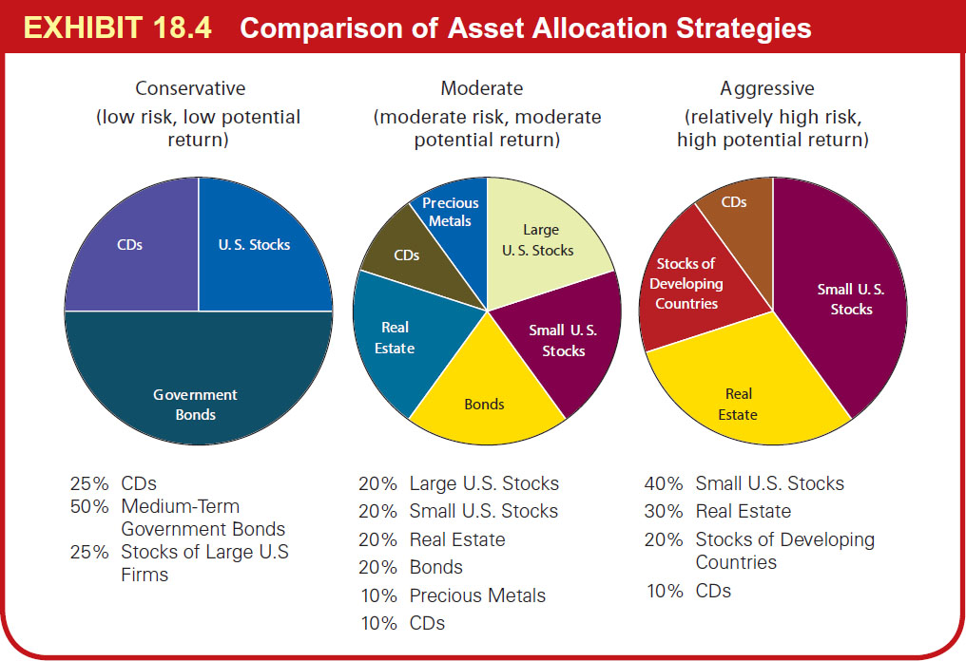
Asset Allocation Strategies (8 of 8)
Exhibit 18.4 Comparison of Asset Allocation Strategies

Slide 21
Your Asset Allocation Decision
Your stage in life
Younger investors need safer, more liquid securities
In the middle stage, investors may reduce risky assets and hold more safe assets
Investors nearing retirement may reduce risky assets even further and allocate more funds toward Treasury bonds

Slide 22
Factors That Affect the Asset Allocation Decision (1 of 3)
Your degree of risk tolerance
Your expectations about economic conditions
If you expect a strong stock market, invest in stocks
If you expect a weak stock market, invest in bonds
If you expect lower interest rates, invest in long-term bonds
If you expect favorable real estate conditions, invest in R E I Ts

Slide 23
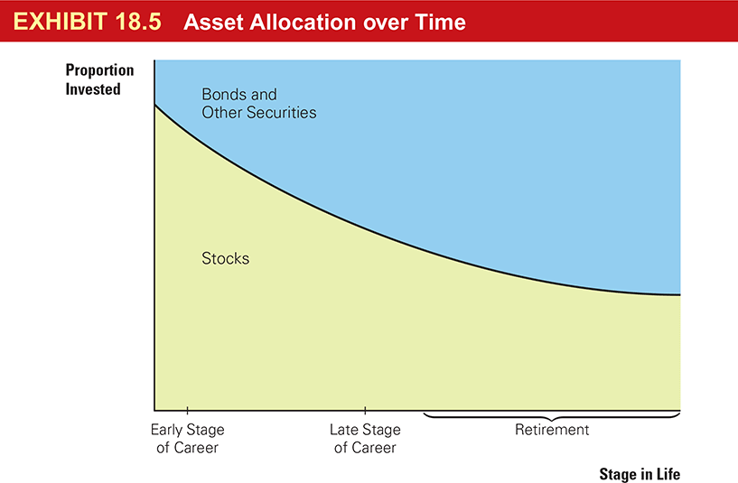
Factors That Affect the Asset Allocation Decision (2 of 3)
Exhibit 18.5 Asset Allocation over Time

Slide 24
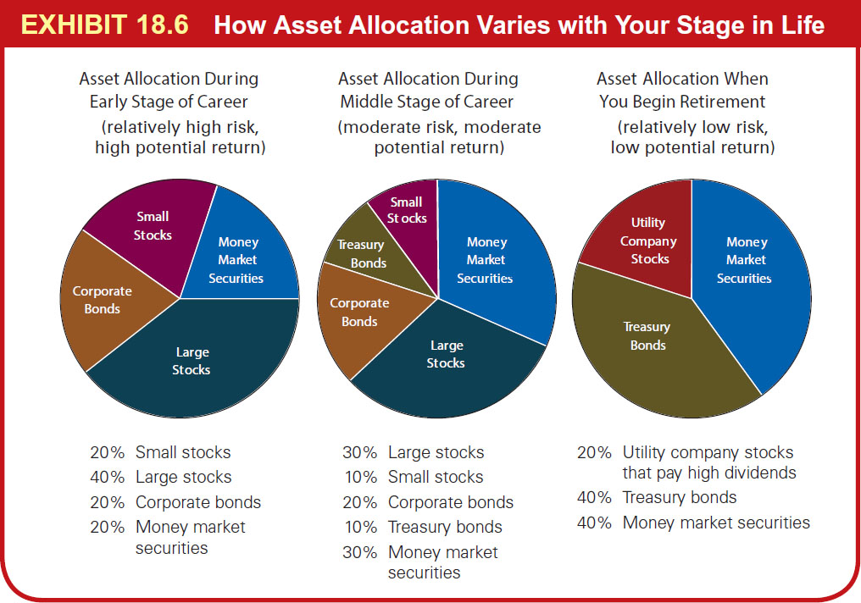
Factors That Affect the Asset Allocation Decision (3 of 3)
Exhibit 18.6 How Asset Allocation Varies with Your Stage in Life

Slide 25
Financial Planning Online (2 of 2)
Go to the “Investor Education” under “Investing” at
https://investor.vanguard.com
This Web site provides a personalized recommended asset allocation once you input some basic information about your preferences and degree of risk tolerance.

Slide 26
How Asset Allocation Fits within Your Financial Plan (1 of 4)
Key decision concerning asset allocation for your financial plan are:
Is your present asset allocation of investments appropriate?
How will you apply asset allocation in the future?

Slide 27
How Asset Allocation Fits within Your Financial Plan (2 of 4)
Exhibit 18.7 How Asset Allocation Fits Within Stephanie Spratt’s Financial Plan
Goals for asset allocation
Ensure that my assets are allocated properly in order to avoid excessive exposure to any particular type of investment.
Decide on a specific asset allocation plan for the future.
Analysis: I plan to make investments as follows:

Slide 28
How Asset Allocation Fits within Your Financial Plan (3 of 4)
Exhibit 18.7 [continued]
Decisions
Decision on My Present Asset Allocation:
Once I make my investments, 75% of my investment assets will be in stocks. Since the values of most stocks move in the same direction as the stock market, the performance of my investment portfolio is highly influenced by stock market conditions. I will also invest in a R E I T, in order to achieve a degree of diversification. The R E I T might perform well even in a period when the stock market is performing poorly.

Slide 29
How Asset Allocation Fits within Your Financial Plan (4 of 4)
Exhibit 18.7 [continued]
Decision on My Asset Allocation in the Distant Future:
I will likely change my asset allocation in the future, depending on my expectations of future stock market, bond market, and real estate market conditions. In general, I will likely focus my investments in mutual funds or exchange traded funds rather than individual stocks or bonds, so that I can achieve greater diversification.

Slide 30
Copyright
This work is protected by United States copyright laws and is provided solely for the use of instructors in teaching their courses and assessing student learning. Dissemination or sale of any part of this work (including on the World Wide Web) will destroy the integrity of the work and is not permitted. The work and materials from it should never be made available to students except by instructors using the accompanying text in their classes. All recipients of this work are expected to abide by these restrictions and to honor the intended pedagogical purposes and the needs of other instructors who rely on these materials.

