Slide 1

Personal Finance
Seventh Edition
Chapter 19
Retirement Planning
    Slides in this presentation contain hyperlinks. JAWS users should be able to get a list of links by using INSERT+F7
Copyright © 2020, 2017, 2014 Pearson Education, Inc. All Rights Reserved
Notes:
If this PowerPoint presentation contains mathematical equations, you may need to check that your computer has the following installed:
1) MathType Plugin
2) Math Player (free versions available)
3) NVDA Reader (free versions available)

Slide 2
Chapter Objectives (1 of 2)
19.1 Describe the role of Social Security
19.2 Explain the difference between defined-benefit and defined-contribution retirement plans
19.3 Present the key decisions you must make regarding retirement plans
19.4 Identify the retirement plans offered by employers
19.5 Explain the retirement plans available for self-employed individuals

Slide 3
Chapter Objectives (2 of 2)
19.6 Describe types of individual retirement accounts
19.7 Explain how annuities are used to prepare for retirement
19.8 Illustrate how to estimate your future retirement account savings
19.9 Explain how retirement planning fits within your financial plan

Slide 4
Social Security (1 of 5)
Social Security is a federal program that taxes you during your working years and uses the funds to make payments to you upon retirement
It does not provide adequate income to solely support most people

Slide 5
Social Security (2 of 5)
Qualifying for Social Security
  You need to accumulate 40 credits from contributing to Social Security
    Four credits per year if your income is at least $1,320 per quarter
  Social Security also available for disabled

Slide 6
Social Security (3 of 5)
  Survivor’s benefits are also provided
    A one-time income payment to the spouse
    Monthly income payments if spouse is older than 60 or has a child under the age of 16
    Monthly income payments to children under age 18 or up to age 19 if still attending secondary school full-time

Slide 7
Social Security (4 of 5)
Retirement benefits
  Depends on your income and the number of years you earned income
  Provides about 40% of your annual income
  Can receive reduced benefits beginning at age 62
  Eligible for full retirement benefits at age 65 to 67, depending on when you were born
  You can earn limited income while receiving Social Security

Slide 8
Social Security (5 of 5)
Concern about retirement benefits in the future
  Retirees are living longer which costs the program more in benefits
  The number of retirees continues to grow
  Many people are relying less on Social Security and establishing their own retirement programs

Slide 9
Financial Planning Online (1 of 3)
Go to
http://www.ssa.gov
This Web site provides an estimate of how much earnings you have accumulated over time, how much taxes you have paid, estimates of retirement benefits, and additional information about Medicare and Social Security.

Slide 10
Defined-Benefit versus Defined-Contribution Plans (1 of 5)
Both are employer-sponsored retirement plans designed to help you save for retirement
Employees and/or employers contribute
A penalty is imposed for early withdrawal (Before you
reach age
Your contributions are tax-deferred, but taxed as ordinary income when withdrawn after retirement

Slide 11
Defined-Benefit versus Defined-Contribution Plans (2 of 5)
Defined-benefit plan: an employer-sponsored retirement plan that guarantees you a specific amount of income when you retire based on your salary and years of employment
  Vested: having a claim to a portion of the money in an employer-sponsored retirement account that has been reserved for you upon your retirement even if you leave the company

Slide 12
Defined-Benefit versus Defined-Contribution Plans (3 of 5)
Defined-contribution plan: an employer-sponsored retirement plan that specifies guidelines under which you and/or your employer can contribute to your retirement account and that allows you to invest the funds as you wish
  May be contributory or non-contributory for the employee

Slide 13
Defined-Benefit versus Defined-Contribution Plans (4 of 5)
  The decision to contribute
    Some people wait too long to save
    Start saving at an early age
    Contribute from every paycheck
  Benefits of a defined-contribution plan
    Money contributed by employer is like extra income
    Encourages employees to save
    Offers tax deferred income

Slide 14
Defined-Benefit versus Defined-Contribution Plans (5 of 5)
  Investing funds in your retirement account
    Employer, and sometimes the employee, can usually choose from a number of different funds
    Stock mutual funds, bond mutual funds, E T Fs and money market funds are common options available

Slide 15
Your Retirement Planning Decisions (1 of 2)
Which retirement plan should you pursue?
  An employer-sponsored plan is usually the best choice if your employer contributes
How much to contribute?
  As much as you can as early as you can!
  Social Security will not provide sufficient funds
  Increase contribution as salary increases
  Keep in mind you will need about 70% to 80% or your preretirement salary to cover living expenses in retirement

Slide 16
Financial Planning Online (2 of 3)
Go to the retirement section of
https://investor.vanguard.com/
This Web site provides guidance on your retirement decisions

Slide 17
Your Retirement Planning Decisions (2 of 2)
How to invest your contributions?
  Use a diversified set of investments
  Consider the number of years to retirement
  Consider your level of risk tolerance
Lessons from the credit crisis
  Stocks can be risky
  There is a tradeoff between potential risk and return

Slide 18
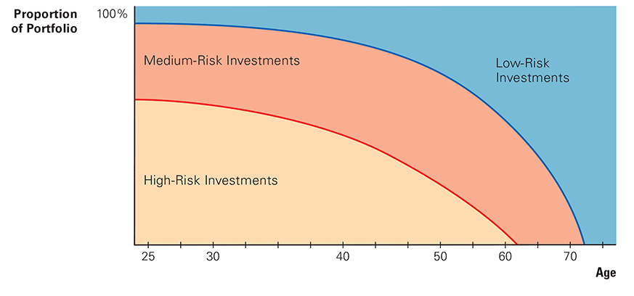
Exhibit 19.1 Typical Composition of a Retirement Account Portfolio (1 of 2)

Slide 19
Exhibit 19.1 Typical Composition of a Retirement Account Portfolio (2 of 2)
Blank | Common High-Risk Investments | Common Medium-Risk Investments | Common Low-Risk Investments
Stock Mutual Funds | Growth stock funds Capital appreciation funds Small-cap funds International stock funds Sector stock funds | High-dividend stock funds S&P 500 index funds | Blank
Bond Mutual Funds | Junk bond funds International bond funds | Medium-rated corporate bond funds | Treasury bond funds High-rated corporate bond funds
Hybrid Mutual Funds | Blank | Balanced (stock and bond) funds | Blank
Money Market Funds | Blank | Blank | Treasury money market funds Money market funds that contain commercial paper and C Ds

Slide 20
Retirement Plans Offered by Employers (1 of 8)
401(k) plan: a defined-contribution plan that allows employees to contribute a maximum of $18,500 ($24,500 if they are age 50 or older) per year on a pre-tax basis, as of 2018.
  Matching contributions by some employers
  Limits change based on inflation adjustments
  Tax on money withdrawn from the account
    Tax and penalty for withdrawals before age

Slide 21
Retirement Plans Offered by Employers (2 of 8)
  Matching contributions by employers
    Some employers match all or a percentage of employee contributions
  Tax on money withdrawn from the account
    10% penalty if withdrawn before age
Roth 401(k) plan: an alternative to a 401(k) account available to people employed by participating companies
  Contributions taxed when contributed but not when withdrawn

Slide 22
Retirement Plans Offered by Employers (3 of 8)
403(b) plan: a defined-contribution plan allowing employees of non-profit organizations to invest up to $18,500 of their income on a tax-deferred basis
The contribution limit is for 2018 and changes periodically due to inflation adjustments

Slide 23
Retirement Plans Offered by Employers (4 of 8)
Simplified Employee Plan (S E P): a defined-contribution plan commonly offered by firms with 1 to 10 employees or used by self-employed people
  Employee cannot contribute to this plan
  Employer can contribute up to 25% of the employee’s salary to this plan
  Tax and penalty for withdrawals before age

Slide 24
Retirement Plans Offered by Employers (5 of 8)
S I M P L E (Savings Incentive Match Plan for Employees) Plan: a defined-contribution plan intended for firms with 100 or fewer employees
  Employee can contribute up to $12,500 annually in 2018 and the employer can match
  Contribution limits change based on inflation

Slide 25
Retirement Plans Offered by Employers (6 of 8)
Profit sharing: a defined-contribution plan in which the employer makes contributions to employee retirement accounts based on a specified profit formula
  Up to 25% of employee’s salary, maximum $55,000 per year in 2018
  Contribution limits change based on inflation

Slide 26
Retirement Plans Offered by Employers (7 of 8)
Employee Stock Ownership Plan (E S O P): a retirement plan in which the employer contributes some of its own stock to the employee’s retirement account
  More risky because it is not diversified
  Focused only on the employer’s stock

Slide 27
Retirement Plans Offered by Employers (8 of 8)
Managing your retirement account after leaving your employer
  You may retain your retirement account at old employer if you have more than $5,000
  You may transfer it to your new employer
  Rollover I R A: an individual retirement account into which you can transfer your assets from your company retirement plan tax-free while avoiding penalties

Slide 28
Retirement Plans for the Self-Employed (1 of 2)
Keogh Plan: a retirement plan that enables self-employed individuals to contribute part of their pre-tax income to a retirement account
  Up to 25% to a maximum of $55,000 annually in 2018
  Contribution limits change based on inflation
  Individual determines how funds are invested

Slide 29
Retirement Plans for the Self-Employed (2 of 2)
Simplified Employee Plan (S E P): a defined contribution plan commonly offered by firms with 1 to 10 employees or used by self-employed people
  Also available for self-employed who can contribute up to 25% of annual income to a maximum of $55,000 annually in 2018
  Contribution limits change based on inflation

Slide 30
Individual Retirement Accounts (1 of 4)
Traditional I R A: a retirement plan that enables individuals to invest $5,500 per year ($11,000 for a married couple)
  Taxpayers aged 50 or over may make additional contributions of $1,000 per year
  Contributions may or may not be tax-deductible if income is too high
  Interest earned is tax-deferred
  Tax and penalty on withdrawals before age

Slide 31
Individual Retirement Accounts (2 of 4)
Roth I R A: a retirement plan that enables individuals who are under specific income limits to invest $5,500 per year ($11,000 for married couples)
  Taxpayers aged 50 or over may contribute an additional $1,000 per year
  Income taxed at time of contribution, but not when withdrawn
  Some income limitations

Slide 32
Individual Retirement Accounts (3 of 4)
Comparison of the Roth I R A and Traditional I R A
  Advantage of traditional I R A over Roth I R A
    Contributions provide a tax-deduction for the year of the contribution
  Advantage of Roth I R A over traditional I R A
    Income is not taxed when withdrawn since contributions are made after-tax

Slide 33
Individual Retirement Accounts (4 of 4)
  Factors that affect your choice
    Marginal tax rates at time of contribution and withdrawal
    Current income since income limits differ

Slide 34
Annuities (1 of 2)
Annuity: a financial contract that provides annual payments over a specified period
Contributions taxable but gains are tax-deferred
Not suitable substitutes for retirement plans
Fixed versus variable annuities
  Fixed annuity: an annuity that provides a specified return on your investment, so you know exactly how much you will receive at a future time

Slide 35
Annuities (2 of 2)
  Variable annuity: an annuity in which the return is based on the performance of the selected investment vehicles
Annuity fees
  High fees are a disadvantage of annuities
  Surrender charge: a fee that may be imposed on any money withdrawn from an annuity
  Pay high commissions to salespeople
  Look for no-load annuities that do not charge commissions and have low management fees

Slide 36
Estimating Your Future Retirement Savings (1 of 7)
Estimating the future value of one investment
Example:
  You consider investing $5,000 this year, and this investment will remain in your account until 40 years from now when you retire. You believe that you can earn a return of 6% per year on your investment. Using F V I F, you expect the value of your investment in 40 years to be:

Slide 37
Estimating Your Future Retirement Savings (2 of 7)
= $5,000 × 10.285
= $51,425

Slide 38
Estimating Your Future Retirement Savings (3 of 7)
Estimating the future value of a set of annual investments
  Relationship between size of annuity and retirement savings
    If you invested $5,000 per year for 40 years, your return at 8%, you would have:
$5,000 × 259.06 = $1,295,300

Slide 39
Estimating Your Future Retirement Savings (4 of 7)
  Relationship between years of saving and your retirement savings
    If you invested $5,000 for 30 years instead of 40 years, your savings would be only $566,416 (assuming a 8% annual return)

Slide 40
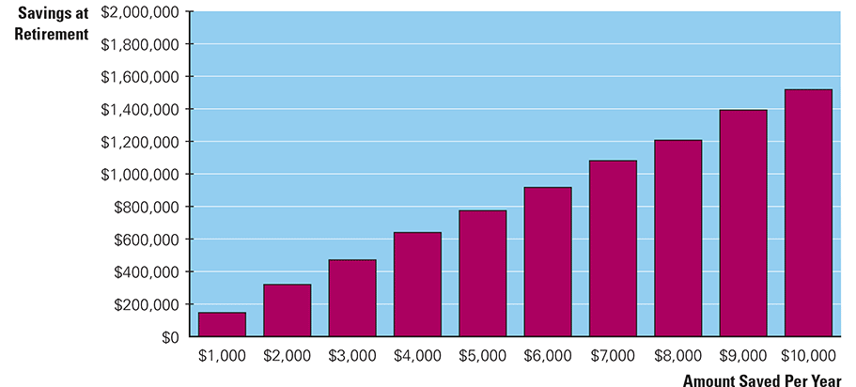
Estimating Your Future Retirement Savings (5 of 7)
Exhibit 19.2 Relationship Between Amount Saved per Year and Amount of Savings at Retirement (in 40 Years, Assuming a 6% Annual Return)

Slide 41
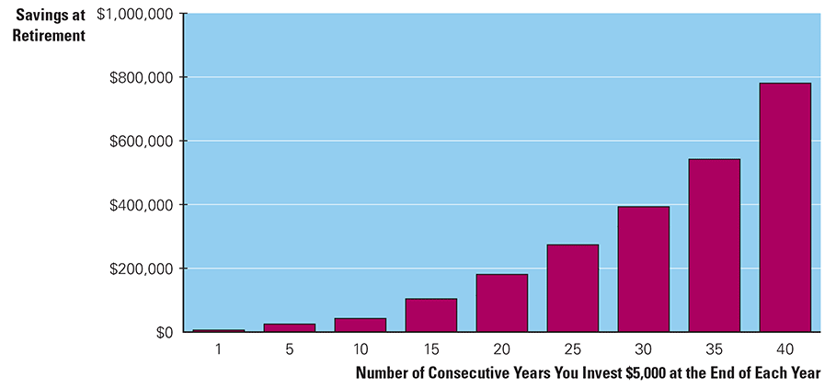
Estimating Your Future Retirement Savings (6 of 7)
Exhibit 19.3 Relationship Between the Number of Years You Invest Annual Savings and Your Savings at Retirement (Assuming a $5,000 Annual Investment and a 6% Annual Return)

Slide 42
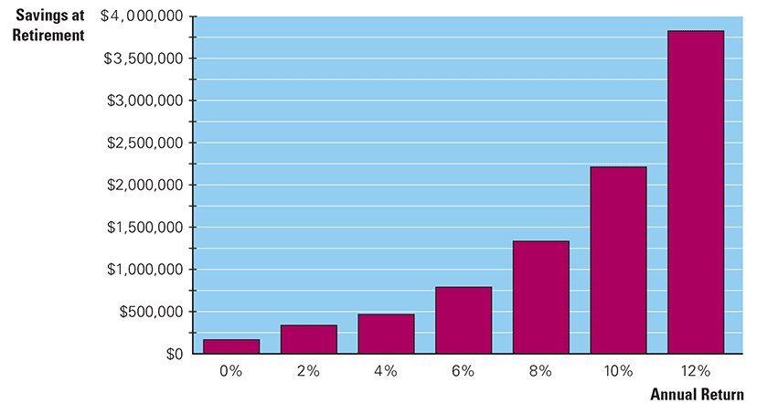
Estimating Your Future Retirement Savings (7 of 7)
Exhibit 19.4 Relationship Between the Annual Return on Your Annual Savings and Your Savings at Retirement (in 40 years, Assuming a $5,000 Annual Investment)

Slide 43
Financial Planning Online (3 of 3)
Go to the “Planning and Advice” section of
http://www.fidelity.com
This Web site provides a framework for building a retirement plan based on your financial situation.

Slide 44
How Retirement Planning Fits within Your Financial Plan (1 of 5)
Key decisions about retirement planning for your financial plan are:
  Should you invest in a retirement plan?
  How much should you invest in a retirement plan?
  How should you allocate investments within your retirement plan?

Slide 45
How Retirement Planning Fits within Your Financial Plan (2 of 5)
Exhibit 19.5 How Retirement Planning Fits Within Stephanie Spratt’s Financial Plan
Goals for retirement planning
Ensure an adequate financial position at the time I retire.
Reduce the tax liability on my present income.
Analysis
Type of Retirement Plan | Benefits
Employer’s retirement plan | I plan to contribute $3,600 of my income (tax-deferred) per year to my retirement plan. In addition, my employer provides a partial matching contribution of $1,400.
Traditional I R A or Roth I R A | I can contribute income each year (tax-deferred) to a traditional I R A. Alternatively, I could contribute to a Roth I R A; in that case, the contribution occurs after taxes, but the withdrawal after retirement will not be taxed.
Annuities | I can contribute money to annuities to supplement any other retirement plan. The only tax advantage is that any income earned on the money invested is not taxed until I withdraw the money after retirement.

Slide 46
How Retirement Planning Fits within Your Financial Plan (3 of 5)
Exhibit 19.5 [continued]
Decisions
Decision on Whether I Should Engage in Retirement Planning:
Even if Social Security benefits are available when I retire, they will not be sucient to provide the amount of financial support that I desire. Given the substantial tax benefits of a retirement plan, I should engage in retirement planning. I plan to take full advantage of my employer’s retirement plan. I will contribute $3,600 per year and my employer will match with $1,400. The benefits of traditional and Roth I R As are also substantial. However, the tradeo is that I will not have access to any income that I invest in my retirement account for many years. Although I have not contributed to these retirement accounts in the past, I plan to do so as soon as possible. Annuities are not attractive to me at this point.

Slide 47
How Retirement Planning Fits within Your Financial Plan (4 of 5)
Exhibit 19.5 [continued]
Decision on How Much to Contribute to Retirement:
I should attempt to contribute the maximum allowed to my employer’s retirement plan and to a traditional or Roth I R A. These contributions will reduce the amount of money that I can dedicate toward savings and investments, but the trade-off favors retirement contributions because of the tax advantages. I will make sure that I maintain enough income to cover my monthly expenses and sucient liquidity. Beyond that, I will attempt to maximize the amount of funds that I can contribute to retirement accounts

Slide 48
How Retirement Planning Fits within Your Financial Plan (5 of 5)
Exhibit 19.5 [continued]
Decision on Asset Allocation Within the Retirement Account:
I plan to invest the money slated for retirement in stock and bond mutual funds. I will invest about 70% or 80% of the money in a few diversified stock mutual funds and the remainder in a diversified corporate bond mutual fund

Slide 49

Copyright
This work is protected by United States copyright laws and is provided solely for the use of instructors in teaching their courses and assessing student learning. Dissemination or sale of any part of this work (including on the World Wide Web) will destroy the integrity of the work and is not permitted. The work and materials from it should never be made available to students except by instructors using the accompanying text in their classes. All recipients of this work are expected to abide by these restrictions and to honor the intended pedagogical purposes and the needs of other instructors who rely on these materials.

