Slide 1
Theories of Leadership
Dr Karina Pilarz

Slide 2
Class No. 1
Organisational issues,
basic information about the subject,
case studies on leadership.

Slide 3
What do you associate with the word 'leader'?
https://www.menti.com/al2kb8whdpgf
How to be a leader?
https://www.menti.com/alrb1t28gu4n
Leadership is . . .
https://www.menti.com/alkh2tsnd9pa

Slide 4
How to define „leadership”?
There are almost as many different definitions of leadership as there are people who have tried to define it;
the following components can be identified as central to the phenomenon:
leadership is a process,
leadership involves influence,
leadership occurs in groups,
leadership involves common goals.

Slide 5
Leadership is a process whereby an individual influences a group of individuals to achieve a common goal.

Slide 6
Defining leadership as a process means that it is not a trait or characteristic that resides in the leader, but rather a transactional event that occurs between the leader and the followers. Process implies that a leader affects and is affected by followers. It emphasizes that leadership is not a linear, one-way event, but rather an interactive event.
When leadership is defined in this manner, it becomes available to everyone. It is not restricted to the formally designated leader in a group.

Slide 7
Leadership involves influence. It is concerned with how the leader affects followers. Influence is the sine qua non of leadership. Without influence, leadership does not exist.

Slide 8
Leadership occurs in groups. Groups are the context in which leadership takes place. Leadership involves influencing a group of individuals who have a common purpose. This can be a small task group, a community group, or a large group encompassing an entire organization. Leadership is about one individual influencing a group of others to accomplish common goals. Others (a group) are required for leadership to occur.

Slide 9
Leadership includes attention to common goals. Leaders direct their energies toward individuals who are trying to achieve something together. By common, we mean that the leaders and followers have a mutual purpose. Attention to common goals gives leadership an ethical overtone because it stresses the need for leaders to work with followers to achieve selected goals. Stressing mutuality lessens the possibility that leaders might act toward followers in ways that are forced or unethical. It also increases the possibility that leaders and followers will work together toward a common good (Rost, 1991).

Slide 10
Trait Versus Process Leadership
We have all heard statements such as “He is born to be a leader” or “She is a natural leader.” These statements are commonly expressed by people who take a trait perspective toward leadership. The trait perspective suggests that certain individuals have special innate or inborn characteristics or qualities that make them leaders, and that it is these qualities that differentiate them from nonleaders. Some of the personal qualities used to identify leaders include unique physical factors (e.g., height), personality features (e.g., extraversion), and other characteristics (e.g., intelligence and fluency; Bryman, 1992).

Slide 11
The trait viewpoint conceptualizes leadership as a property or set of properties possessed in varying degrees by different people (Jago, 1982). This suggests that it resides in select people and restricts leadership to those who are believed to have special, usually inborn, talents.
The process viewpoint suggests that leadership is a phenomenon that resides in the context of the interactions between leaders and followers and makes leadership available to everyone. As a process, leadership can be observed in leader behaviors (Jago, 1982), and can be learned.

Slide 12
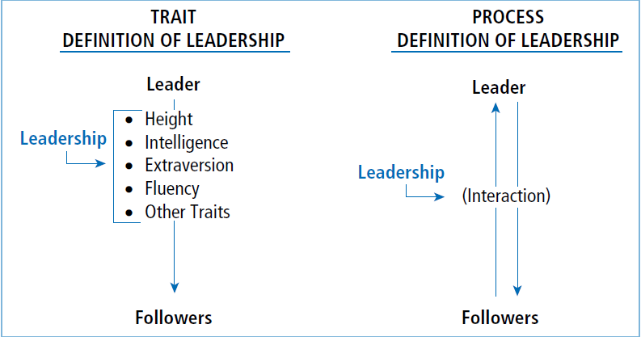

Slide 13
Peter Weaver Case Study https://trainingmag.com/leadership-case-studies/
What leadership traits did Weaver exhibit?
If you were in Weaver’s shoes, what would you have done?
Where does courage come from?
List your three most important values.

Slide 14
Dealing with a Crisis Case Study https://trainingmag.com/leadership-case-studies/
Explain what you would communicate to the following people:
your boss,
your Human Resources Department,
the local police,
the attendees at the conference (Would you continue the conference?)
How will you notify Randy’s wife?
If Randy’s wife and a few family members want to visit the location of Randy’s death, what would you do?
What are some “guiding principles” that leaders need to follow in a crisis situation?

