Slide 1
Human Resources Management
dr Karina Pilarz

Slide 2

Discussion
What’s a CV?
What to include in your CV?
To zdjęcie, autor: Nieznany autor, licencja: CC BY

Slide 3
Job search
Job search is the process of gathering information about potential job opportunities;
it is the individual corollary of recruiting and together they form the basis for successful person–job matching;
job search is sequential, and jobs are evaluated against preestablished standards on a few important criteria, such as:
the nature of the work required,
the rewards the job offers,
the degree of person–organization ‘‘fit’’ based on job requirements, values, personality, or needs.

Slide 4
CV
short for the Latin phrase “curriculum vitae” meaning “course of life”;
is a detailed document highlighting professional and academic history;
typically includes information like work experience, achievements and awards, scholarships or grants, coursework, research projects and publications;
typically two or three pages long (can be much longer for mid-level or senior job applicants).

Slide 5
CV format
CV sections
Contact information
Academic history
Professional experience
Qualifications and skills
Awards and honors
Publications
Professional associations
Grants and fellowships
Licenses and certificates
Volunteer work
Personal information (optional)
Hobbies and interests (not necessary but appreciated)

Slide 6
How to write a CV
Include your contact information
Detail your academic history in reverse-chronological order
Record your professional experience
Include relevant skills and qualifications
List honors and awards
Include relevant publications and presentations
List your professional associations and affiliations
Check your CV for errors

Slide 7
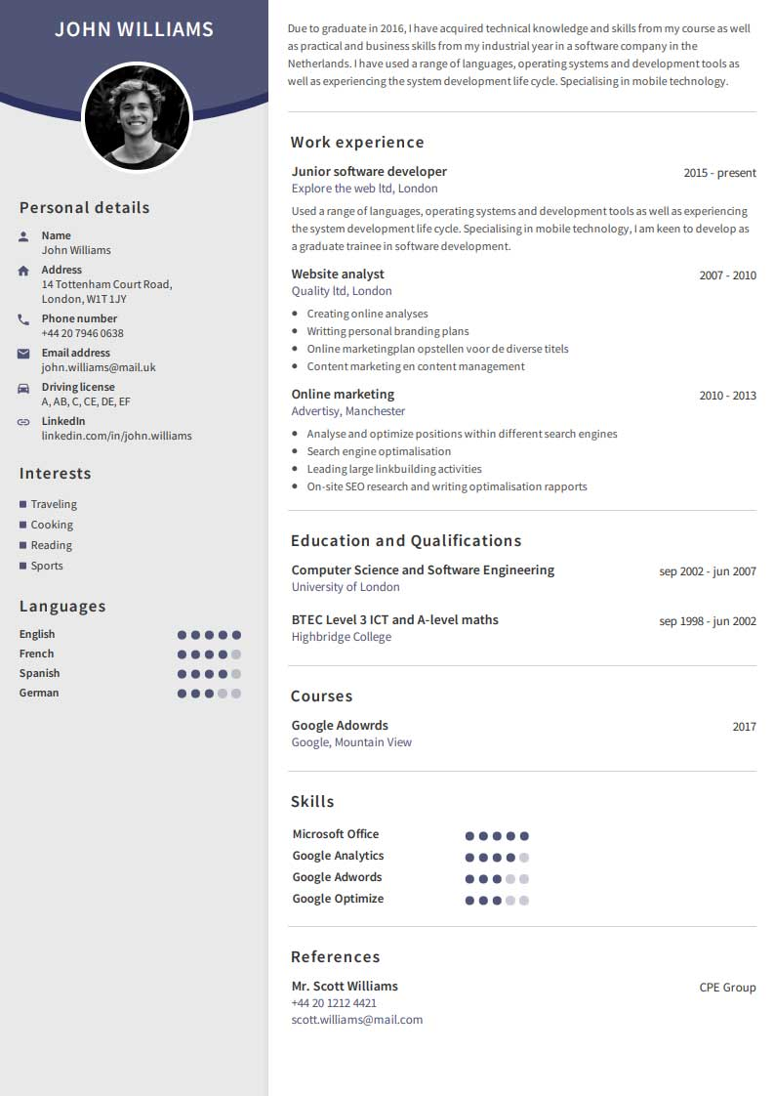
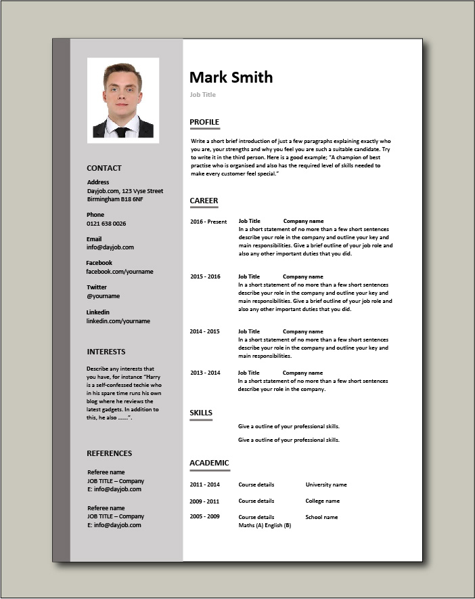
CV examples

Slide 8
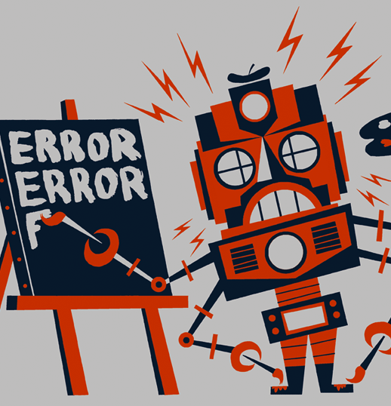
CV mistakes
Having spelling errors and bad grammar (you can put your application through a spell and grammar checker);
Exaggerating the truth/lying (never assume that recruiters won’t make enquiries to corroborate the facts);
Poor formatting (you need to pay close attention to detail);
Making CV too long (more than 1-2 pages);
An unoriginal personal profile (writing a short personal statement at the top of a CV is essential, it should give an idea to a prospective employer of the type of person, work ethic, values);
Putting the wrong contact information, using an inappropriate email address;
Not including hobbies and interests (hobbies can show teamwork, leadership, time management and communication skills);
Not tailoring CV to the specific role.
To zdjęcie, autor: Nieznany autor, licencja: CC BY-SA-NC

Slide 9
Resume
A CV and resume are similar – they’re both documents that summarize your professional history, education, skills and achievements;
primarily in the United States resumes and CVs are not interchangeable;
a resume is typically a one-page document that provides a concise overview of your previous roles, skills and details about your education – you can call it “abstract” or “summary”;
a CV – typically a longer, more detailed document focused largely on academic coursework and research;
however, for example in India, South Africa and Australia, the terms CV and resume are interchangeable.

Slide 10

Cover letter
A cover letter is a document sent alongside your CV when applying for jobs;
it acts as a personal introduction and helps to sell your application;
a cover letter is necessary as it gives you the chance to explain to an employer why you're the best candidate for the job;
you do this by highlighting relevant skills and experience;
therefore you should always write your cover letter with the position you're applying for in mind;
cover letters should complement your CV but not duplicate it;
typically three to five short paragraphs, cover letters should not exceed one A4 page.
To zdjęcie, autor: Nieznany autor, licencja: CC BY-NC-ND

Slide 11
How to address a cover letter
Always try and address your cover letter directly to the person who will be reading it;
you're more likely to receive a reply if you send it to the right person;
if you're struggling to find a named contact you can use a general greeting such as:
Dear Sir/Madam,
Dear Hiring Manager,
Dear Human Resources Director;
general greetings should only be used once you have exhausted methods of finding a named contact.

Slide 12
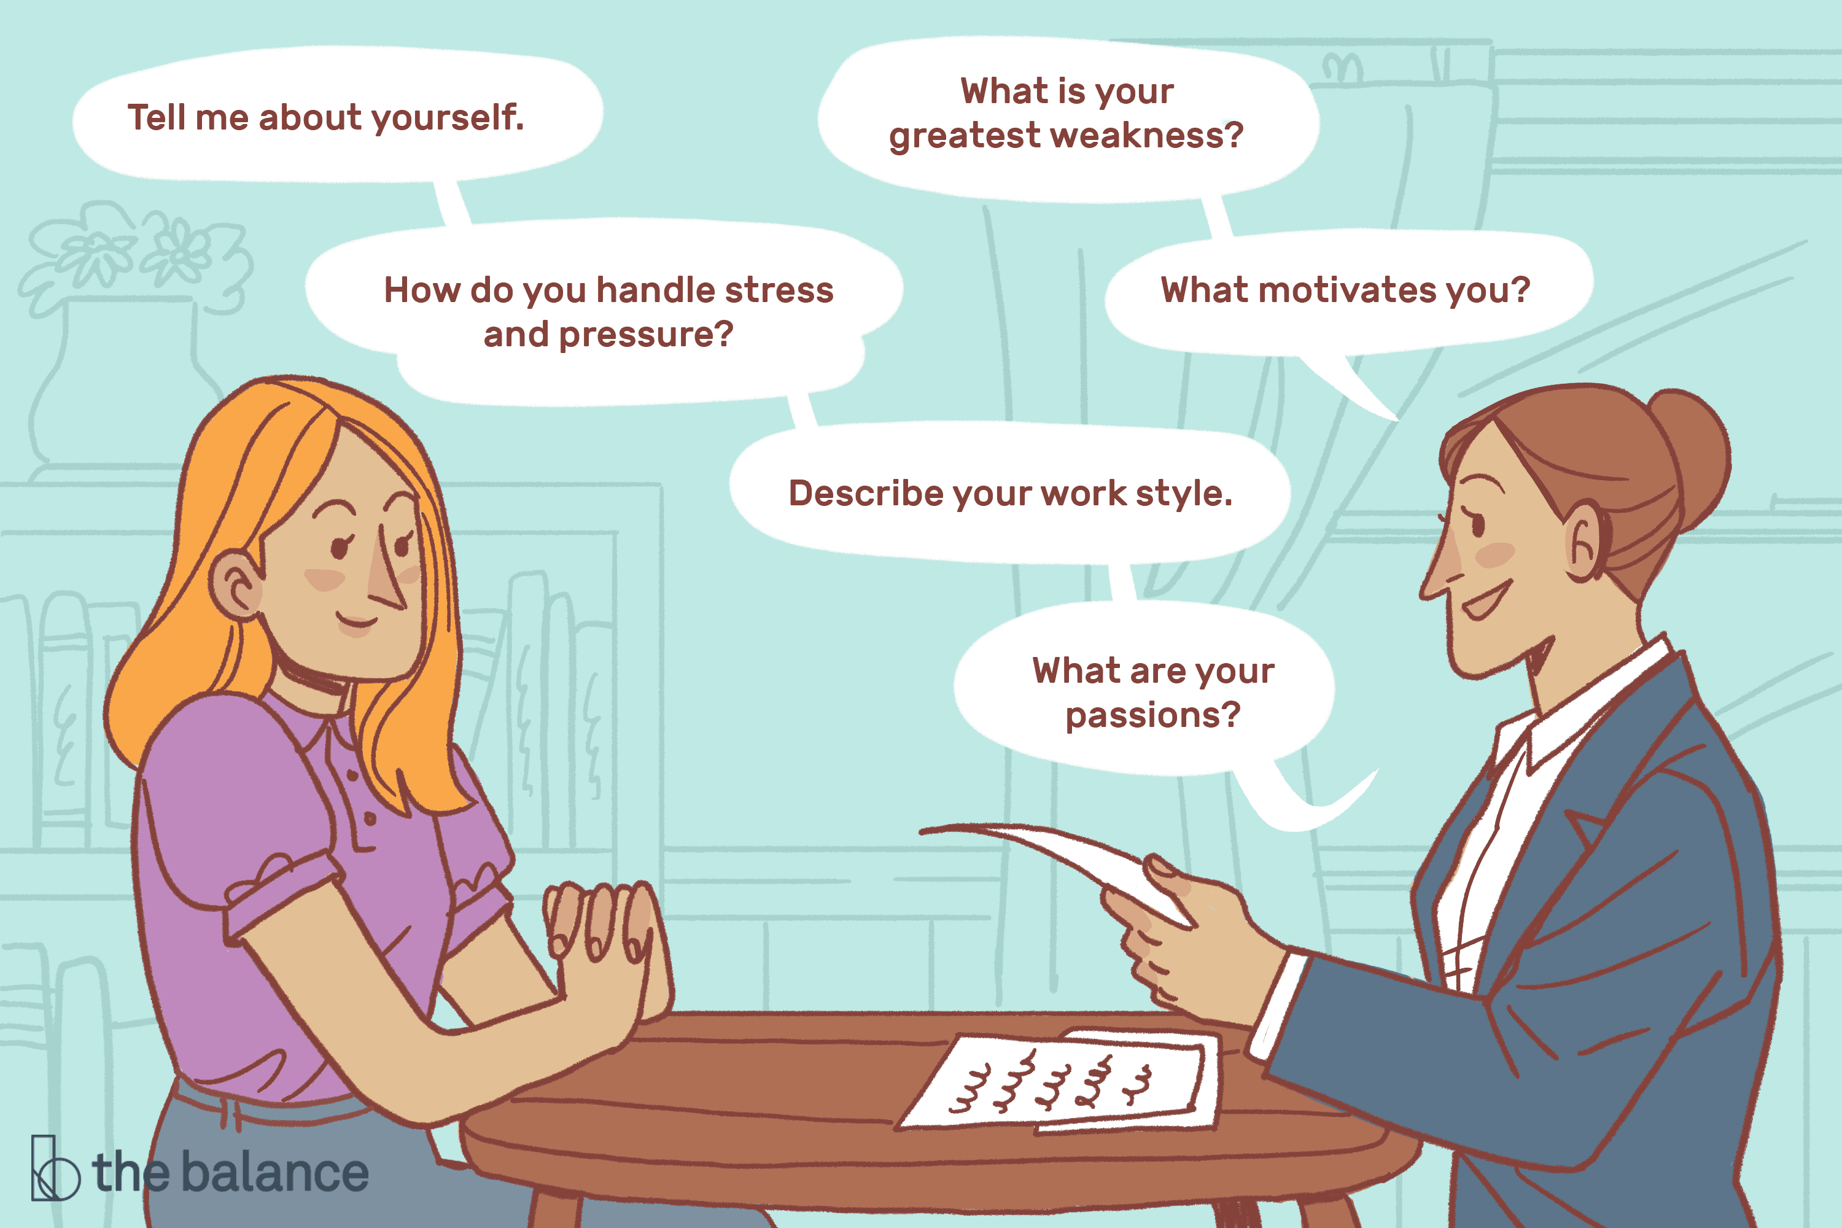
Job interview

Slide 13
The employment interview is defined as a dialogue initiated by one or more persons to gather and evaluate information on the qualifications of a job applicant. Except for reference checks and application blanks, this is the most frequently used technique of personnel selection.
Even when other selection procedures are used, information often influences the final decision only after it has been filtered through interviewer judgments.

Slide 14
How to prepare for a job interview
Read and review the job description (a list of the qualifications, qualities and background the employer is looking for in an ideal candidate)
Consider why you are interviewing (you should be prepared to explain your interest in the opportunity and why you’re the best person for the role)
Research the company (company website, culture, competitors)
Consider your answers to common interview questions (Why do you want to work here?, What are your greatest strengths?)
Plan your journey to the job interview (make sure you arrive on time, search the location in advance)

Slide 15
How to act in a job interview
It’s important to make great first impression
Make sure your clothes are clean, ironed and presentable
Make eye contact (this will signal your confidence)
Remember your CV details
Make a note of your questions
Don’t volunteer your weaknesses
Don’t criticise your current or previous employer
Sit still, with your feet firmly on the ground (this will help you maintain your posture and avoid fidgeting)

Slide 16
https://www.youtube.com/watch?v=uG2aEh5xBJE
https://www.youtube.com/watch?v=hrZSfMly_Ck
https://www.youtube.com/watch?v=HG68Ymazo18

Slide 17
Job loss - outplacement
Outplacement is the process by which an individual whose employment has been terminated makes the transition from one employer to another work situation with the assistance of reemployment professionals and appropriate support services, provided by the former employer;
in its most basic form, the purpose of outplacement is to help a terminated employee find a new job or career;
while assistance is offered, the responsibility for finding a new job or changing careers remains with the employee;
in addition to job and career counseling, outplacement services typically include some form of emotional support and assistance in coping with the stress of job loss.

Slide 18
Outplacement is a well-established service in the UK, adopted by thousands of responsible organisations who recognise the importance of supporting employees as they leave the business.
Historically, outplacement was predominantly focussed on those in senior positions but in a modern context, organisations now provide employees with Outplacement Support at all levels and grades.

Slide 19
Outplacement support is there to help employees move on quickly and effectively, helping with a broad range of areas including:
Establishing career priorities and assessing their options
Developing their own personal career plan
Revitalising their personal brand
Networking their way to success
Preparing for self-employment, interim or portfolio careers
Mastering the art of modern job searching
Creating great CVs that get them noticed
Transforming their interview performance
Harnessing the power of LinkedIn
Preparing for retirement of the ‘Third age’ of their careers

Slide 20
Why is outplacement important?
OUTPLACEMENT SERVES THREE MAIN INTERRELATED PURPOSES FOR ORGANIZATIONS:
strengthening brand reputation,
reducing business costs,
creating a positive company culture.

